Slide 2
LI: To compare the longest river in Europe to a river in Britain
Success Criteria
To identify the different landscapes that a river might pass through.
To extend your geographical vocabulary by learning key rivers terms

Slide 3
Monday 8th February 2020
LI: To compare the longest river in Europe to a river in Britain
Success Criteria
To identify the different landscapes that a river might pass through.
To extend your geographical vocabulary by learning key rivers terms
Before we compare, lets check our understanding of distance (miles)

Slide 4
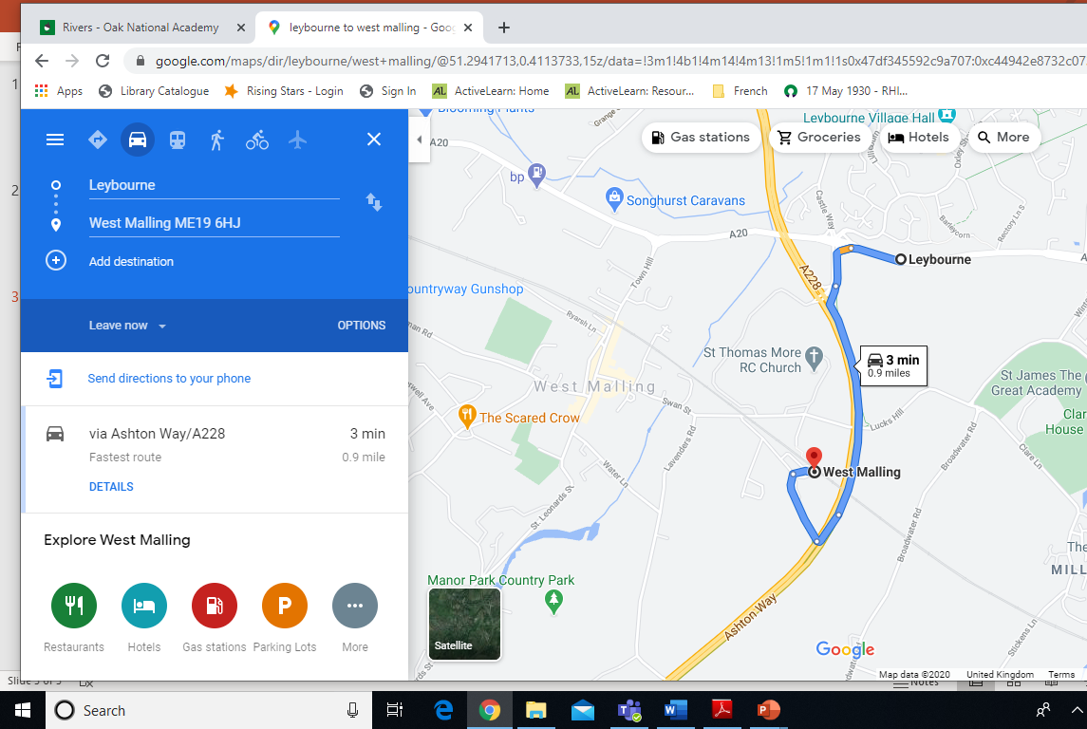
How far do you have to travel to school?
0.9 miles

Slide 5
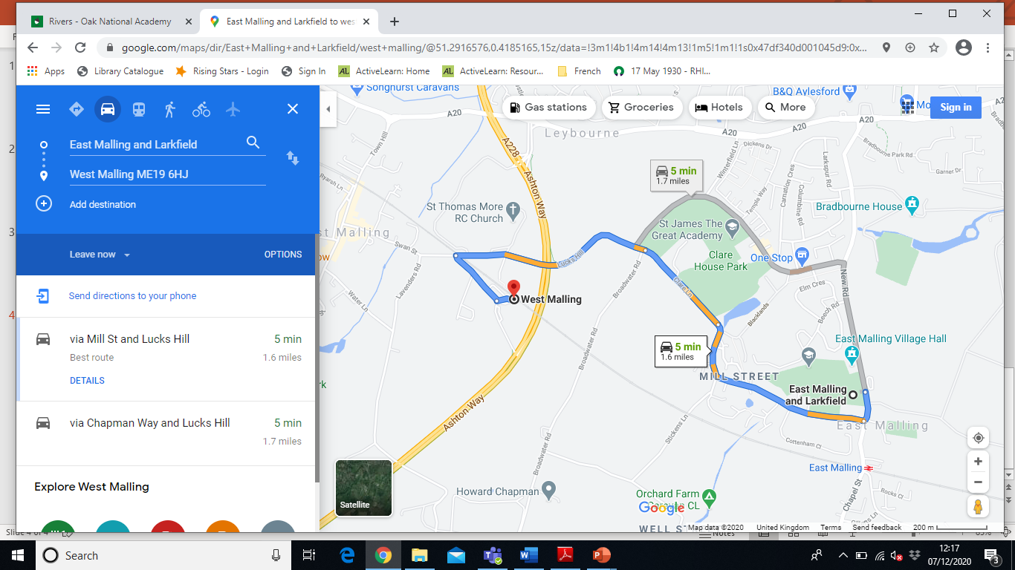
1.6 miles

Slide 6
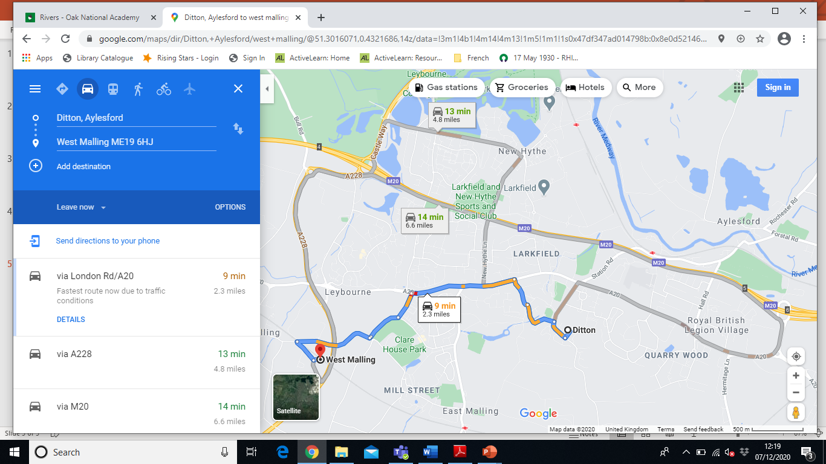
2.3 miles

Slide 7
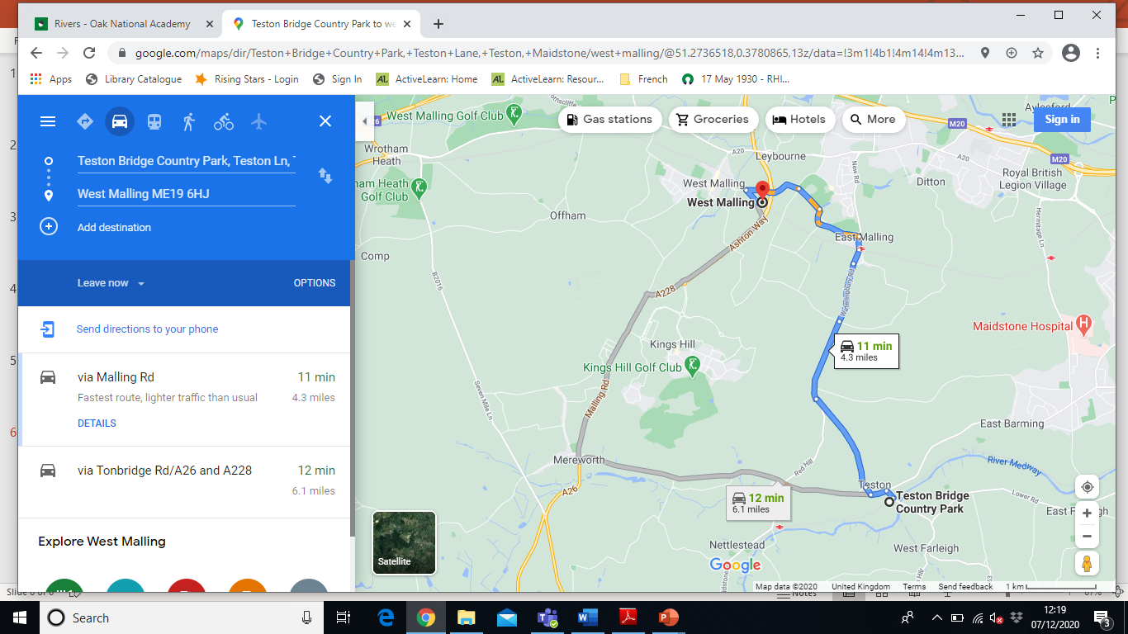
4.3 miles

Slide 8
Holidays in the United Kingdom
How far do you travel?

Slide 9
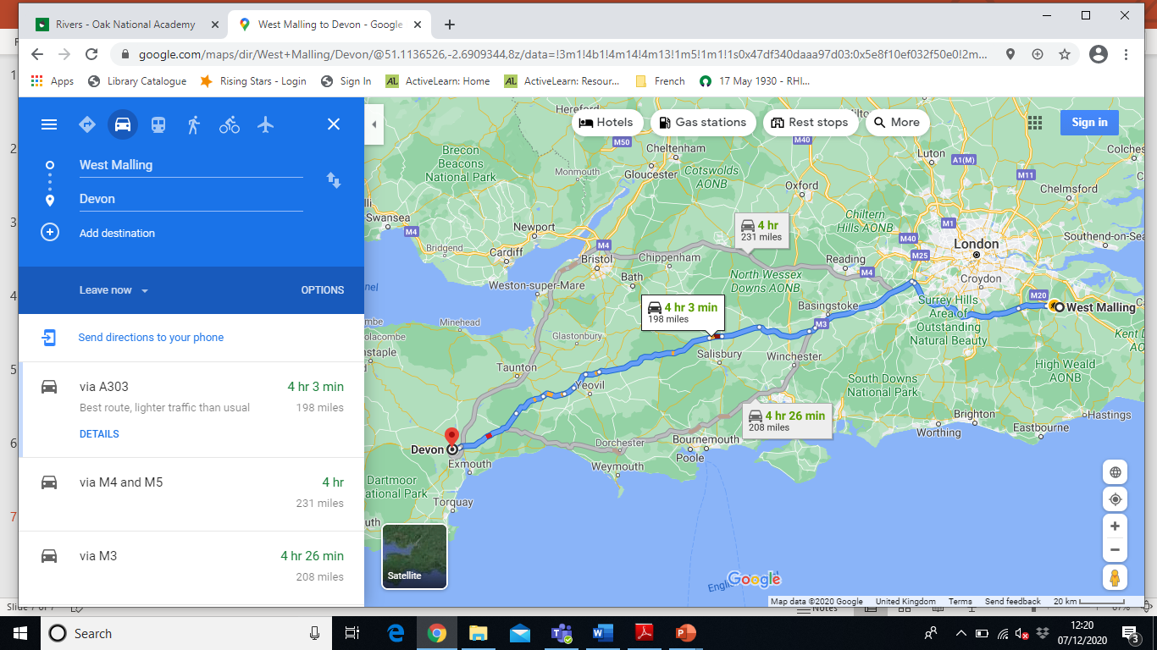
Devon
198 miles

Slide 10
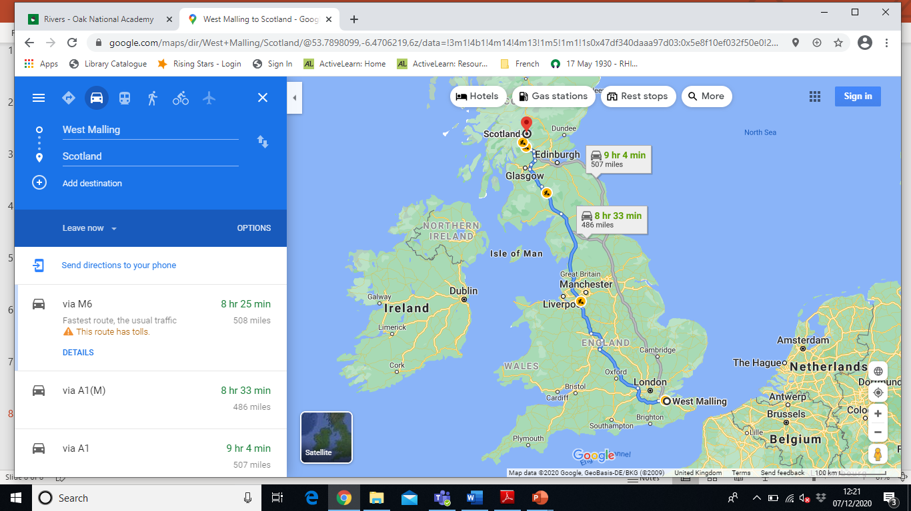
Scotland
508 miles

Slide 11
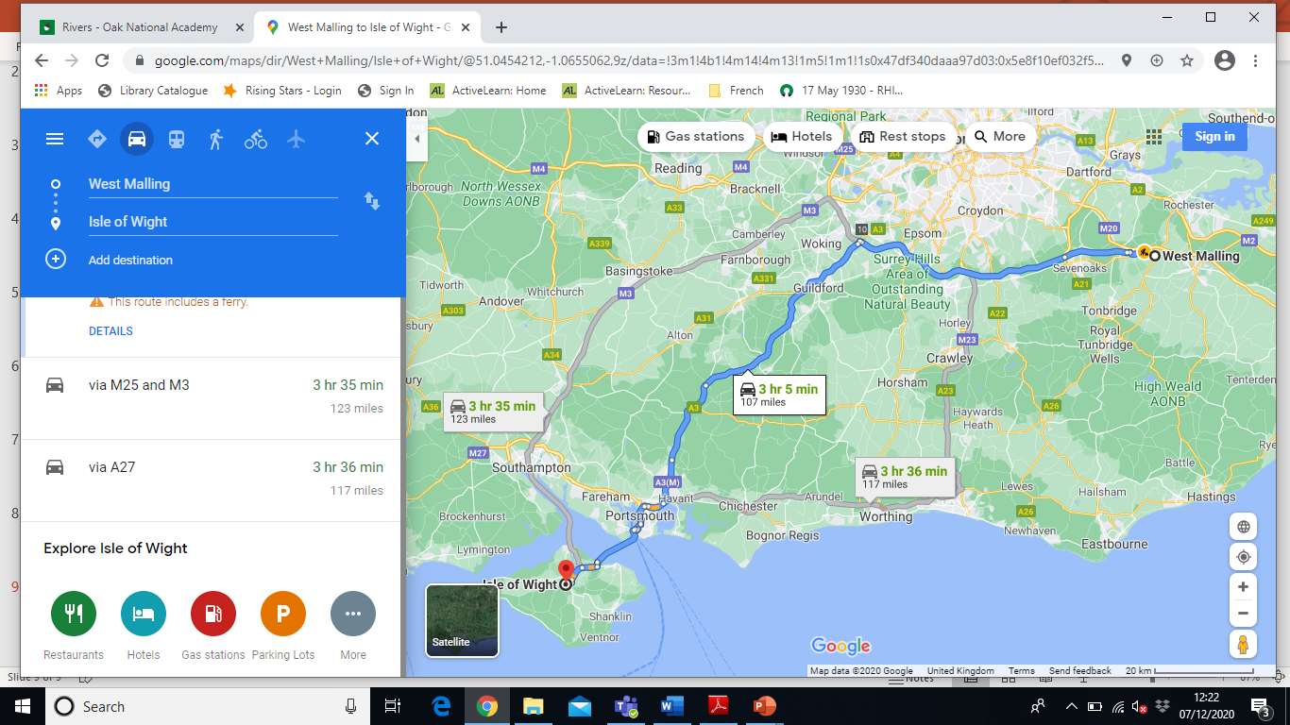
Isle Of Wight 117 miles

Slide 12
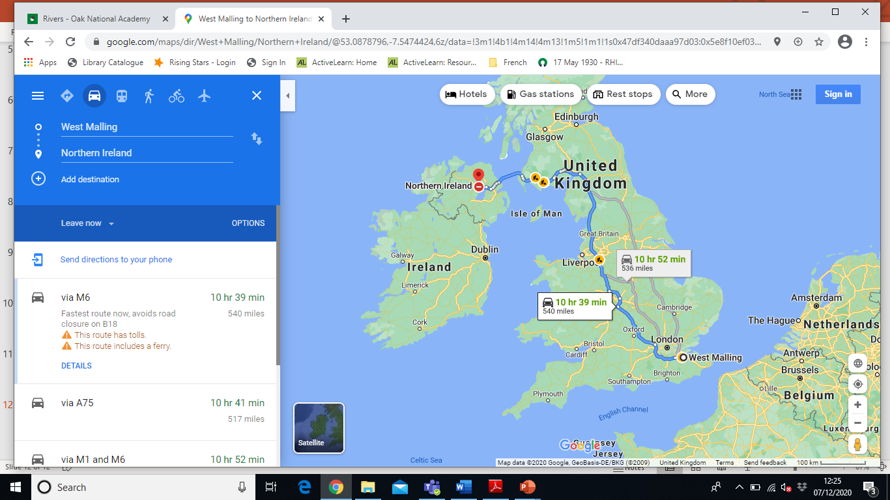
Northern Ireland
540 miles

Slide 13
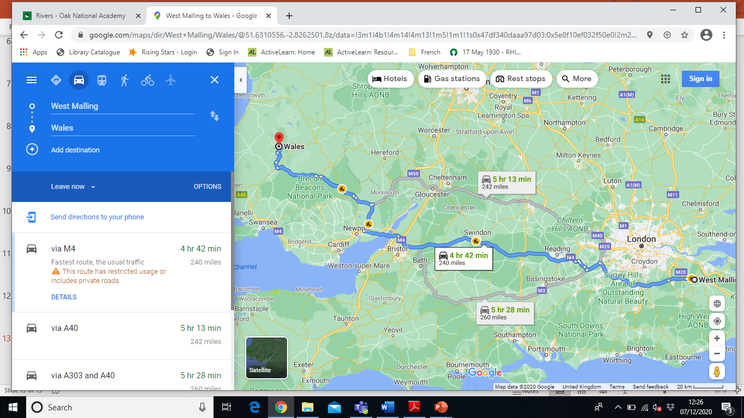
Wales
242 miles

Slide 14
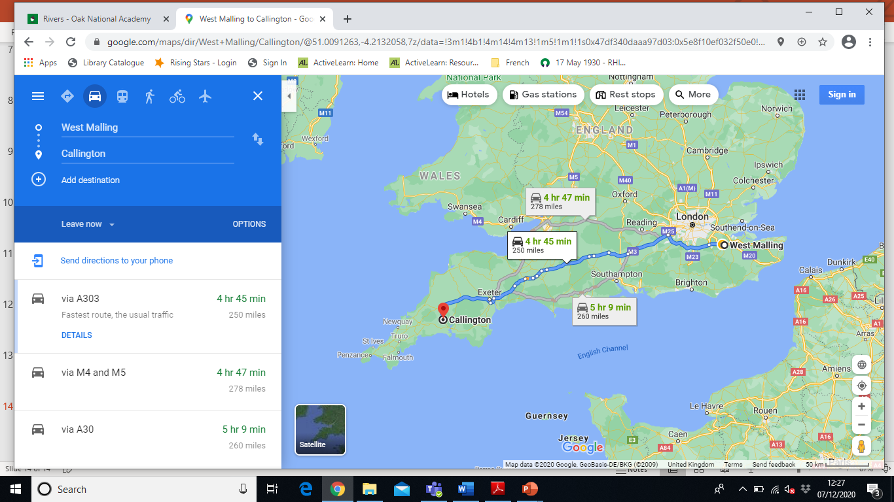
Cornwall
250 miles

Slide 15
Lets compare The River Thames and The River Rhine – You can make notes on scrap paper

Slide 17
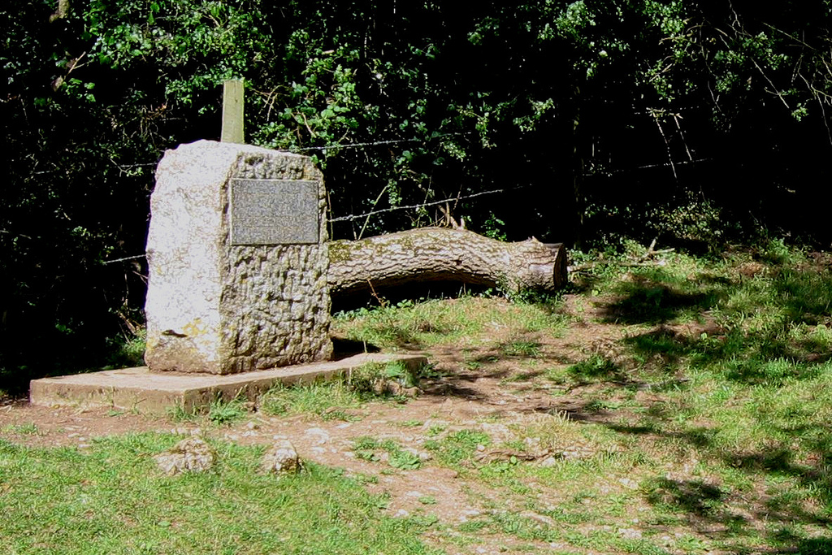


The Source of the River Thames
A stone marker has been placed on the spot where a spring provides the source of the River Thames. Rosie fell into the water here and began her journey downstream.
Key Terms
Spring – a place where water naturally emerges from the ground.
Photo courtesy of sumonedbyfells (@flickr.com) - granted under creative commons licence - attribution

Slide 18
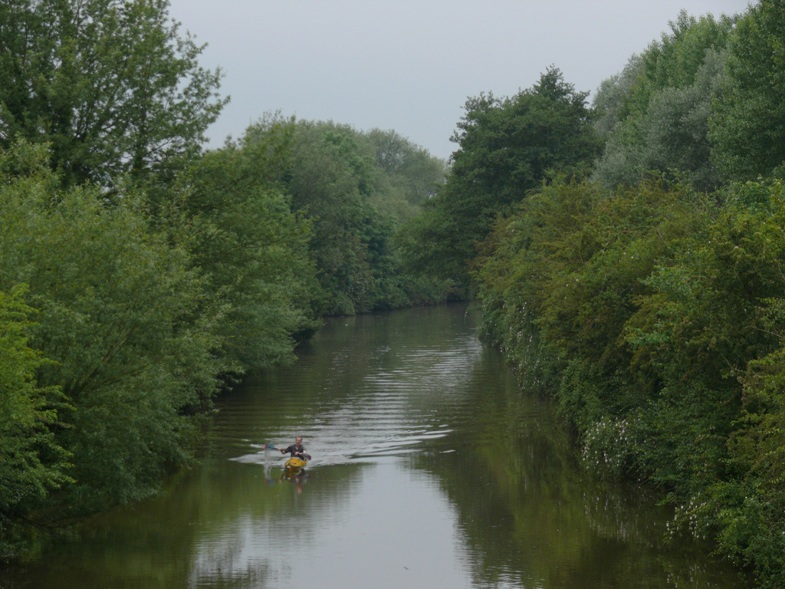
The River Thames Starts to Grow
The river started to get bigger and passed through countryside.
Photo courtesy of generalising (@flickr.com) - granted under creative commons licence - attribution

Slide 19
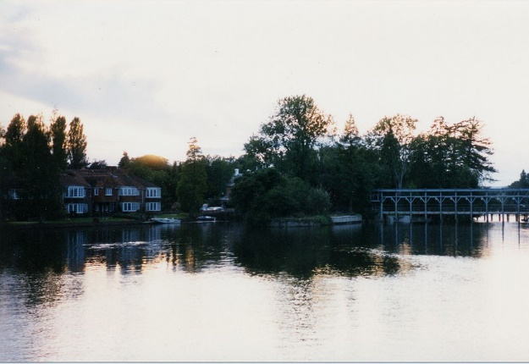
Through Villages and Towns…
As the Thames got even bigger, Rosie began to travel through small settlements, such as villages and towns.
Photo courtesy of Jonathan Smith (@flickr.com) - granted under creative commons licence - attribution

Slide 20
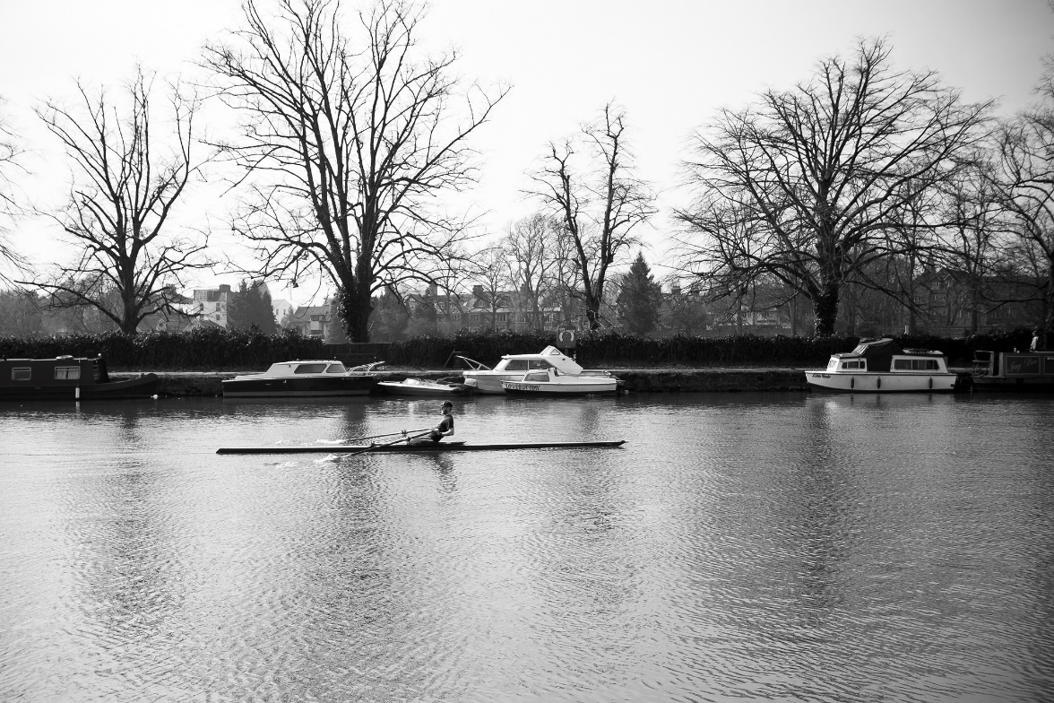
Through Cities…
The River Thames passes through Oxford as it gets bigger. Rosie had to dodge the rowers! Many tributaries have now joined the Thames.
Photo courtesy of Daniel enchev (@flickr.com) - granted under creative commons licence - attribution

Slide 21

Check your notes
What have you found out about the River Thames?

Slide 30
Check your notes
What have you found out about the River Rhine?

Slide 31
Pause
Read through your notes to yourself. Check you understand your notes.
What have you learnt in this lesson?

Slide 32
Lets compare
Features | River Thames | River Rhine | Both
Source
Tributaries
Mouth
Passes through villages
Passes through cities
Passes through countries
215 miles long
764 miles long
Confluence
Please tick either River Thames, River Rhine or both to show if the rivers we have compared have each feature.

