Slide 1
LI: To understand the journey a river makes from the hills to the sea.
Success Criteria
To identify the different landscapes that a river might pass through.
To extend your geographical vocabulary by learning key rivers terms.
To make informed choices using newly-gained knowledge.

Slide 2
What do you know about Rivers?
Watch the Oak Academy Video
https://classroom.thenational.academy/lessons/where-are-the-worlds-rivers-6dh32d?activity=video&step=1

Slide 3

Meet Rosie Raindrop!
This is Rosie Raindrop. One rainy day, Rosie fell to the ground at the point where the River Thames starts. She eventually travelled all the way to the North Sea. It was an incredible journey!

Slide 4
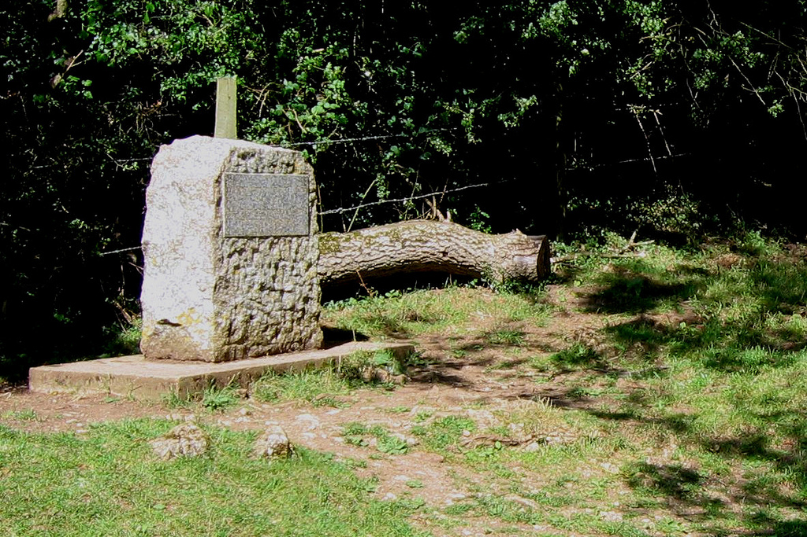


The Source of the River Thames
A stone marker has been placed on the spot where a spring provides the source of the River Thames. Rosie fell into the water here and began her journey downstream.
Describe what she saw…
Key Terms
Spring – a place where water naturally emerges from the ground.
Photo courtesy of sumonedbyfells (@flickr.com) - granted under creative commons licence - attribution

Slide 5
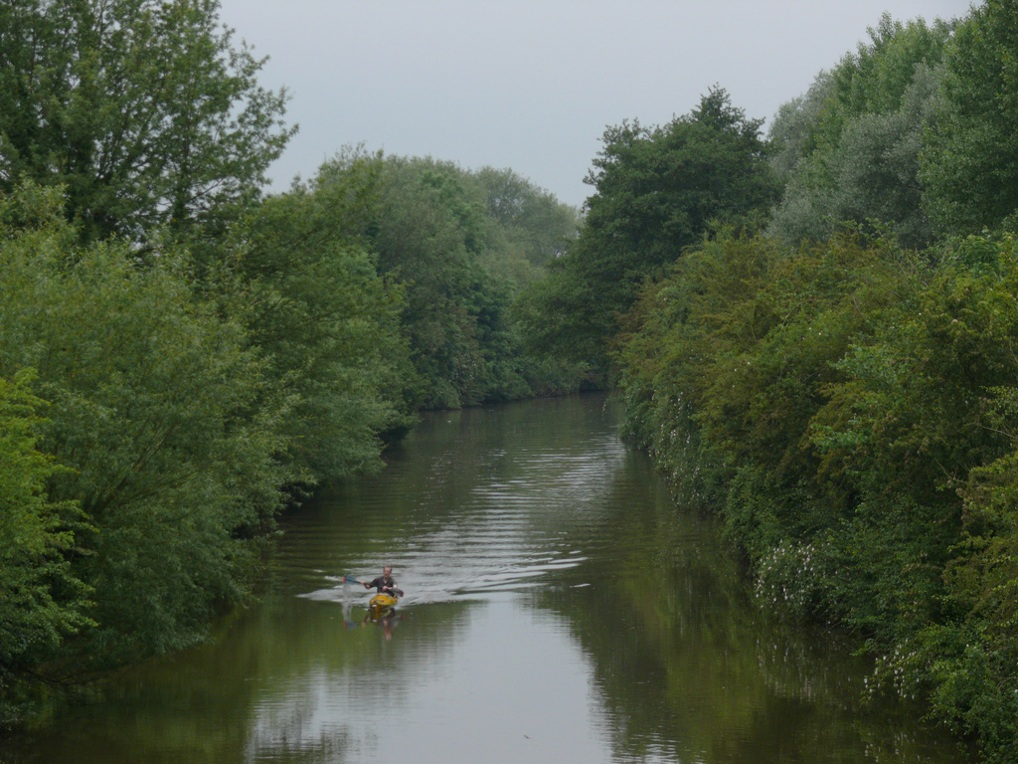
The River Thames Starts to Grow
The river started to get bigger and passed through countryside. Describe what Rosie saw. What would she have heard?
Photo courtesy of generalising (@flickr.com) - granted under creative commons licence - attribution

Slide 6
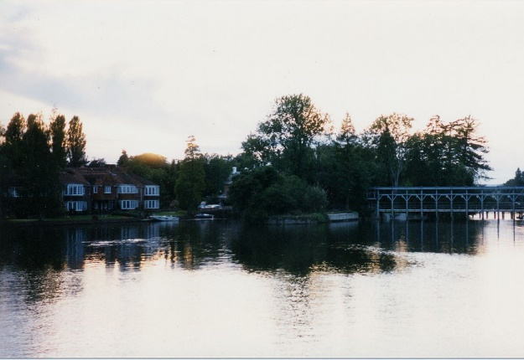
Through Villages and Towns…
As the Thames got even bigger, Rosie began to travel through small settlements, such as villages and towns. Describe how the scenery has changed. What sounds could she hear now?
Photo courtesy of Jonathan Smith (@flickr.com) - granted under creative commons licence - attribution

Slide 7
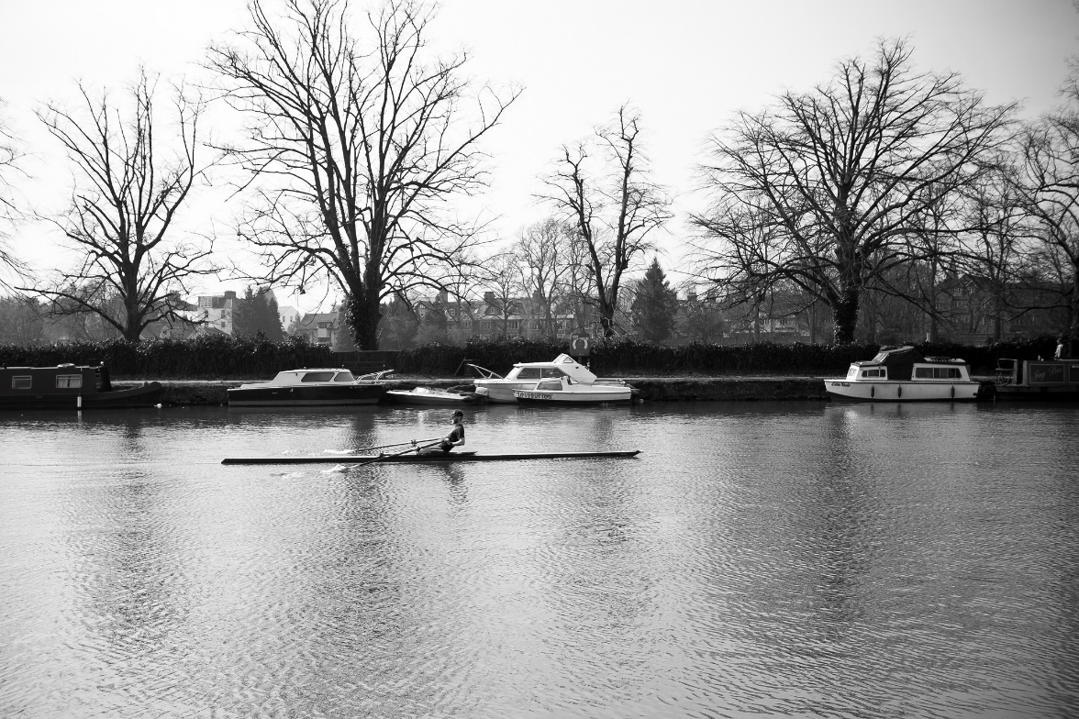
Through Cities…
The River Thames passes through Oxford as it gets bigger. Rosie had to dodge the rowers! Many tributaries have now joined the Thames.
What could Rosie see and hear on this stretch of the river? Can you think of any problems Rosie might have in towns and cities?
Photo courtesy of Daniel enchev (@flickr.com) - granted under creative commons licence - attribution

Slide 8
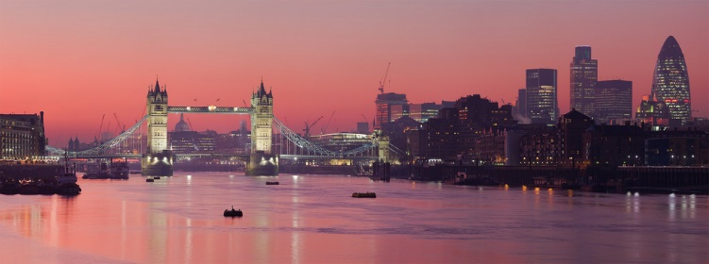
Through Cities…
What would Rosie have seen and heard as she went through the centre of London? How do people use the river here?
Photo courtesy of UltraView Admin (@flickr.com) - granted under creative commons licence - attribution

Slide 9
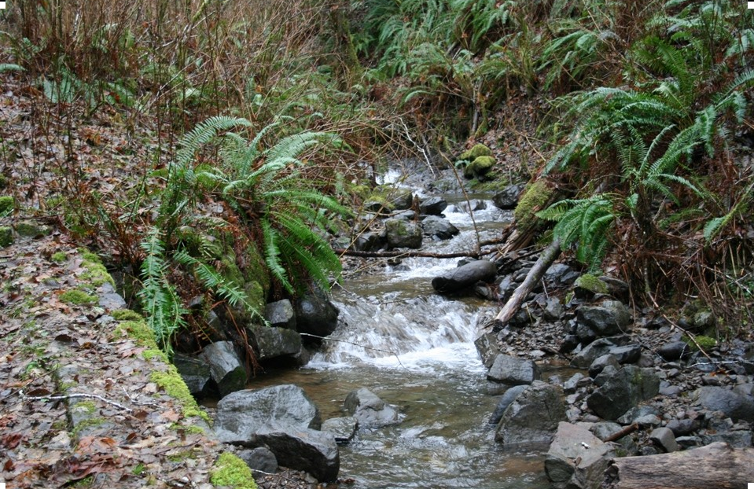
What River Feature is This?
Clue
It begins with T
Answer
Tributary
Photo courtesy of KaCey97078 (@flickr.com) - granted under creative commons licence - attribution

Slide 10
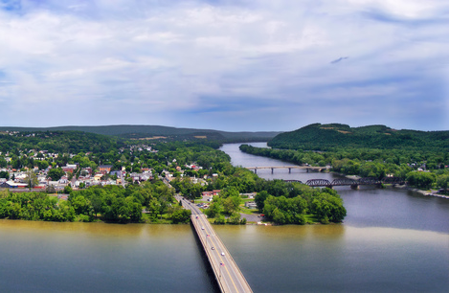
What River Feature is This?
Clue
It’s the joining of
two rivers
Answer
Confluence
Photo courtesy of Nicholas A. Tonelli (@flickr.com) - granted under creative commons licence - attribution

Slide 11
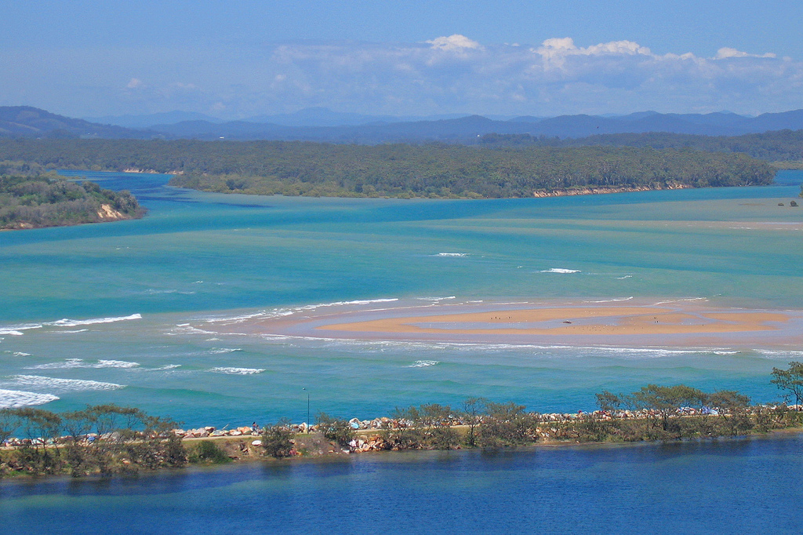
What River Feature is This?
Clue
Where the river meets the sea.
Answer
Mouth
Photo courtesy of Tim J Keegan (@flickr.com) - granted under creative commons licence - attribution

Slide 12
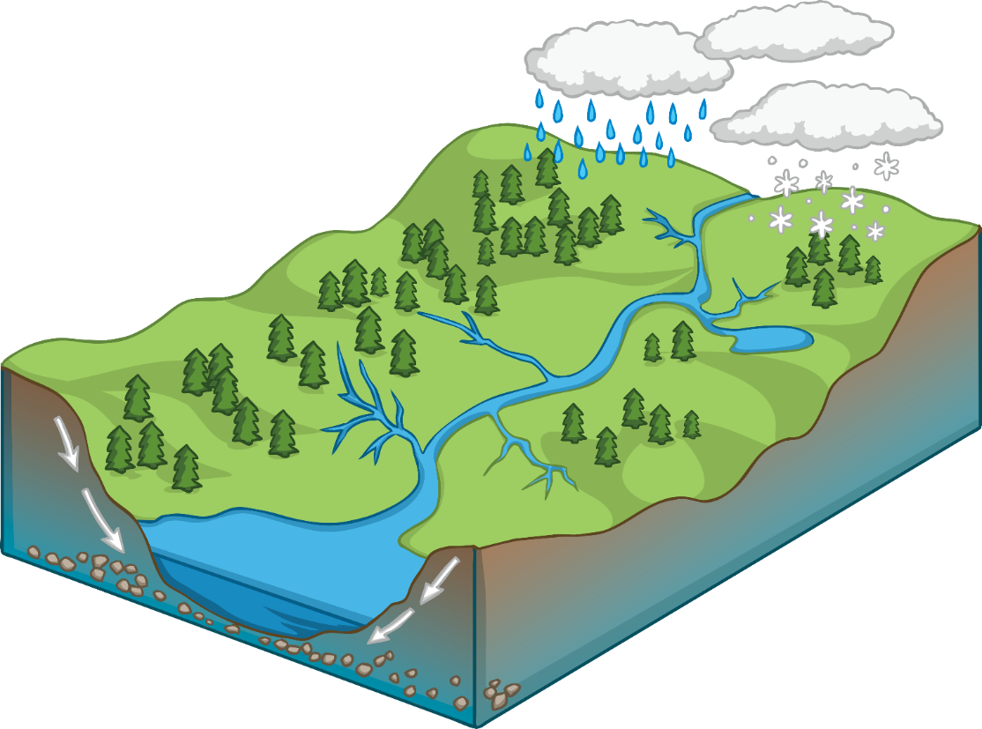
Drainage Basin
Click each point on the diagram to learn more.
Watershed – an imaginary line separating one drainage basin from another.
River channel – the area a river flows in, with banks on each side.
Source – the point at which a river starts its journey.
Drainage basin – the area of land drained by a river.
Tributary – a small river leading into a bigger river.
Confluence – where two rivers join together.
Mouth – where a river enters the sea.
Notes:
To the teacher: Click on the red dots to toggle the Key Terms and their corresponding definitions on and off.

Slide 13
https://classroom.thenational.academy/lessons/what-are-the-features-of-a-drainage-basin-64rp2d?step=2&activity=video
Watch the Oak Academy video
Please do not do the quiz at the start but you can try the quiz at the end.
You can either draw a drainage basin or make a model of a drainage basin. I have uploaded a template onto the class page. I would love to see pictures of your work!

