Slide 1

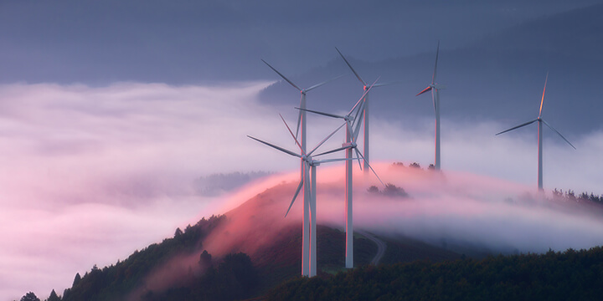
WIND ENERGY
Hello and welcome to Olwyn’s report, here you will find some amazing facts about wind energy hope you enjoy!
BY OLWYN BEULAH
THULANI MTUNGWAZI

Slide 2
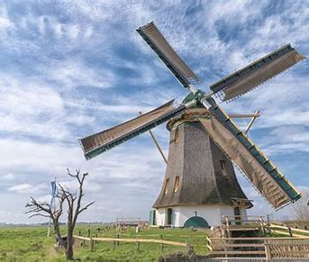
Introduction
Wind turbines used to be called windmills. The earliest-known windmills were built more than 1,000 years ago. People used them to grind grain.
The Dutch used windmills to pump water out of low-lying areas near the sea.
These days we have Wind Turbines.

Slide 3
What is Wind Power?
In recent times, Wind power, is created using a wind turbine. This is a machine that channels the power of the wind to generate electricity.
The wind blows the blades of the turbine, which are attached to a rotor. The rotor then spins a generator to create electricity.
Wind is a renewable energy source because there is always wind on the Earth and we aren't "using up" the wind when we make energy from it.

Slide 4
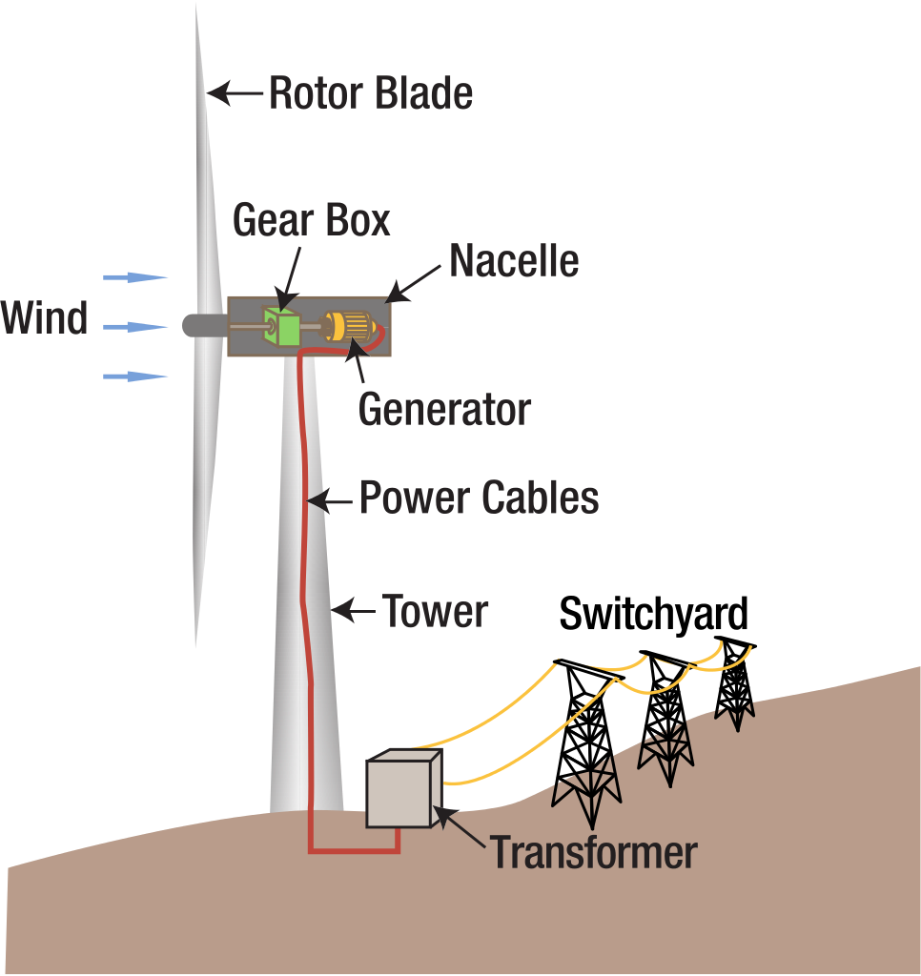
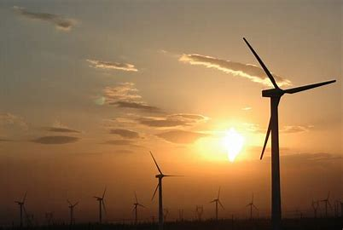
A Wind Turbine

Slide 5
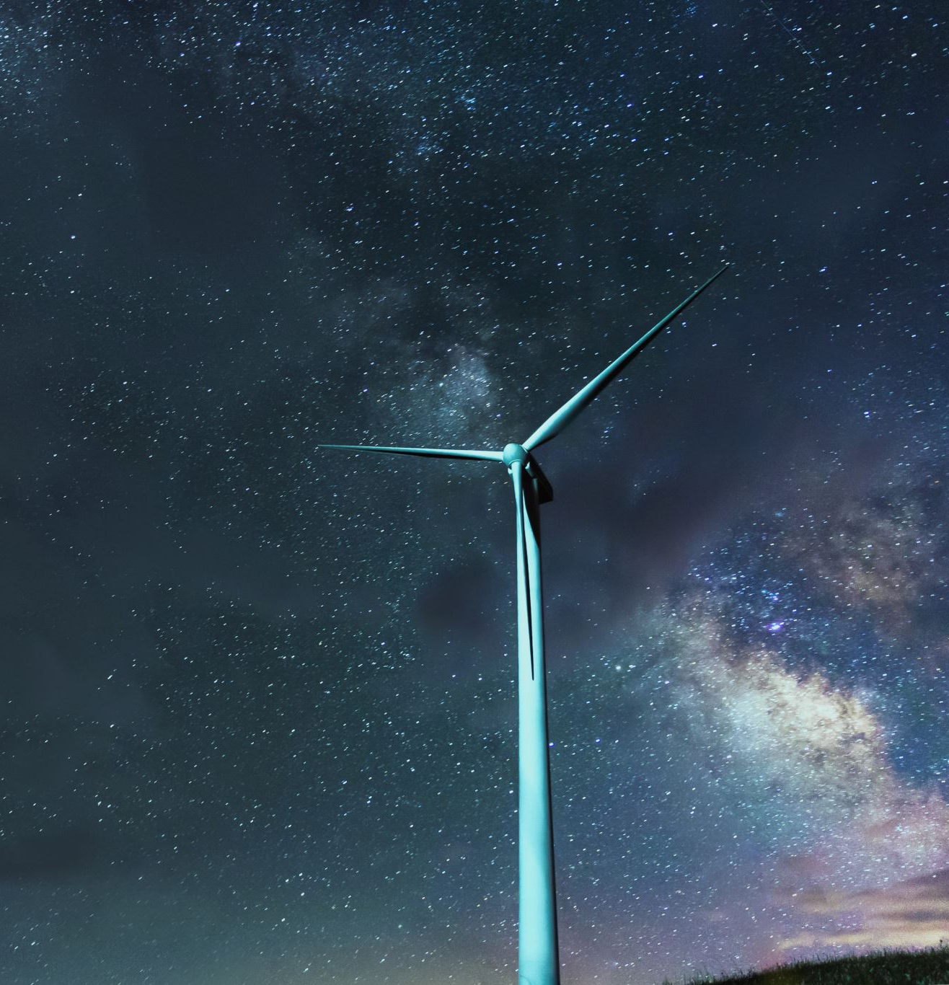
Wind Turbine Facts
Wind turbines are really big structures.
The tower itself is typically between 200 - 300 feet tall.
When you add in the height of the blades, some turbines tower 400 feet high!
The blades are quite big, too. There are typically three wind blades on a wind turbine.
Each blade is usually between 115 and 148 feet long.

Slide 6
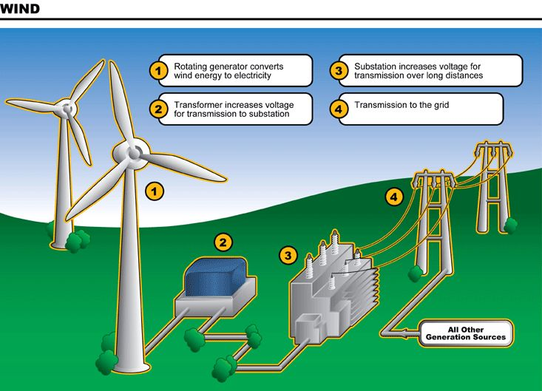
Wind Power Journey

Slide 7
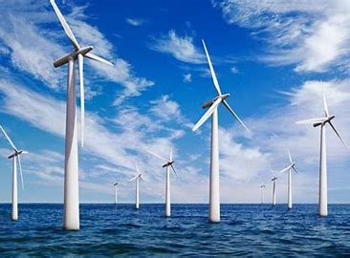
Wind Farms
Wind Farms are usually built in consistently windy places.
Some companies build wind farms out in the ocean.
These are called offshore wind farms.

Slide 8
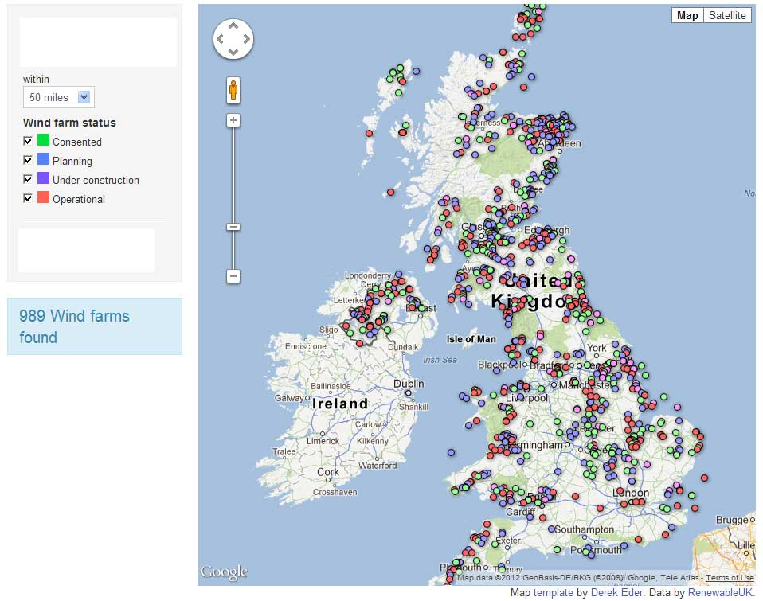
UK’s Wind Power Plan
“We believe that in 10 years’ time offshore wind will be powering every home in the country, with our target rising from 30 gigawatts to 40 gigawatts. Your kettle, your washing machine, your cooker, your heating, your plug-in electric vehicle – the whole lot of them will get their juice cleanly and without guilt from the breezes that blow around these islands.”
Boris Johnson, Prime Minister

Slide 9
The End

