Slide 1
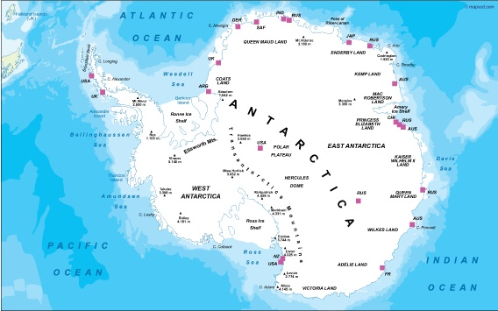
Antarctica
( South Pole).
By Taylor

Slide 2
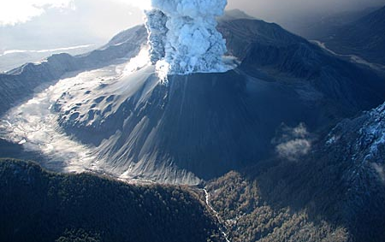

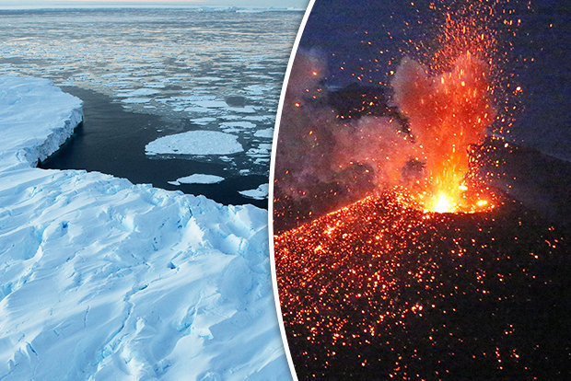
Antarctica holds most of the worlds fresh water.
Antarctica is a desert.
There is also Active Volcanoes.

Slide 3

Animals
Animals what live in the Antartica are blue whales, ablatross, killer whales, penguins, seal are a few of the 235 animal species that live there

Slide 4
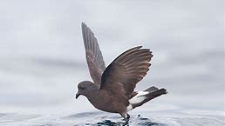
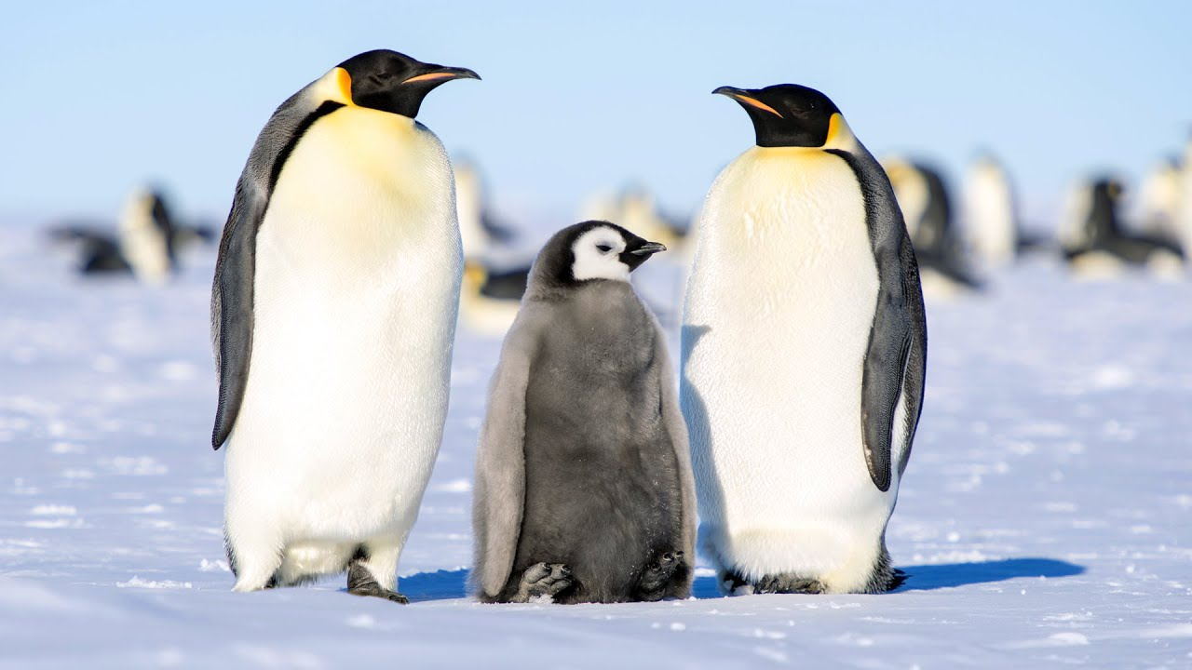
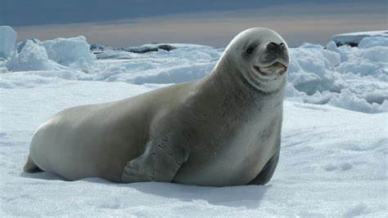
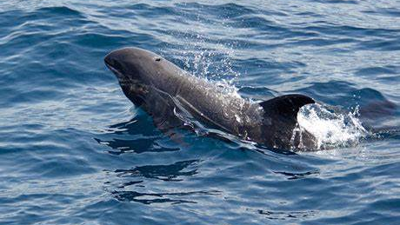
Animals

Slide 5
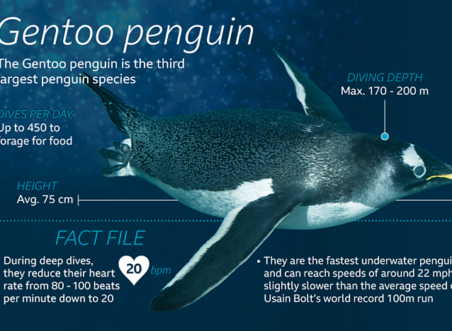
Facts Gentoo penguins waddle on land but swim gracefully underwater

Slide 6
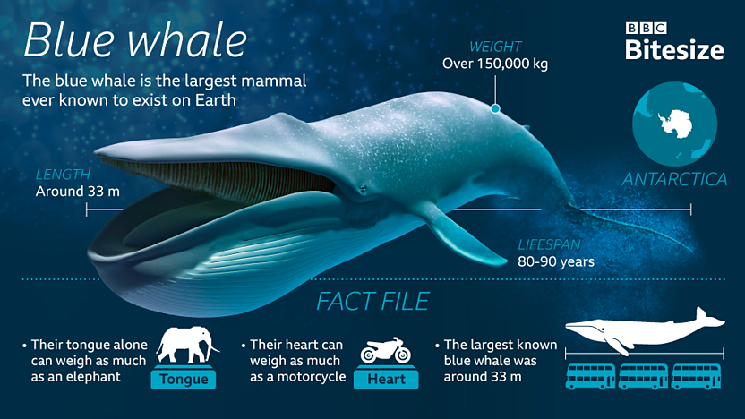
Blue whale is the largest mammal to ever exist

