Slide 1
Antarctica and it’s many features
By toby sutton

Slide 2
What is antarctica ?
Antarctica, the southernmost continent and site of the South Pole, and is virtually uninhabited
Antarctica is land that is more than just ice but it mostly is because less than half of Antarctica is it’s wilderness

Slide 3


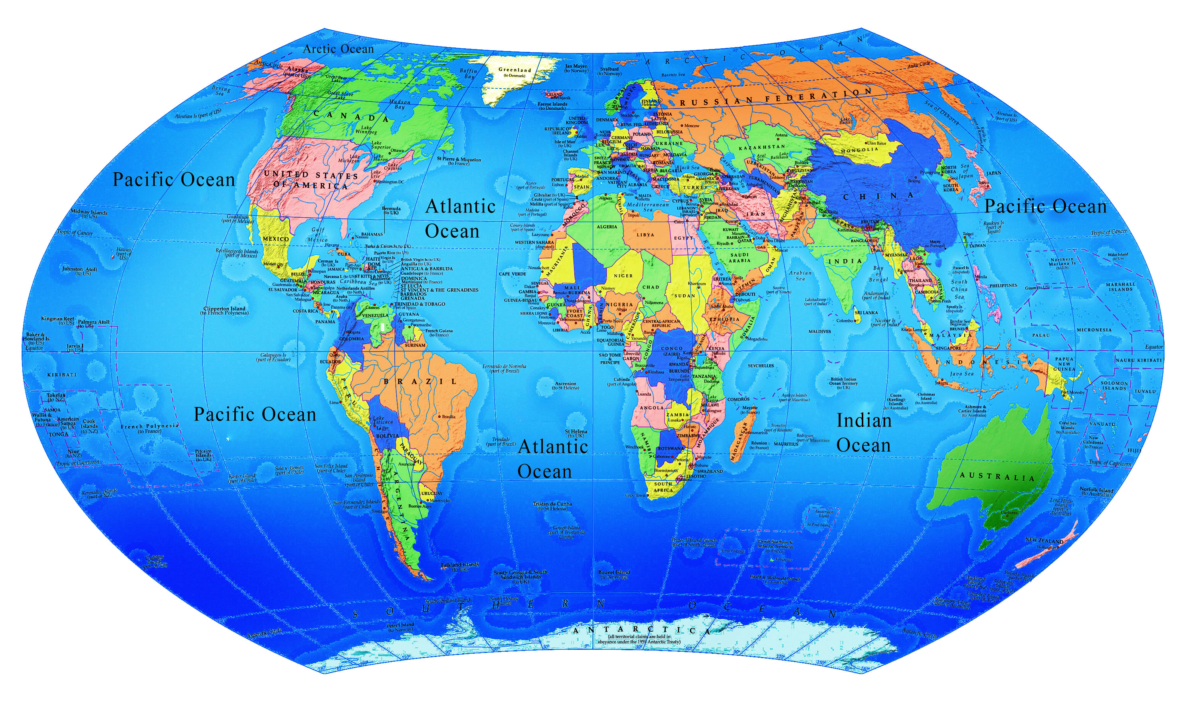
Where is antarctica located?
• Antarctica is located at the South Pole and is surrounded by the Southern Ocean. Over 98% of Antarctica is covered by ice. It is the driest and coldest continent on earth

Slide 4
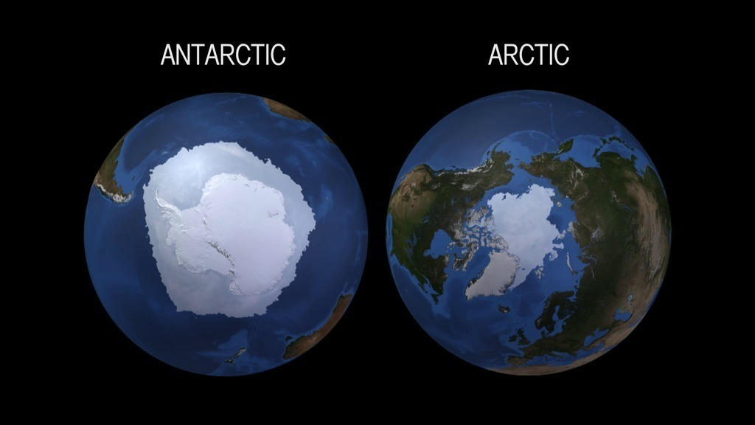
How did antarctica form?
• Antarctica as we know it was formed roughly 34 million years ago, when the continent was enveloped by the massive ice sheet it is known for today. But Antarctica wasn't always the great southern continent covered in ice.
• The first explanation is based on global climate change. Scientists have shown that atmospheric carbon dioxide levels declined steadily since the beginning of the Cenozoic Era, 66 million years ago. Once CO2 dropped below a critical threshold, cooler global temperatures allowed the ice sheets of Antarctica to start to form.

Slide 5
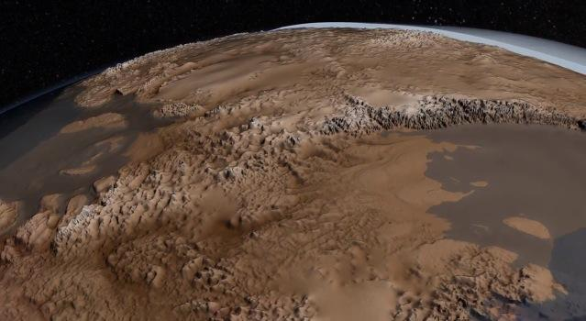
What did antarctica look like without it’s ice
More than 100 million years ago, Antarctica was part of the supercontinent Gondwana. Over time, Gondwana gradually broke apart, and Antarctica as we know it today was formed around 34 millions years ago.

