Slide 1
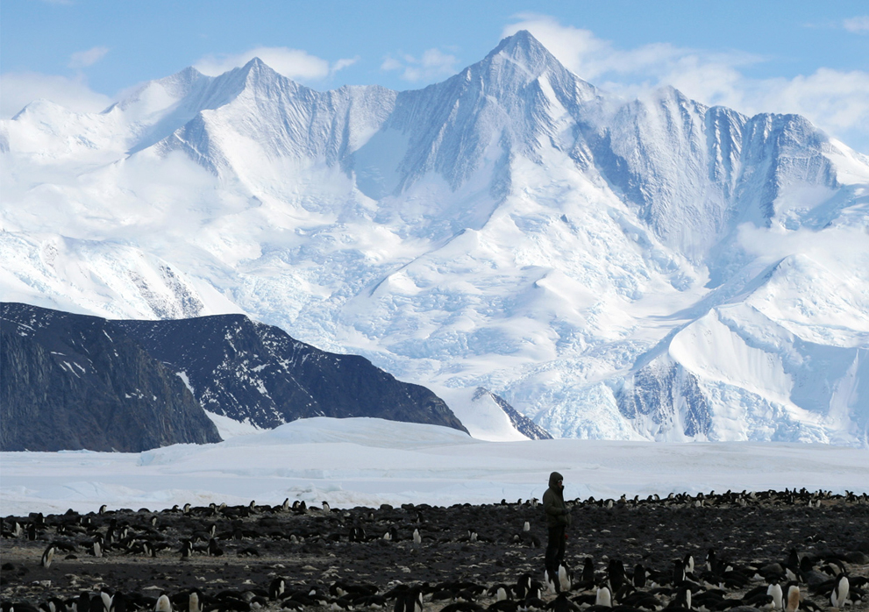
The Antarctic
By Freddie Snell
This Photo by Unknown Author is licensed under CC BY

Slide 2
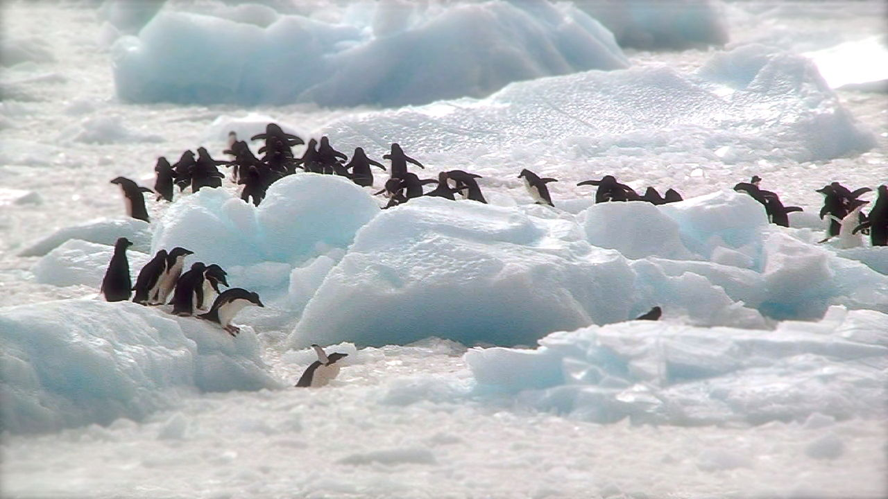
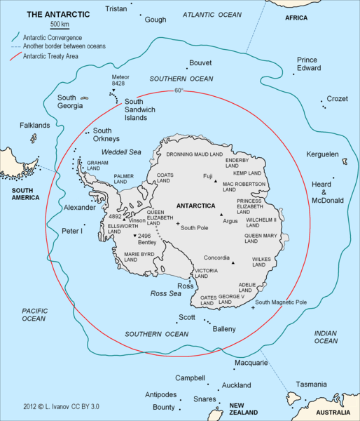
Where is it?
The Antarctic is located in the south pole and covers the continent antarctica. As you can see in the picture to the right there is a little circle around some islands these islands are called the south Orkneys.
This Photo by Unknown Author is licensed under CC BY-SA

Slide 3
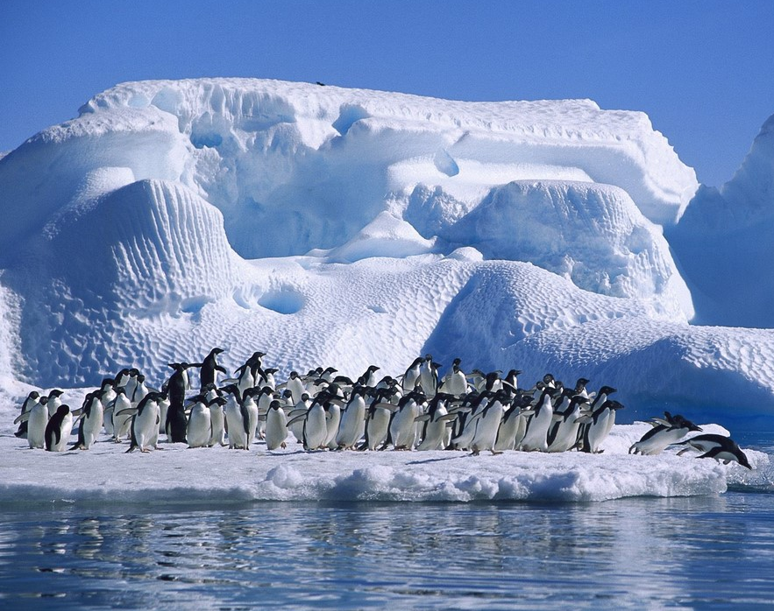
What is it?
One of the main places in the Antarctic is Antarctica. Antarctica is located at the South Pole and is surrounded by the Southern Ocean. Over 98% of Antarctica is covered by ice. It is the driest and coldest continent on earth. Some animals do manage to survive in the cold and dry climate of Antarctica.
This Photo by Unknown Author is licensed under CC BY-NC-ND

Slide 4
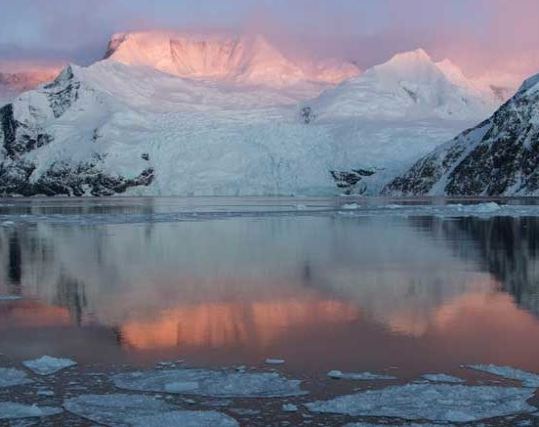
What is the weather like?
Antarctica’s average annual temperature ranges from about −10 °C on the coast to −60 °C at the highest parts of the interior.
Near the coast, the temperature can exceed +10 °C in summer and fall to below −40 °C in winter. Over the elevated inland, it can rise to about −30 °C in summer but fall below −80 °C in winter.
The lowest temperature ever recorded on the Earth’s surface was −89.2 °C at Vostok station on 21 July 1983.
This Photo by Unknown Author is licensed under CC BY-ND

Slide 5
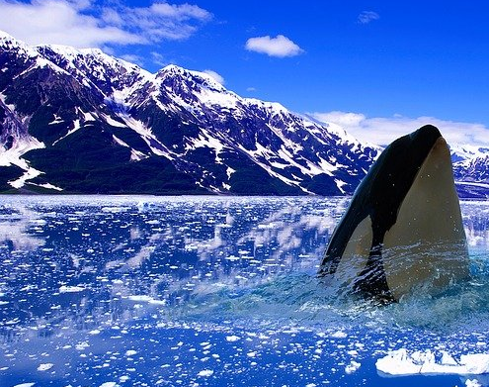
What lives there?
Albatross.
Bugs. Antarctica's only true land predators fall solidly under the "creepy-crawly" category.
Orcas.
Leopard seal.
Blue whales.
Penguins

Slide 6
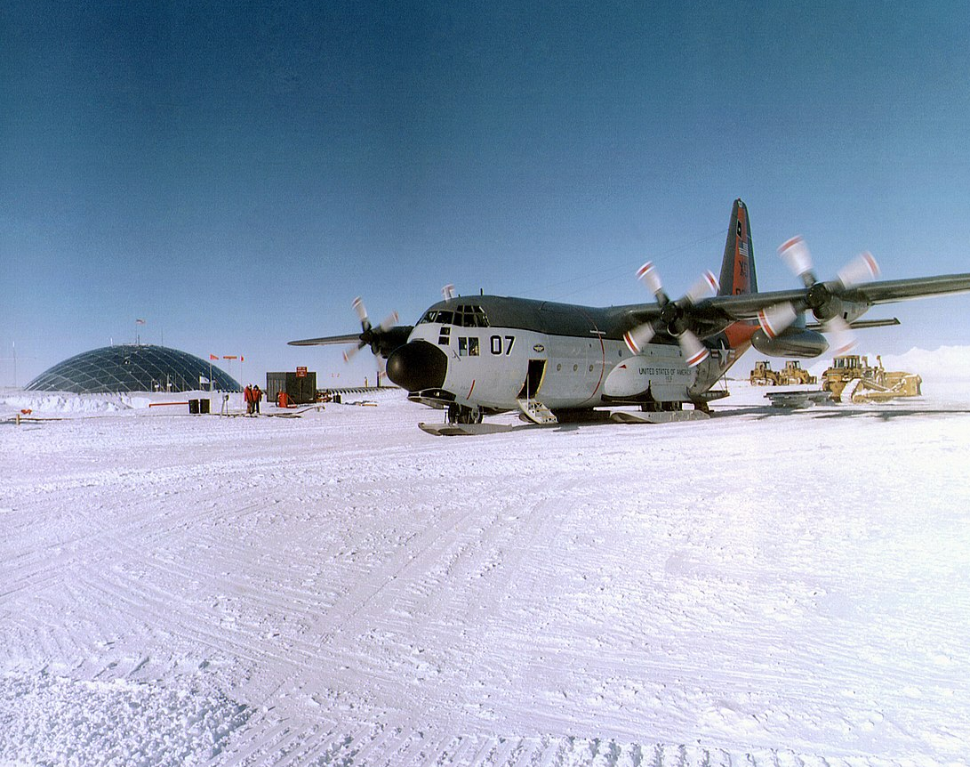
Who was the first person to explore it successfully?
Roald Amundsen
The first person to reach the South Pole was Norwegian explorer Roald Amundsen, said Ross MacPhee, a curator in the American Museum of Natural History in New York and author of Race To the End: Amundsen, Scott, and the Attainment of the South Pole
This Photo by Unknown Author is licensed under CC BY-SA

