Slide 1
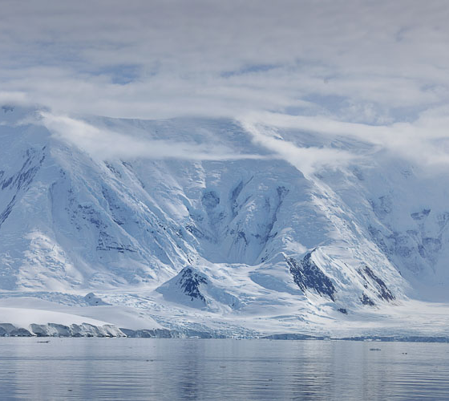
Facts about Antarctica!
By Ruby Platt!

Slide 2
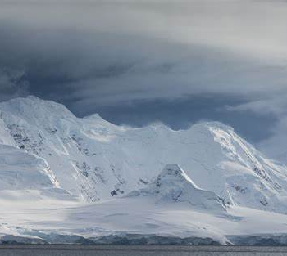
Did you know facts…
1.One of the most interesting facts about Antarctica is that even the hottest dessert in the world has seen more rain because, Antarctica is on the bottom of the earth, so it barely gets any rain.
2. Antarctica is earths southernmost continent.

Slide 3
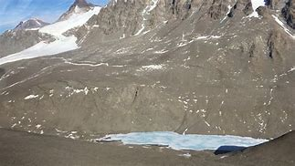
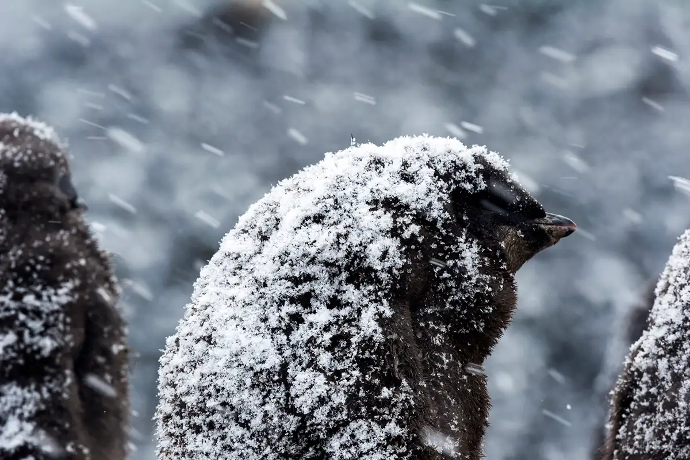
Pictures of Antarctica!
Dry in antarctica
Snowing in antarctica

Slide 4
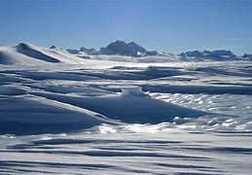
How often does it rain in Antarctica?
Antarctica is sometimes above freezing, that allows rain to fall. Antarctica gets rain throughout the years, the average rainfall received per year is approximately 35-50cm

Slide 5
More facts about antarctica!
Antarctica is not very popular; it is the least populated continent on our planet. The word Antarctica comes from the Greek term of Antarktik meaning the opposite to Antarctic or opposite to North.

Slide 6
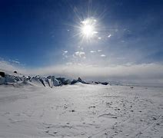
Fun facts about antarctica!
Antarctica is an ice-covered continent surrounded by the southern ocean. Almost all the continents land is covered by a thick layer of ice. On average the ice is 1.9km/6,200 ft deep. The inland icesheet thickens up to 4km/13,000 ft.
Antarctica is weirdly the driest continent of the seven continents. Antarctica is an icy desert with a very little rainfall throughout the year.

Slide 7
Thank you for reading this, have a great day!!!!!
I hope you learned lots of facts from this, stay safe and be positive!!!!! ☺

