Slide 1
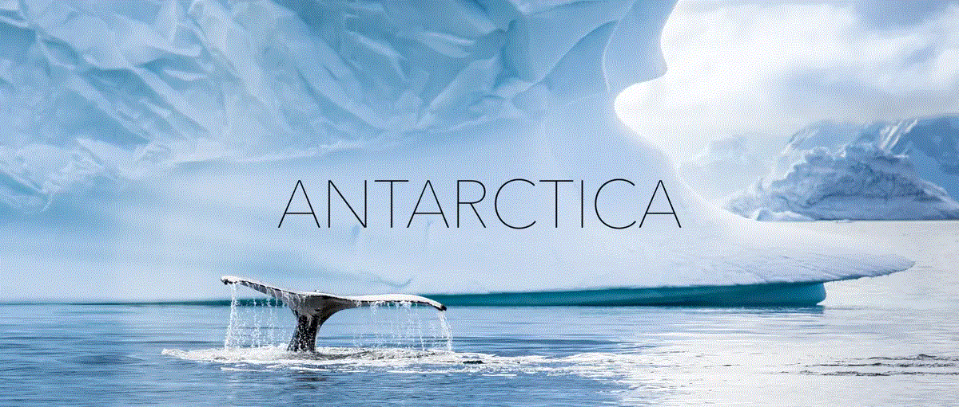
By Phoebe Boyer

Slide 2
INTRODUCTION
This presentation is about Antarctica and will cover the following topics:
Physical Geography
Wildlife
Scientific Interest
Interview

Slide 3
PHYSICAL GEOGRAPHY

Slide 4
Introducing Physical Geography
Antarctica is a continent made of a landmass covered in ice with little snow (the north pole has no land, and is just ice). As much as it looks like there are tonnes of snow it’s actually ice. This continent has only got two seasons: summer and winter. In the summer there is plenty of sunlight in the winter there is little sunlight, in fact in mid winter some days the sun doesn’t go above the horizon.

Slide 5
The continent of Antarctica
Antarctica is in the southern hemisphere of the world.
Antarctica is 14.2 million km² in size.
Antarctica is a Land mass rather than an ice sheet like the north pole.
Fun fact : Antarctica is double the size of Australia !!!

Slide 6
WILDLIFE

Slide 7
Introducing Wildlife
Animals, plants and all living things have adapted to living in extreme conditions.
Every habitat is unique to that continent.
Not all species that live in Antarctica stay there all year, many migrate to other continents –even as far as Europe.
You can study penguin migration from space by seeing their poop trails.

Slide 8
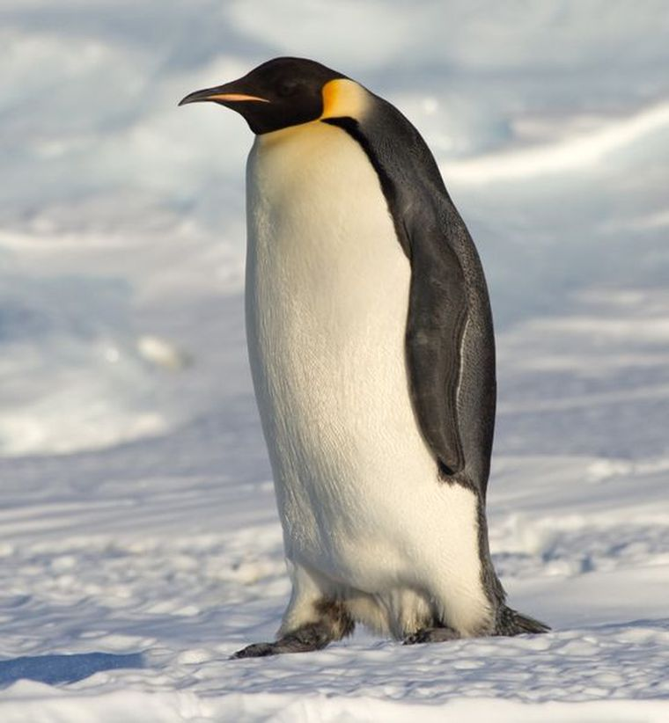
Emperor Penguin Fact File
Height -3.75 feet
Diet - Carnivore
Mate - March - April
Offspring - One egg May-June
Fact - Male incubates while mothers fish

Slide 9
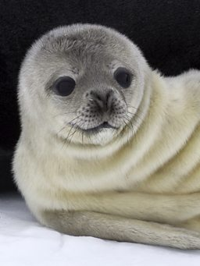
Weddell Seals Fact File
Can stay underwater for over 80 minutes or 1:20
Can dive down up to 600m
Spend most of the time in the ocean.
Carnivore
10 feet

Slide 10
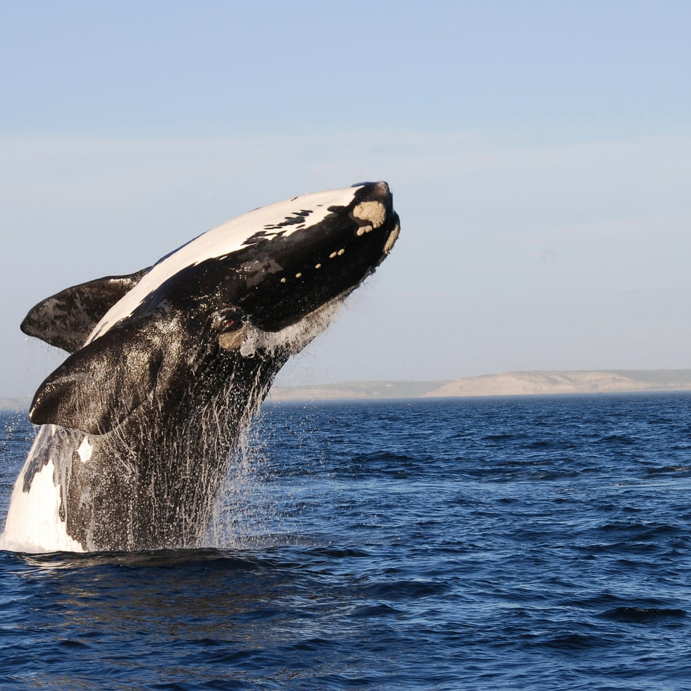
Southern Right Whale Fact File
Whalers were banned from hunting them
Carnivore
50 feet

Slide 11
SCIENTIFIC INTEREST

Slide 12
Science is really significant in Antarctica because unlike most other areas of the world, it remains relatively untouched and all activities are carefully controlled and monitored. The scientific studies in Antarctica are often ones that cannot usually be conducted elsewhere and help our understanding of global environmental issues including climate change, ozone depletion and sea level rise.
Taken from the British Antarctic survey website

Slide 13
REASONS FOR SCIENCE IN ANTARTICA
It has a unique ecosystem
  To study adaptations, new species and extinction
It shows how ice sheets shrink or grow
  This is important for sea level changes
Its the best place on Earth to find meteorites
Scientists can find information for about a million years of climates in the ice.
  Chemicals, atmospheric gasses and organisms are preserved entirely in the depths of the ice.

Slide 14
Interview with a person that's been to Antarctica

Slide 15
Ross Newham visited Antarctica in 2006
The most interesting bird he saw was a snowy sheathbill and Wilsons petril (also seen on the isle of Scilly).
The temperature was mostly -4 to -10, as he visited in summer.
He saw : Humpback whales, elephant seals, Leopard seals and Weddle seals.
He saw the Ukrainian research Centre (Vernadsky), where they first found hole in the ozone layer.
Asked what it was really like being there he said ‘It was lovely, quiet, really bright and clean’.
The greatest thing he experienced on his visit was the sound of the icebergs creaking and seeing the animals bringing up their children.
FUN FACT: they say you always remember your first iceberg (he did).

Slide 16
I hope you enjoyed !!!
Hopefully you've Learnt about:
Physical Geography.
Wildlife.
Scientific Interest.
and even learnt a few thing from the interview from someone who actually has been there.

