Slide 1
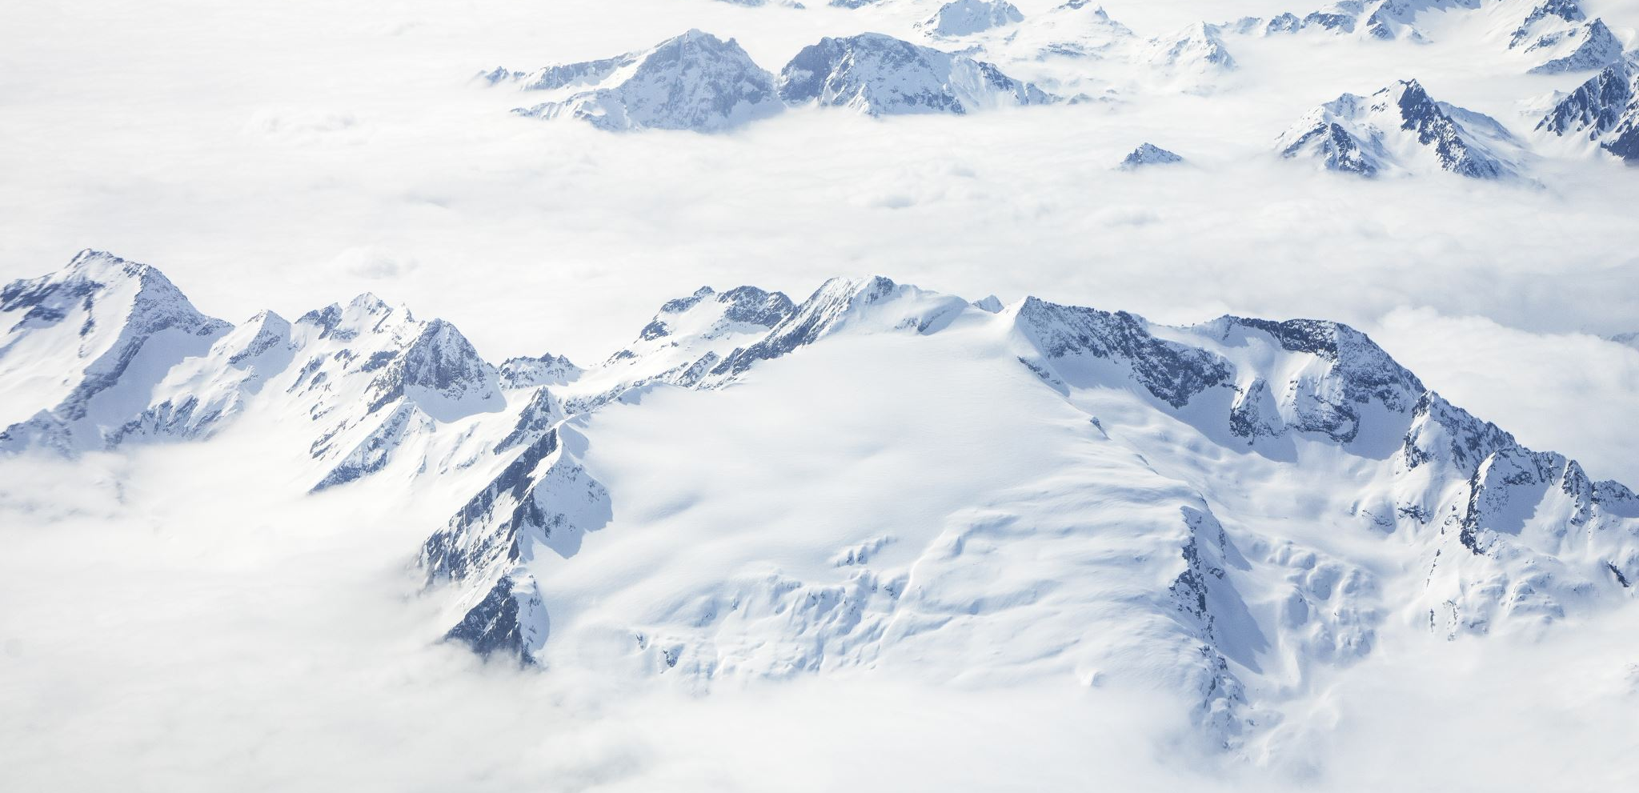
Emily Dean
Antarctica

Slide 2

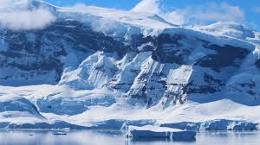
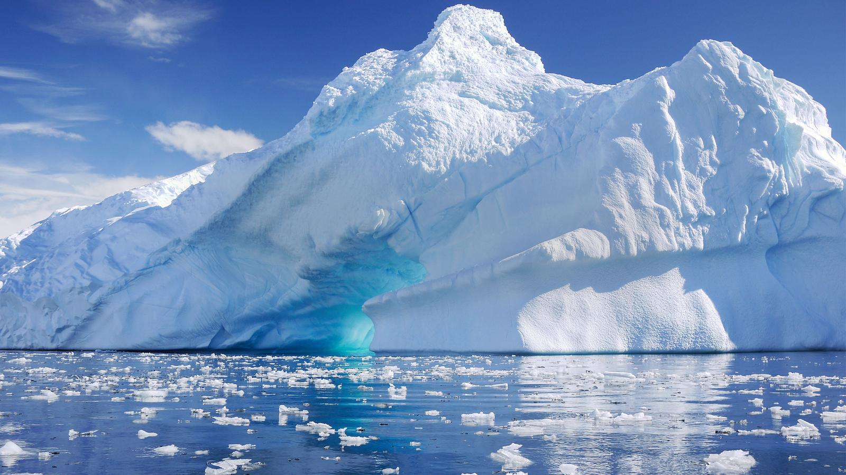
The Antarctic
Antarctica is the 5th largest continent on the planet and is surrounded by the Southern Ocean. The whole continent is covered in ice and is called an icy desert.
There are no permanent residents living in Antarctica as it is the coldest continent on the planet.

Slide 3
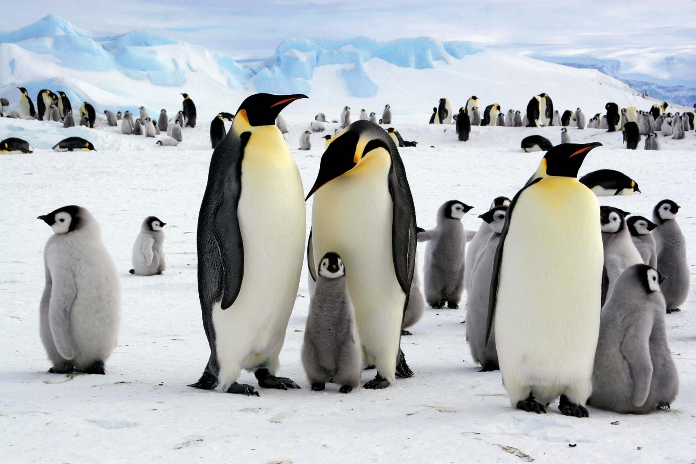
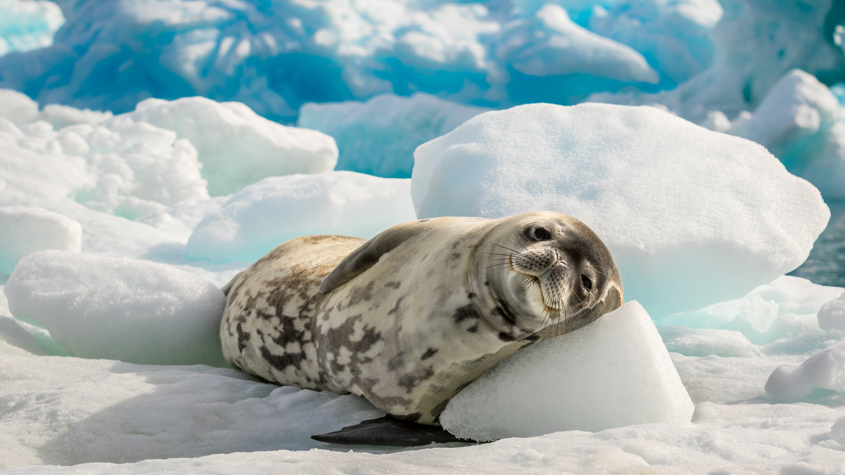
Wildlife
There are not many animals that live in Antarctica. Those that do live there are whales, seals and emperor penguins. They all live on fish that are found in the surrounding Oceans.

Slide 4
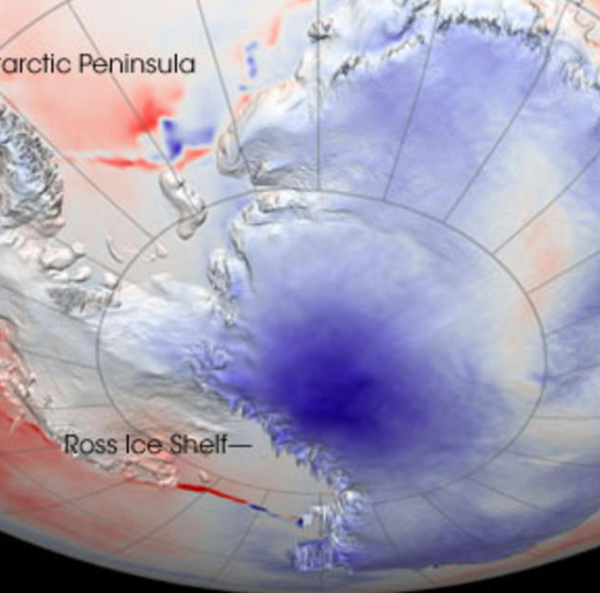
ANTARCTIC FACTS
Antarctica is bigger than the whole of Europe.
The ice in Antarctica is over a mile thick.
Antarctica is the windiest place on earth with winds up to 218 mph.
Only scientists and researchers stay for a short while as its so cold.
During the summertime in Antarctica the sky never gets dark, it is light for 24 hours a day. In the winter is is dark for 24 hours a day.

