Slide 1
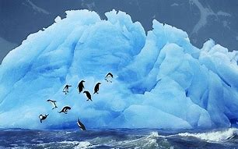
Antarctica

Slide 2
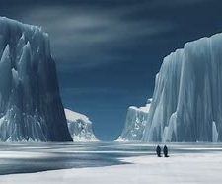
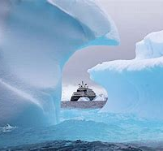
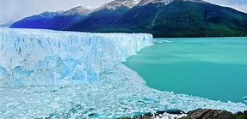
Antarctica Facts
1. It is coldest place on earth
2. It is the windiest place on earth
3. It is the largest desert in the world
4. It was first discovered in 1820
5.The average temperature is -50⁰c

Slide 3
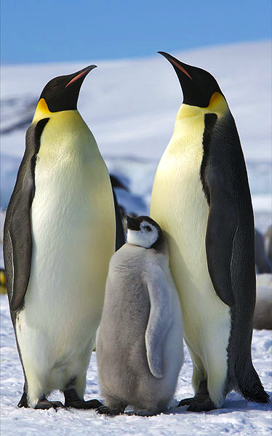
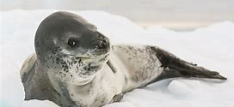
Antarctic Animal Facts
1. The blue wale lives in Antarctica
2. The fastest penguin called the Gentoo lives in Antarctica
3. The Gentoo penguin does up to 450 leaps per day when looking for food
4. One specie of Elephant Seals almost went extinct
5. The life span of the leopard seal is 12 to 15 years

Slide 4
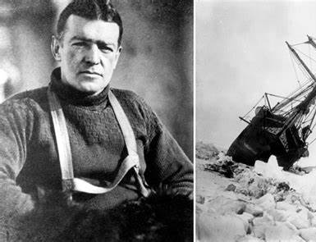
Ernest Shackleton
He almost was in Antarctica for 2 years and still survived
He was born in Ireland
His father was a doctor and wanted Shackleton to be a doctor as well
Shackleton died by a heart attack
He was a polar explorer

Slide 5
Spare facts
1.Antarticas air and water is heating up!
2.Ice is retreating and melting rapidly
3.Penguin populations are shrinking
4.Snow is turning red
5.Land is getting greener

