Slide 1


Antarctica
By Noah

Slide 2
How I feel about Antarctica
Negative
Positive
Snow
Beautiful view
Animals
You probably would get to drink hot chocolate a lot
Freezing, cold, icy
No food until summer if gone none of that
No pets
Dangerous environment

Slide 3
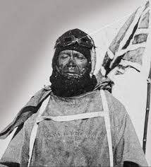
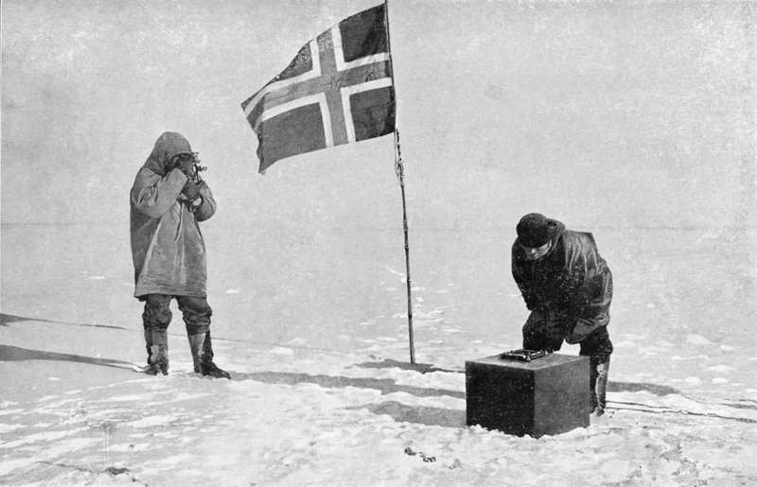
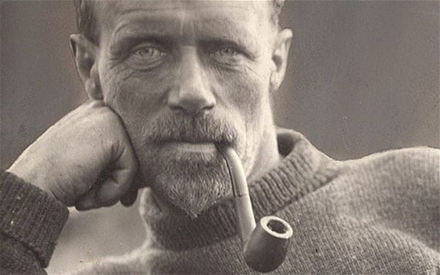
People who have been to Antarctica
Robert Falcon Scott
Roald Amudsen
Ernest Shackleton
Robert was a man in the navy and he had two expeditions to Antarctica. His name is still known today by people who are not interested in polar activities. His son started probably the most important wild life fund WWF
Roald and his crew were the first people to reach the south pole 1911 and him and Scott were racing to the reach the south pole first but Roald was there first.
Ernest Shackleton died during a journey to the Falklands Islands.

Slide 4
The Ups And Downs About Weather
The coldest it has been on Earth is -89.2c in Antarctica.
In Antarctica it is regularly -50c
The coldest it has ever been in Scotland is -23c!
Antarctica is also known as a desert because there is barely any rain.
Antarctica’s summer is the same as when it’s the UK’s winter.
The ice in Antarctica is 2.5km thick, that is the same as walking from school to Larkfield.

Slide 5
Living Conditions
Most people who go to Antarctica leave in the summer so if they stay they are there for the rest of the six months.
Nobody is actually born in Antarctica everybody is from different countries.
Prepare for unpredictable weather
Don’t forget sunscreen and sunglasses
Stay hydrated
Know sign hypothermia
See a doctor before

Slide 6
Animals that live in Antarctica
Penguins
Krill
Whales
Birds
Seals
And others
NOT POLAR BEARS

