Slide 1
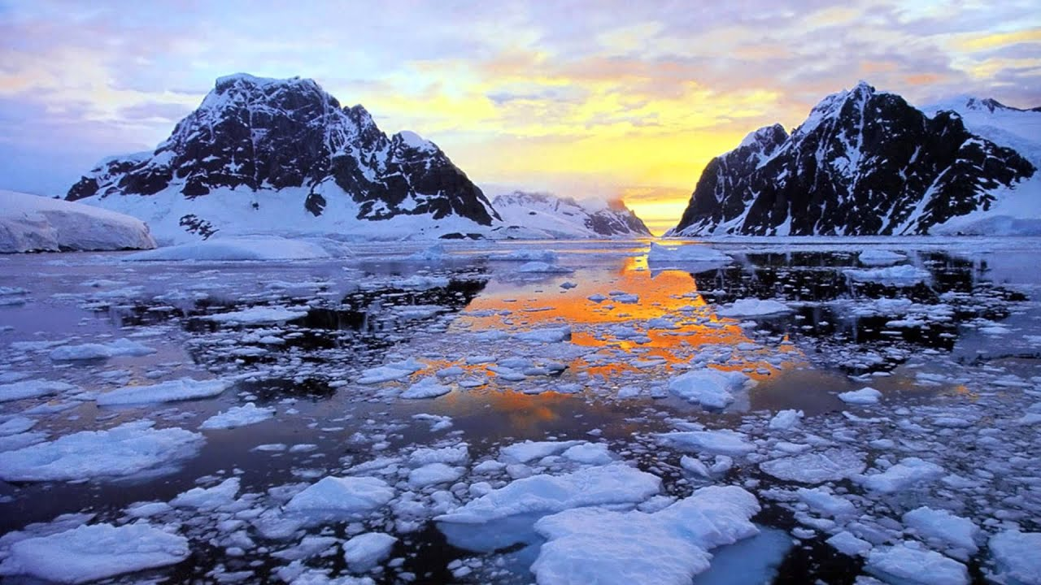
About Antarctica

Slide 2
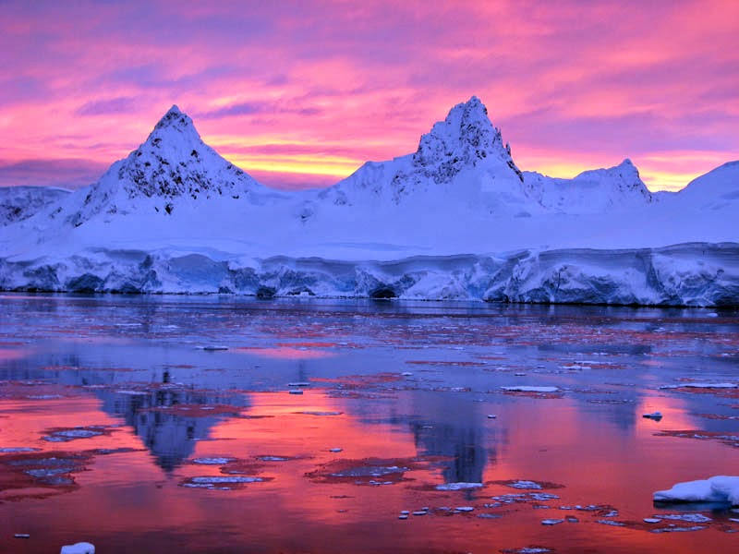
Facts about Antarctica
Antarctica is the world’s southernmost continent. It is also the world’s highest, driest, windiest, coldest, and iciest continent. Antarctica is about 5.5 million square miles (14.2 million square km) in size, and thick ice covers about 98 percent of the land.

Slide 3
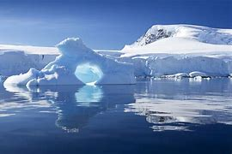
About Antarctica
Antarctica, on average, is the coldest, driest, and windiest continent, and has the highest average elevation of all the continents. Most of Antarctica is a polar desert, with annual precipitation of 20 cm (7.9 in) along the coast and far less inland.

Slide 4
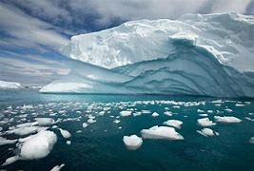
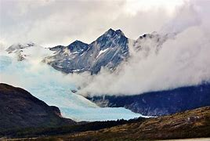
Pictures of Antarctica

Slide 5
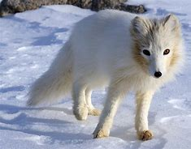
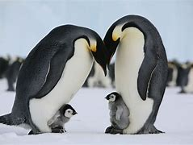
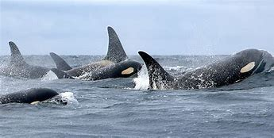
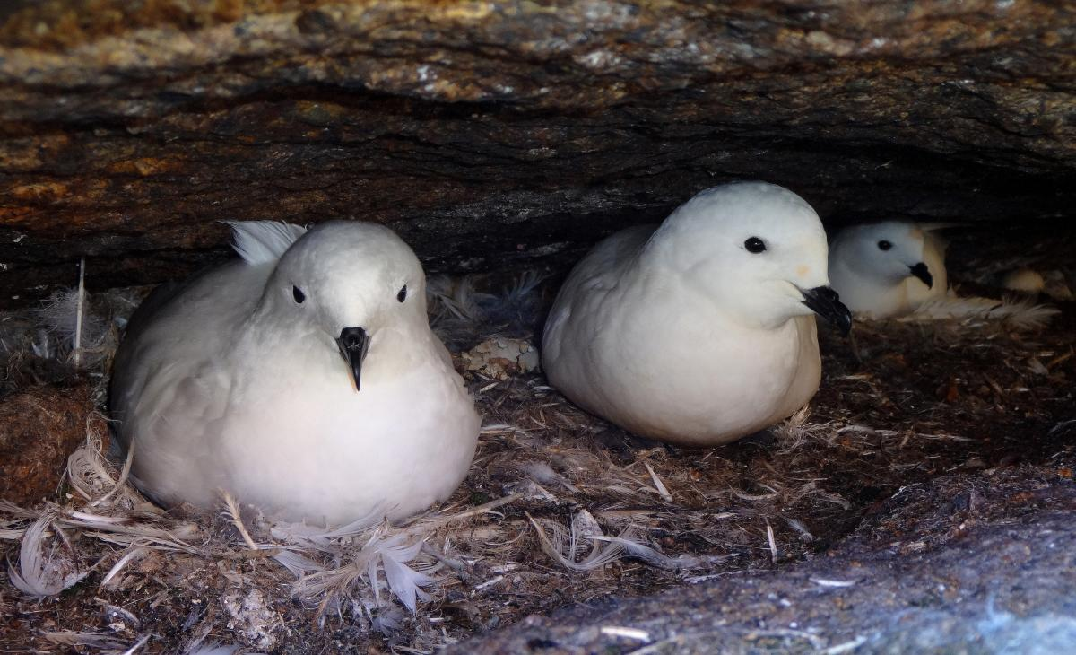
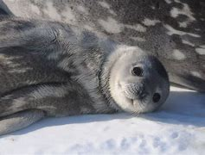
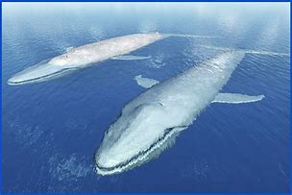
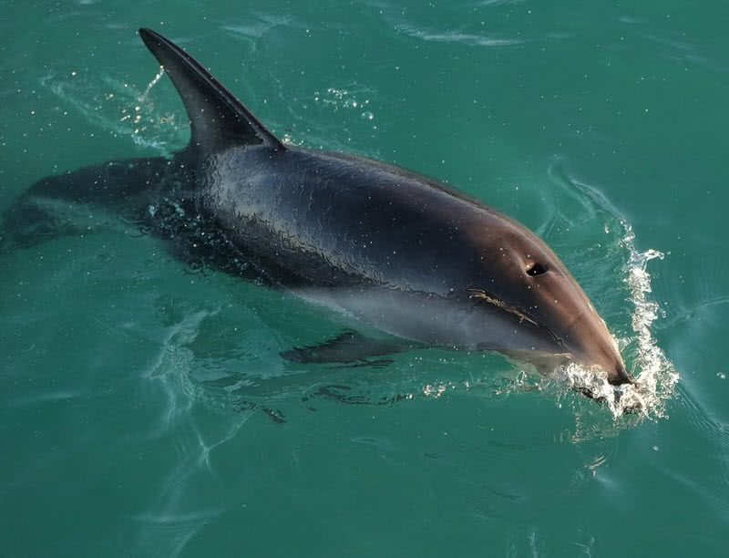
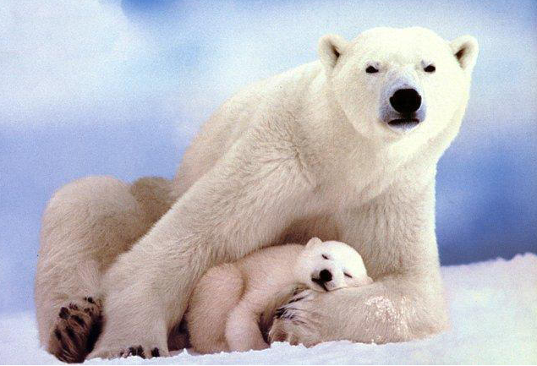
What animals live in Antarctica
Arctic fox, Penguins, seals and Blue Whales
Killer Whales, Sown Petrel, Dolphin and polar Bears

