Slide 1


The Antarctic
Ollie

Slide 2
Some Facts About Antarctica
1. Antarctica is a region and the Antarctic is an ice sheet
2. The Antarctic ice sheet contains 90% of the ice on Earth
3. There are no native people in Antarctica
4. There are no polar bears in Antarctica
5. There are about 5 million penguins in Antarctica
6. Eighteen countries operate year-round scientific research stations
7. The South pole is in the middle of the Antarctic ice sheet

Slide 3
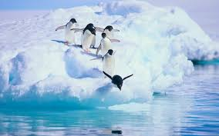
Picture of a Group of Penguins in Antarctica

Slide 4
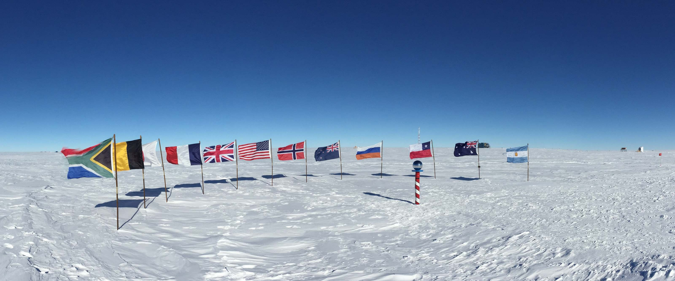
Picture of the South Pole

Slide 5
Some More Facts About Antarctica
90% of the Earth’s ice is in Antarctica
2. There is an ozone layer around the Earth protecting it
3. There is a hole in the ozone layer above Antarctica but that is bad because if the sun is over Antarctica, the ice will melt
4. The coldest temperature ever recorded in Antarctica is -89.6°C and is the coldest place on Earth
5. The Antarctic ice sheet is the largest ice store on Earth
6. Antarctica is the highest, driest, coldest and windiest continent on Earth
7. Antarctica is larger than Europe
8. The Antarctic covers 98% of Antarctica

