Slide 1
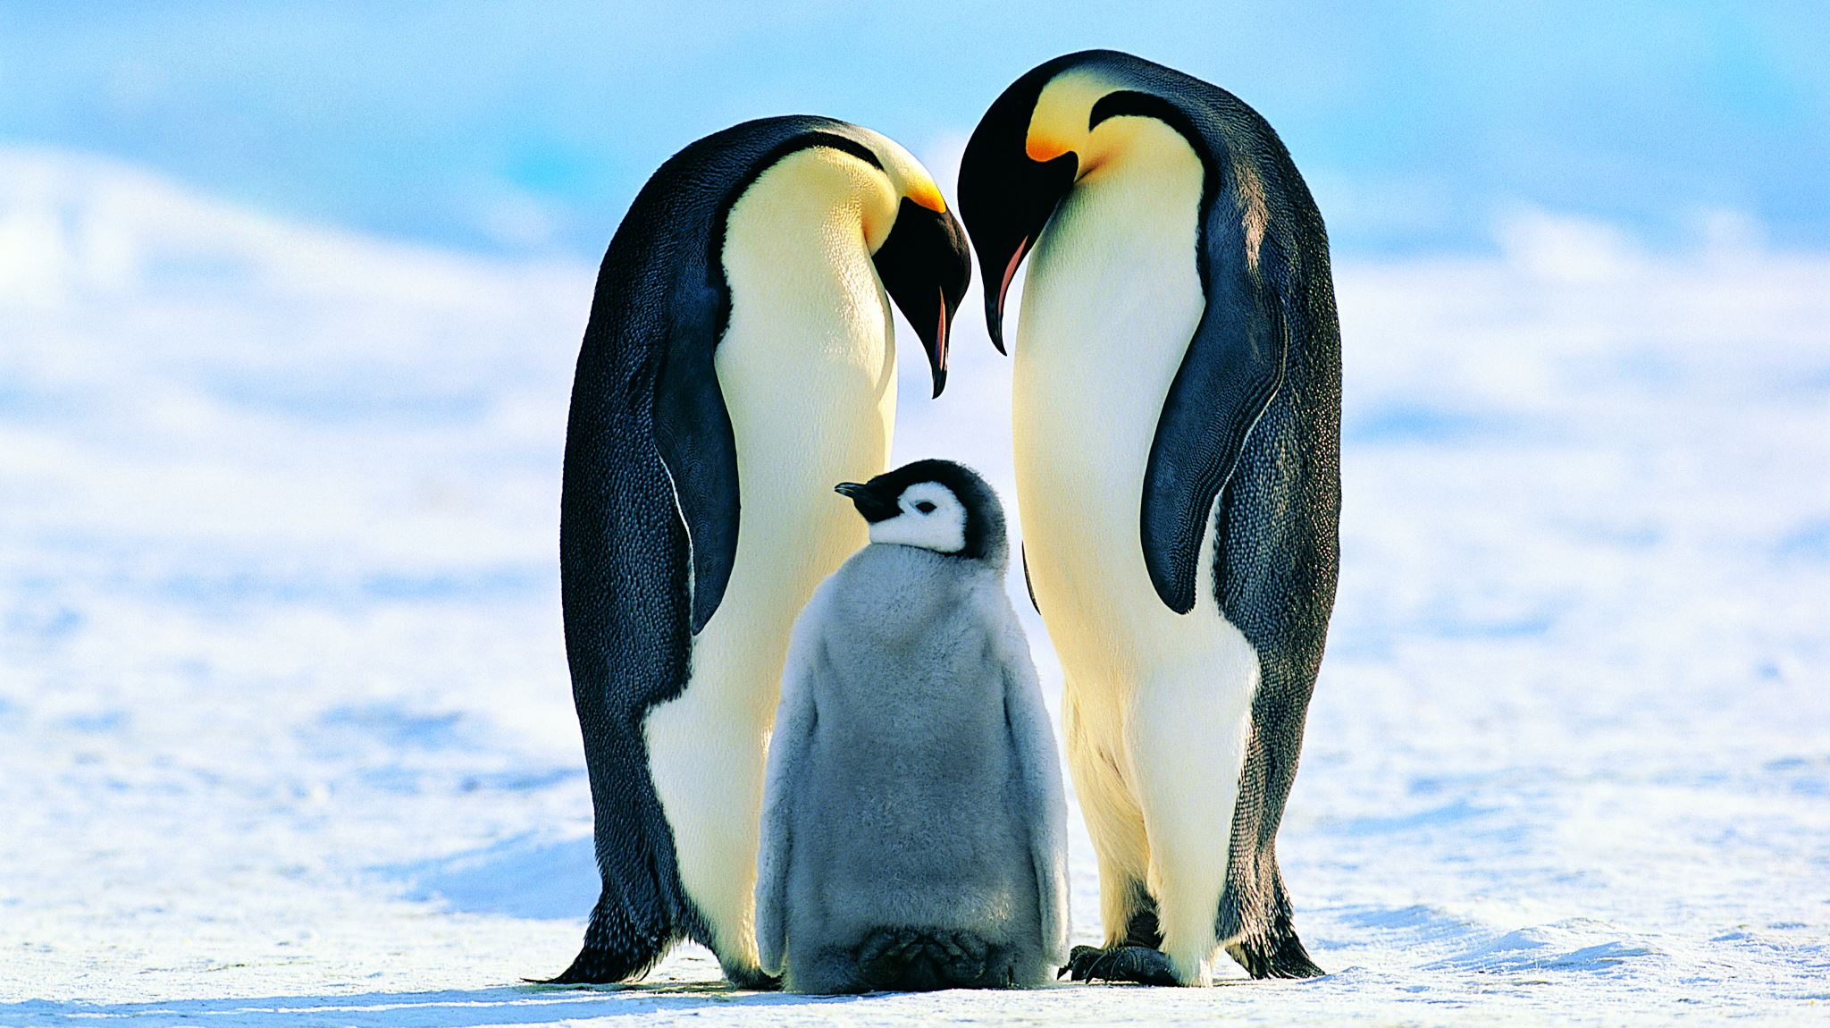
ANTARCTICA
By Hannah

Slide 2
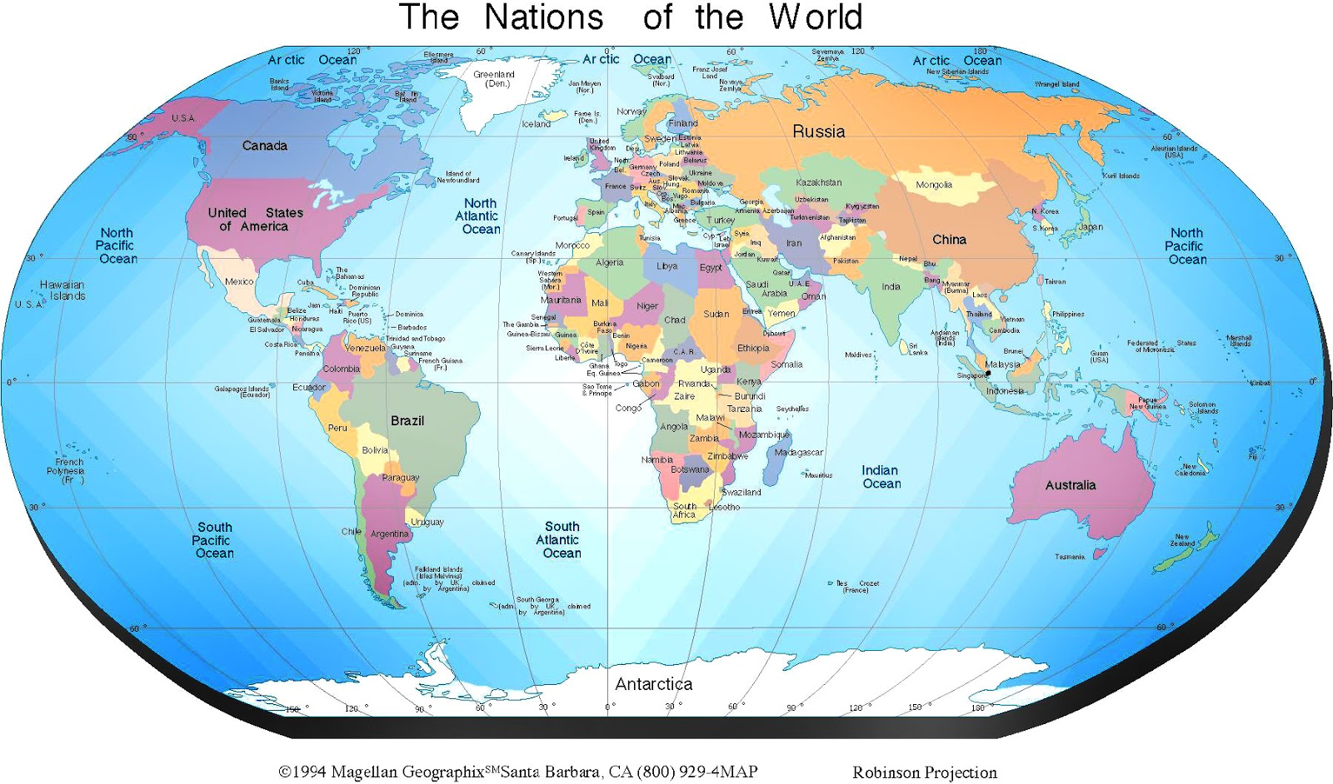

Slide 3
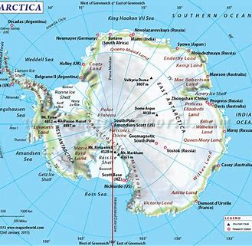
Map of Antarctica

Slide 4
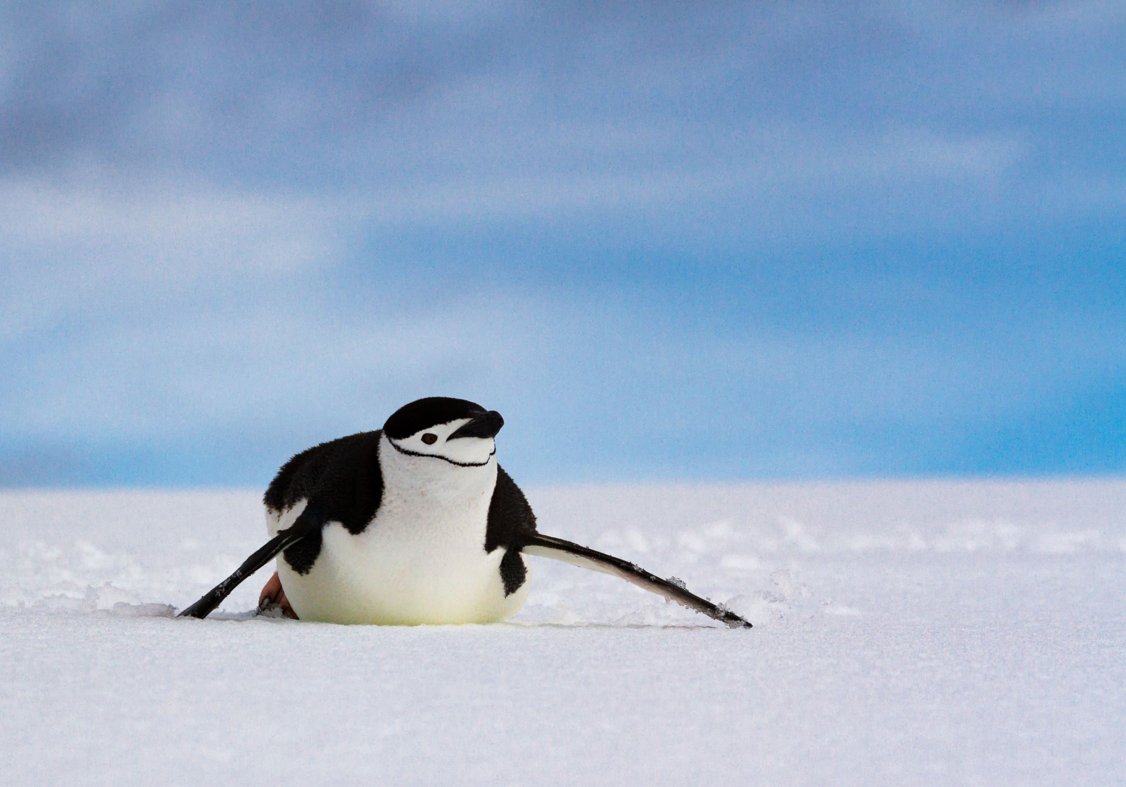
ANTARCTICA
Only scientists go to Antarctica to test the ice.
They observe the wildlife .
They analyse chemicals in the ice so they can find out how the Earth’s atmosphere has changed over the years.

Slide 5

ANTARCTICA
. Antarctica at the Earth’s southern tip and where the south pole is and is the coldest continent .
. The land lies beneath a thick layer of ice.
. Nearly half of the coastline is surrounded by ice.
. There are two distinct parts of antarctica.
. Antarctica has lots of ice.

Slide 6
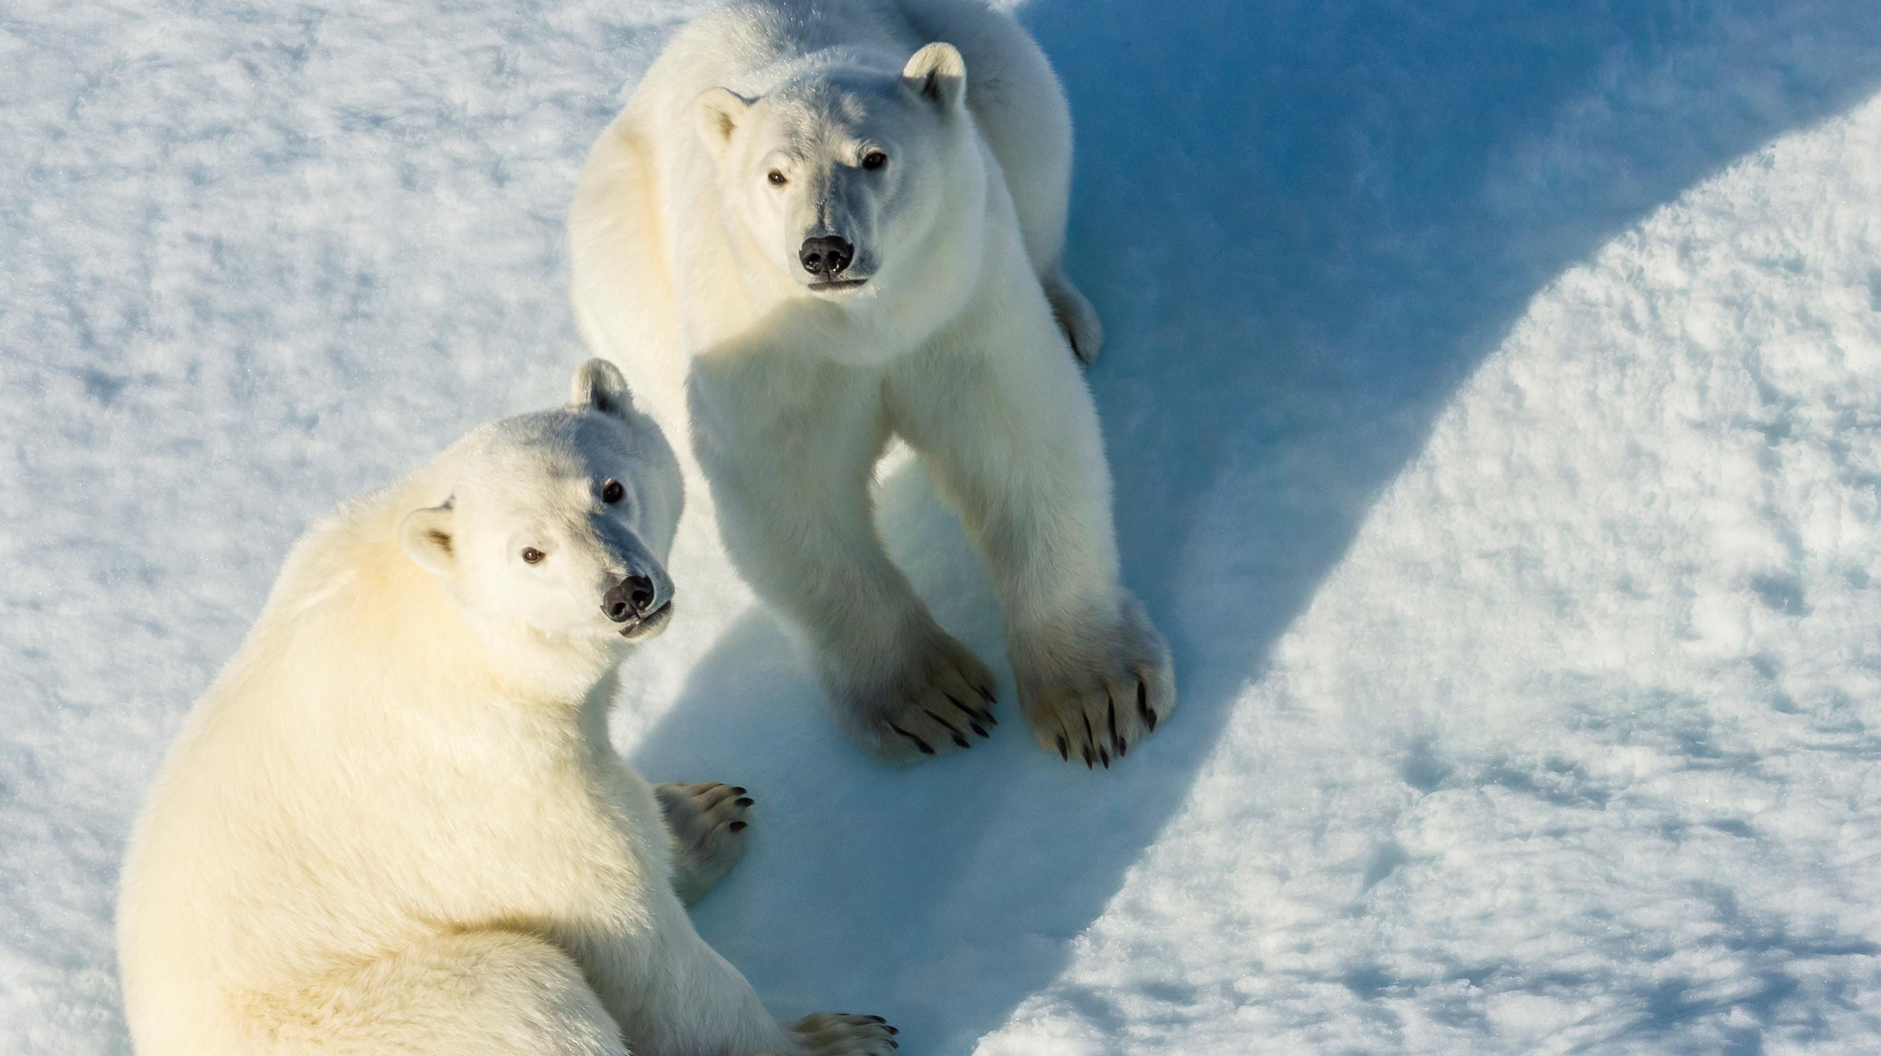
Antarctica is governed by Argentina , Brazil , Chile , the United Kingdom , Norway , France , Australia and New Zealand. All these countries have agreed that the continent should only be used for peaceful work.

Slide 7
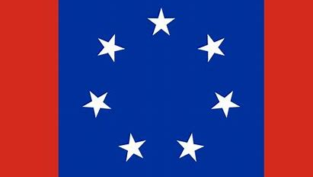
ANTARCTICA
5,000 people live in Antarctica. More than 4,000 scientists from different nations and different interests, experiment together .

Slide 8

The end
. .

