Slide 1

Antarctica
By Fletcher Whybrew

Slide 2
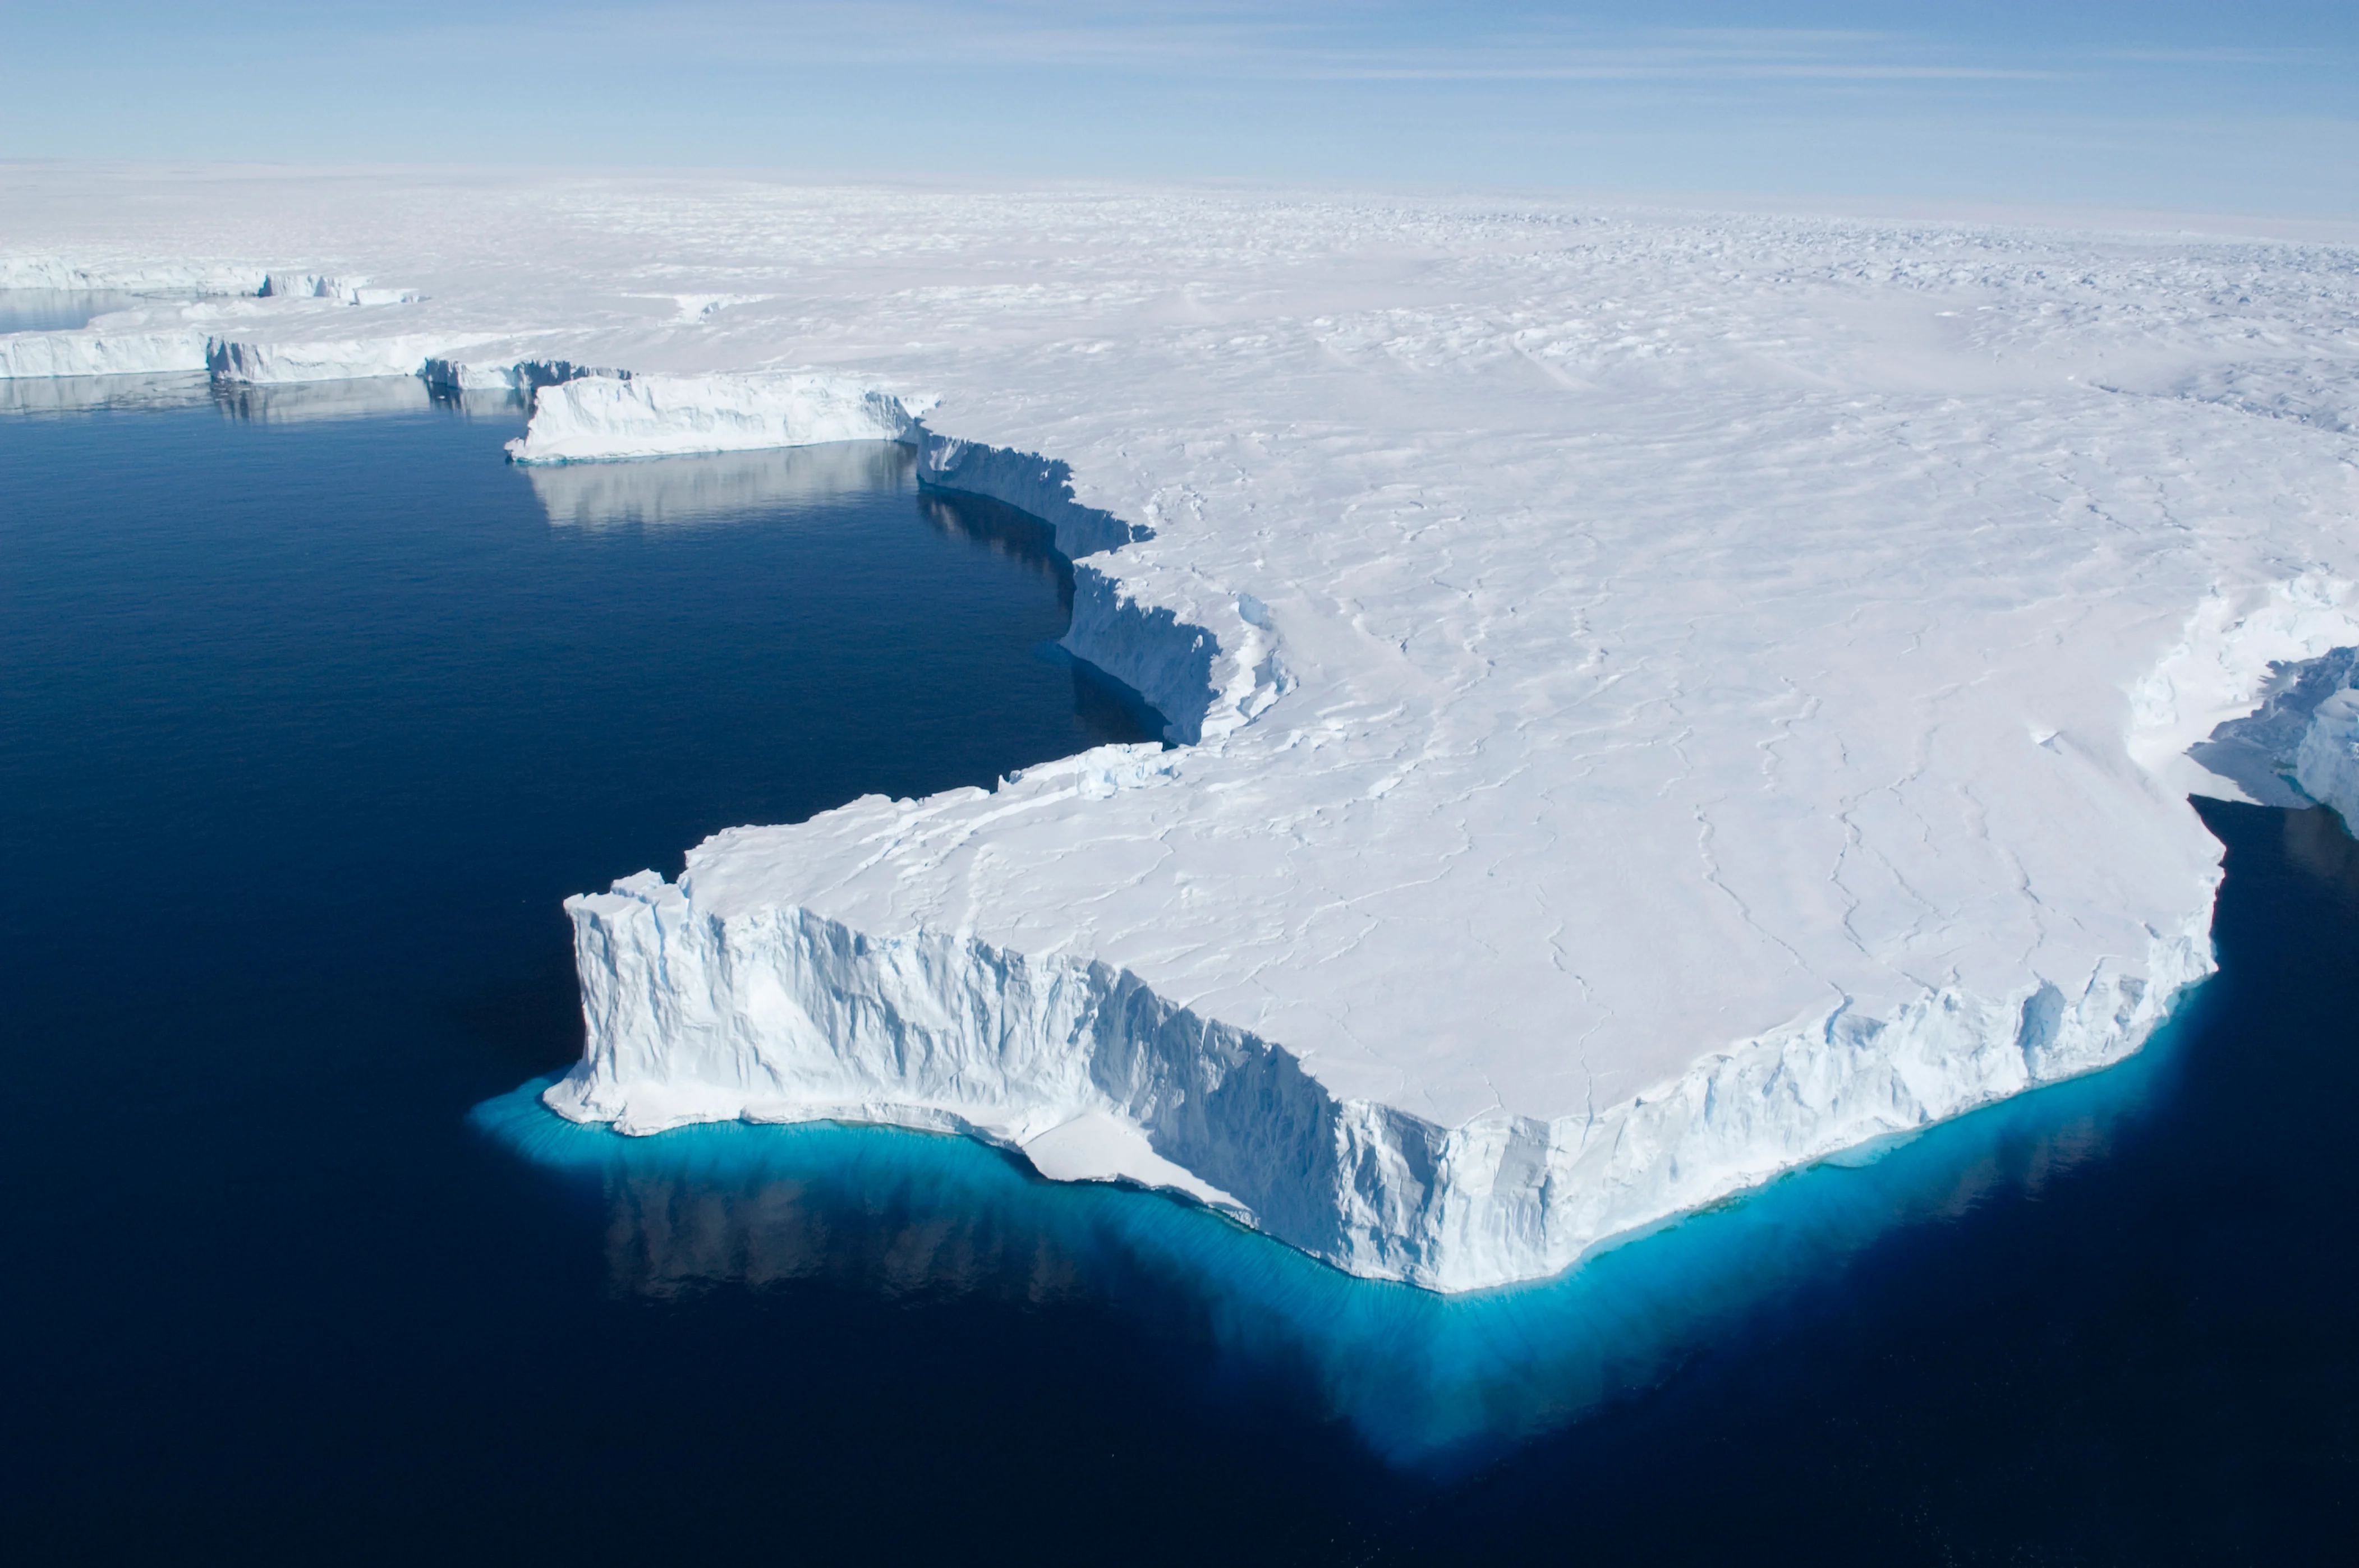
Where is Antarctica?
It is built over the South Pole. Antarctica is the fifth largest of the seven continents. It is twice the size of Australia and fifty times the size of the UK. Everywhere is north. Antarctica is the highest, driest, coldest and windiest place on earth.

Slide 3
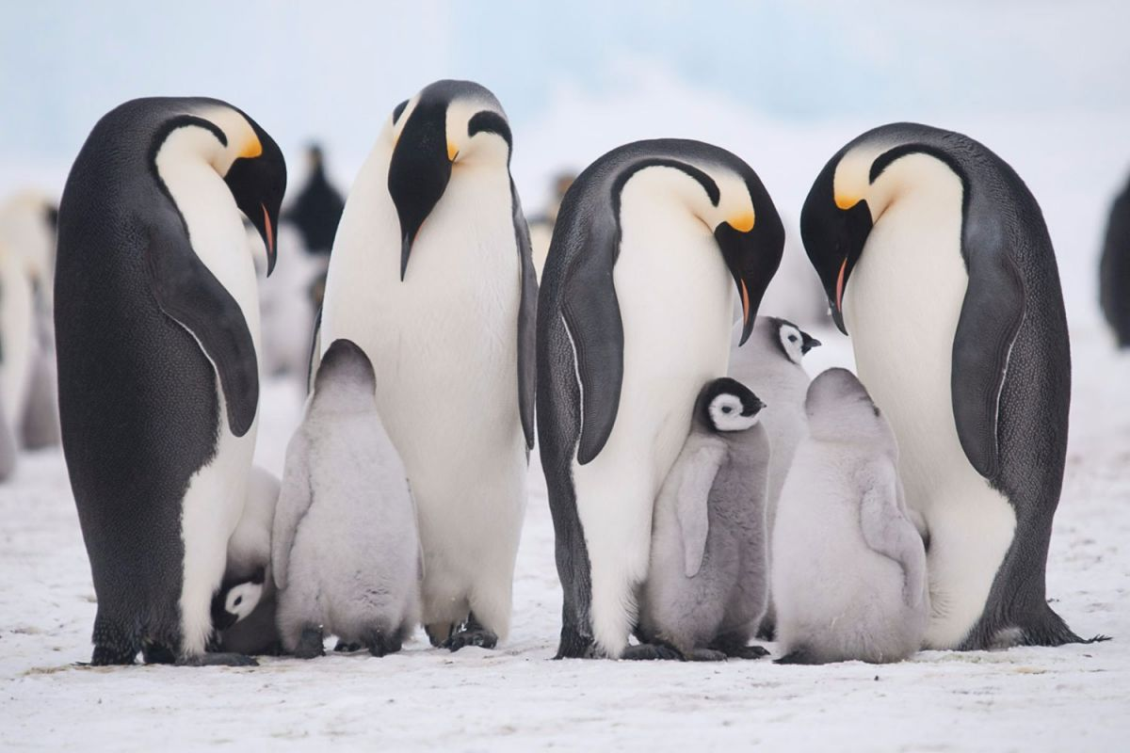
What lives there
Antarctica is the least popular continent. No one lives there permanently. The only creatures that can live there is penguins, seals, whales, sea birds, commerce's dolphins, polar bears and more. There are over 235 animals species that live there.

Slide 4
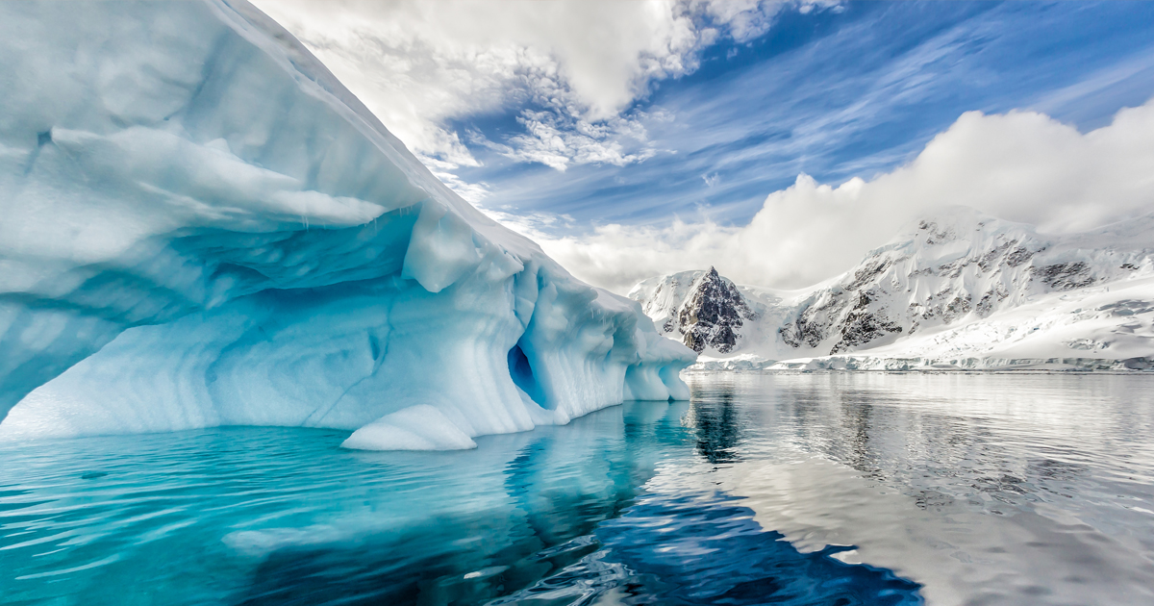
The Ice

