Slide 1
Antarctica
By Alexandra

Slide 2
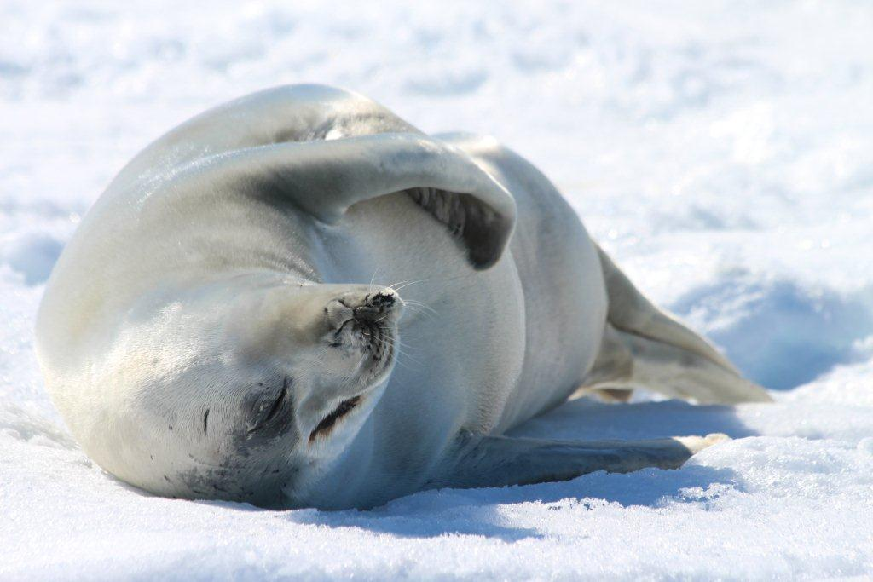
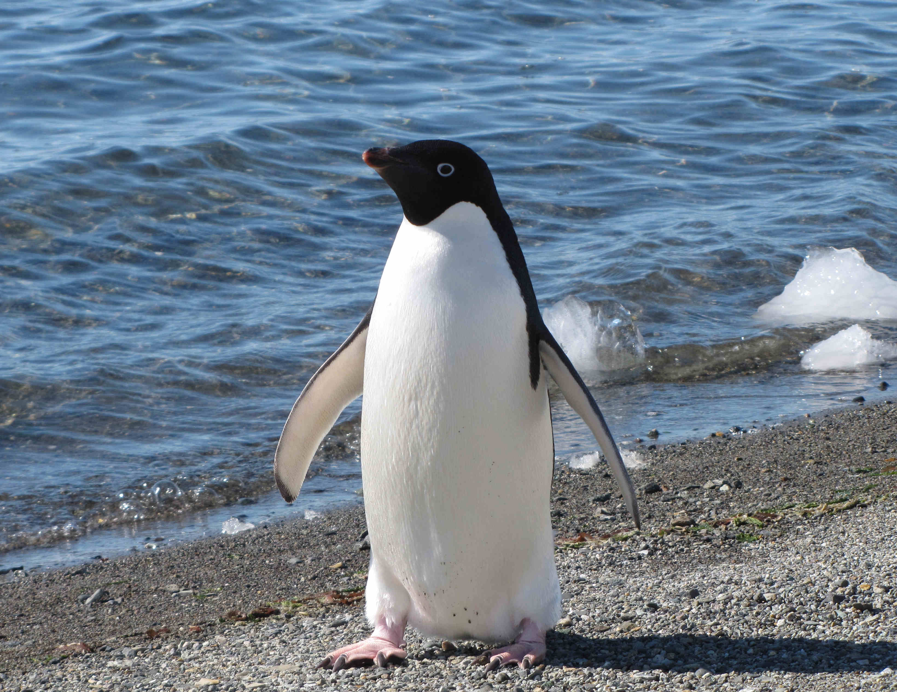
Animals
There are 235 species of animals in Antarctica. Every animal in Antarctica relies on the ice around in Antarctica to survive.
The penguins can dive up to 250m below the surface but mostly go to 10m.The deepest dive ever recorded was by a female emperor penguin. She went 535m.
This Photo by Unknown Author is licensed under CC BY-SA-NC
This Photo by Unknown Author is licensed under CC BY-SA-NC

Slide 3

Covid-19
You might think that Antarctica wouldn’t have covid but people go there for scientific reasons. There are 58 recorded cases there. Way less than England.

Slide 4
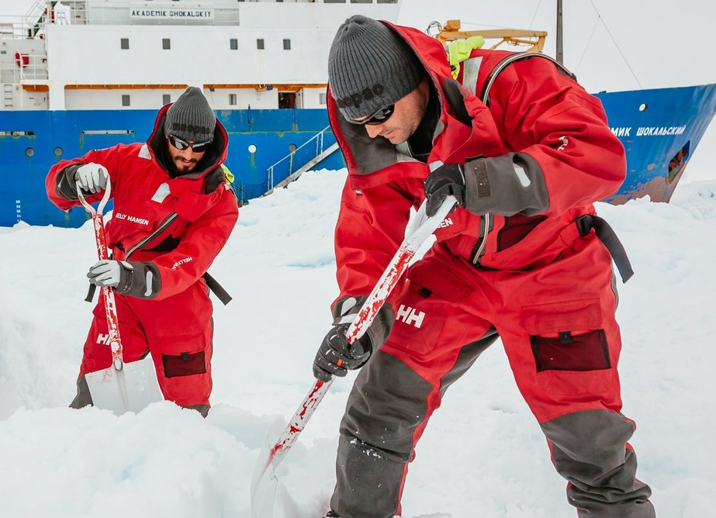
Scientific studies
The main reason people go to Antarctica is for scientific reasons. Scientists from all over the world visit Antarctica to study the climate, weather, geology and wildlife. Their research has helped to highlight global problems, such as climate change.
This Photo by Unknown Author is licensed under CC BY-ND

Slide 5
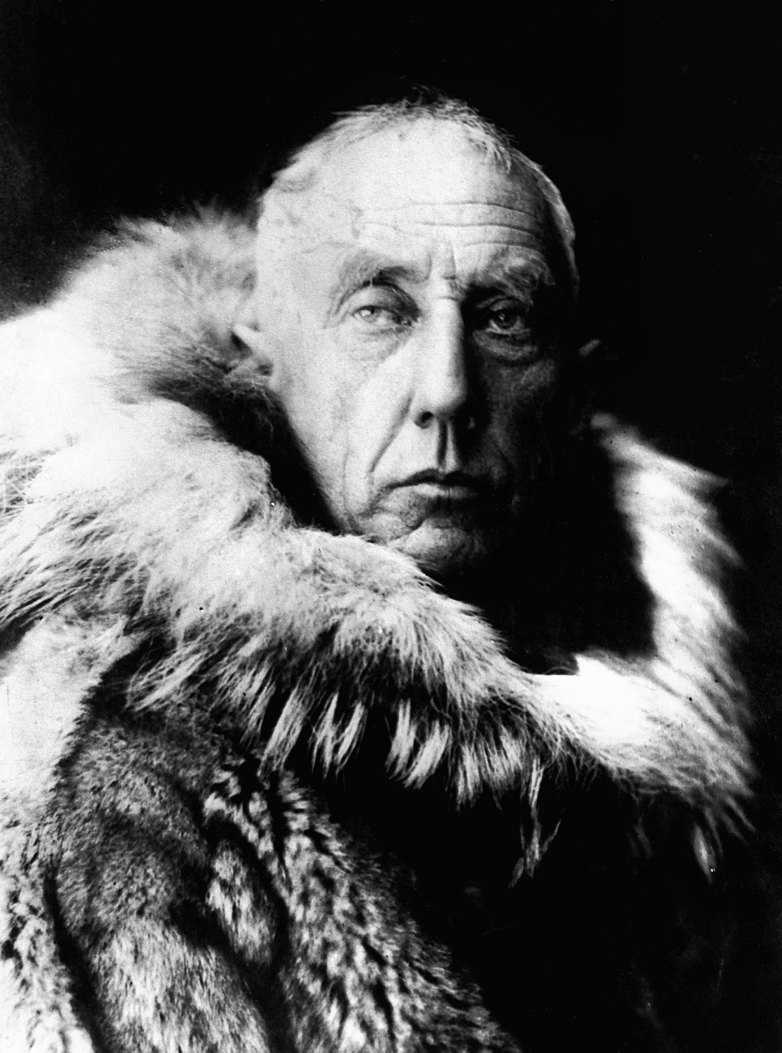
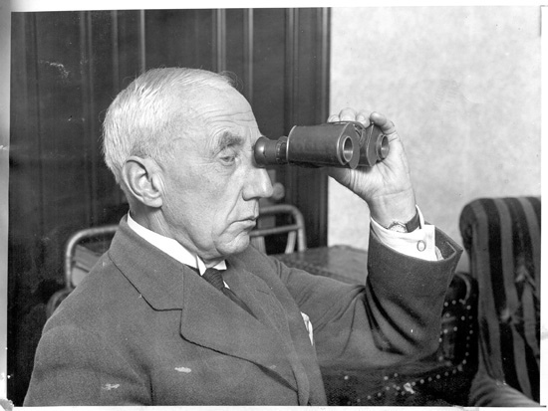
First Ever Person in Antarctica
You might think Captain Scott was the first ever person in Antarctica actually, he was not. On the 14th of December a man named Roald Amundsen and four fellow Norwegian explorers to reach Antarctica. They beat Captain Scott by a month.
This Photo by Unknown Author is licensed under CC BY-SA
This Photo by Unknown Author is licensed under CC BY-SA

Slide 6
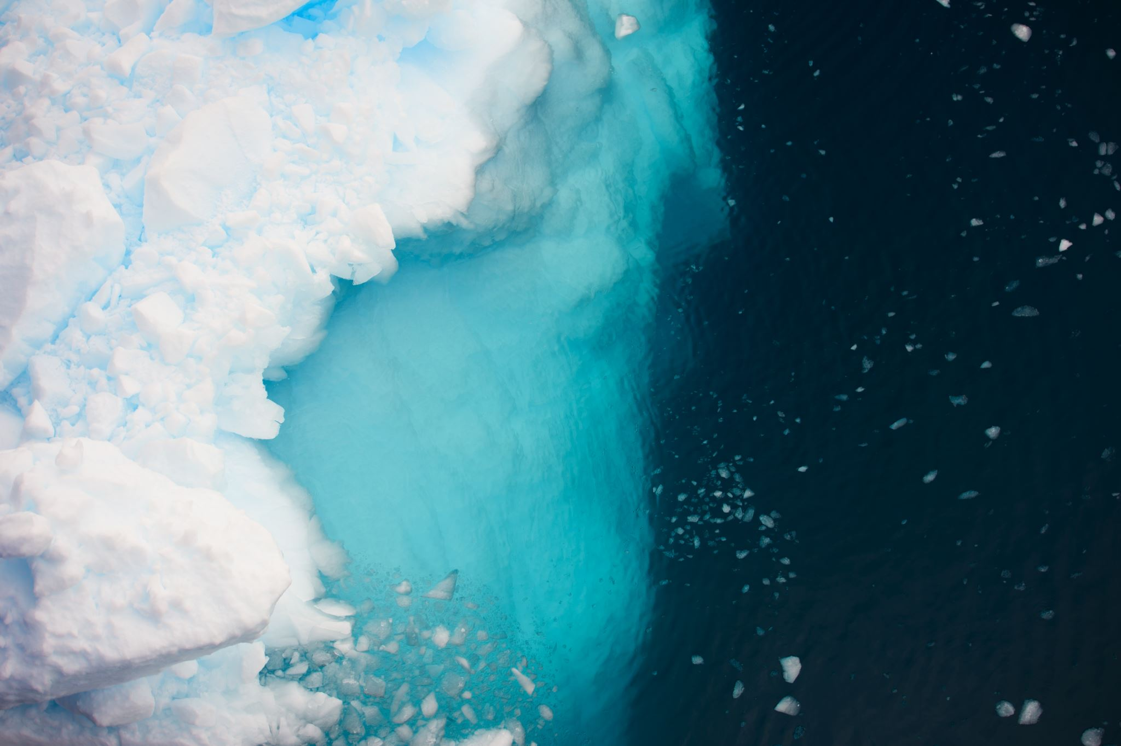
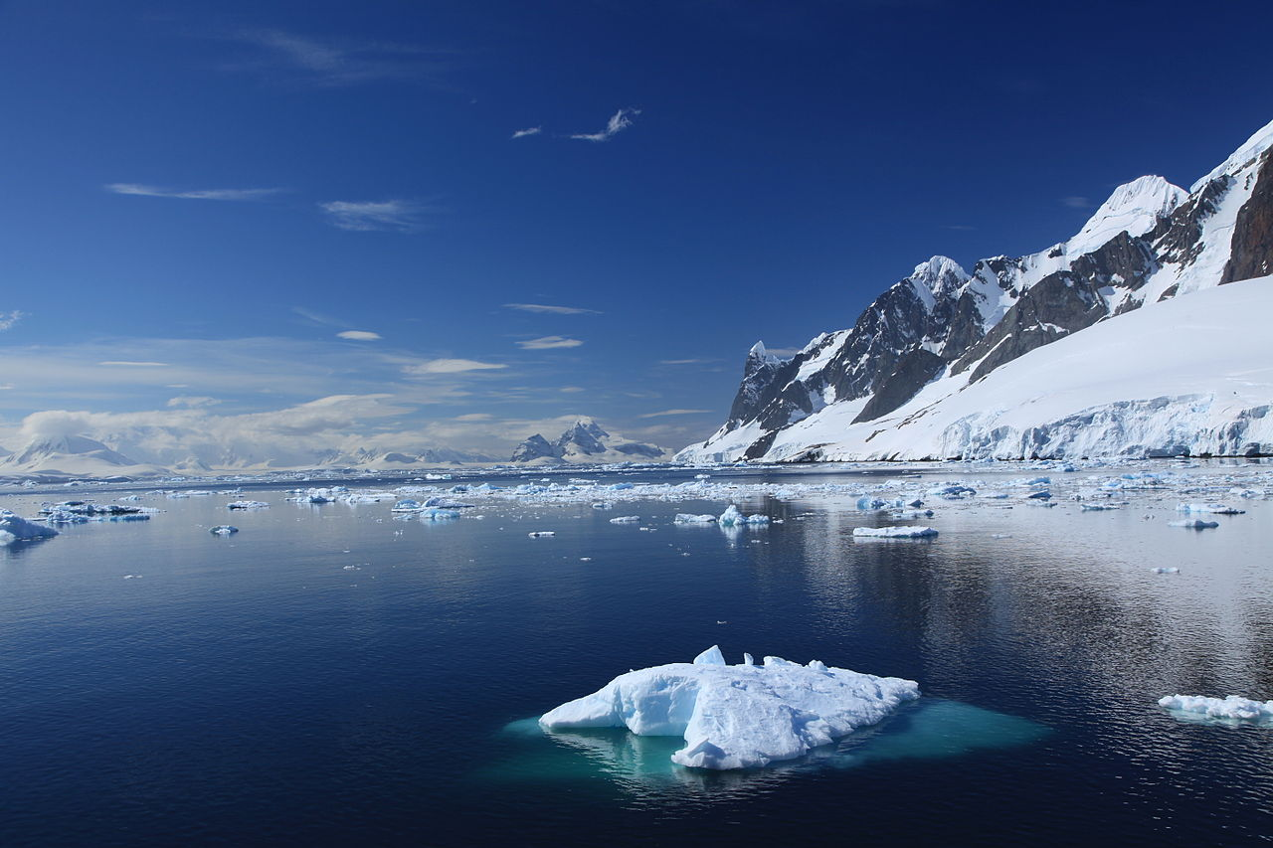
Climate
Antarctica is the coldest continent on Earth. The average temperature in the interior throughout the year is about -57 degrees Celsius, with the minimum temperature being -90 degrees Celsius during the winter season. Although the coast is warmer and temperatures can reach a maximum of between -2 degrees Celsius and -8 degrees Celsius.
This Photo by Unknown Author is licensed under CC BY-SA

