Slide 1
The Arctic!
By Ruby Platt!

Slide 2
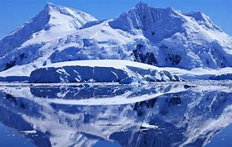
Facts about the Arctic!
The Arctic is a polar region located at the northernmost part of the earth. The Arctic consists of the Arctic Ocean. Land within the Arctic has been seasonally varying snow and ice cover.

Slide 3
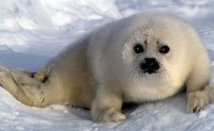
What animals live in the arctic?
There are lots of species that live in Arctic, some nice but some are ruthless. I’d advise you to stay away from them, even if they are cute and cuddly.

Slide 4
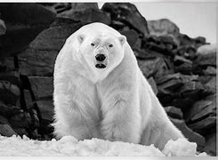
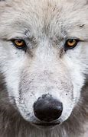
Scary animals!
I don’t think I’m going near these animals any time soon!

Slide 5
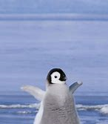
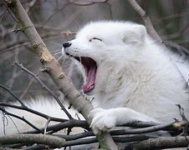
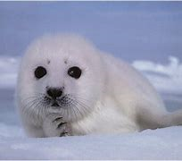
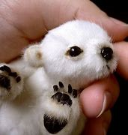
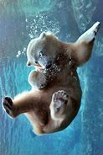
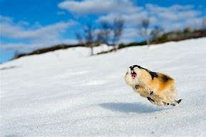
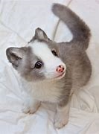
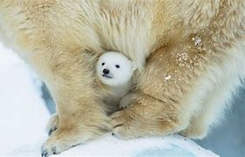
Cute Animals!!!!

Slide 6
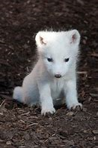
Thank you for listening, I hope you have learned something new today! ☺

