Slide 1
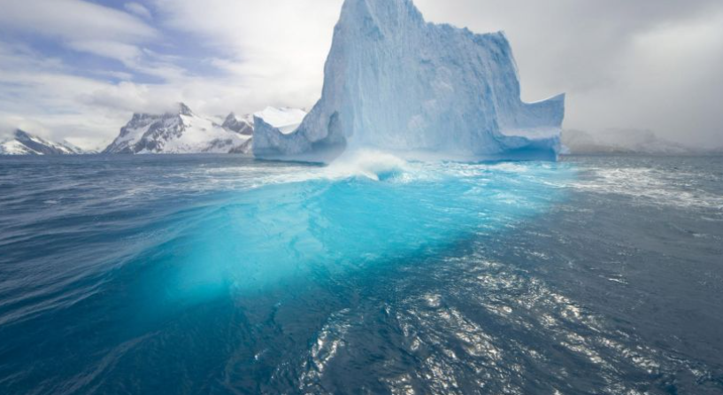
The Arctic
By Phoebe

Slide 2
Introduction
In this Presentation we will cover these topics
Physical Geography
Wildlife
Interview
Fun Facts

Slide 3
Physical Geography

Slide 4
The arctic is also known as the north pole. The arctic itself is a sheet of ice but the continent is mostly land and snow. The Arctic Circle is made up of Finland, Norway, Sweden, Greenland, Russia, Canada and North America.

Slide 5
Wildlife

Slide 6
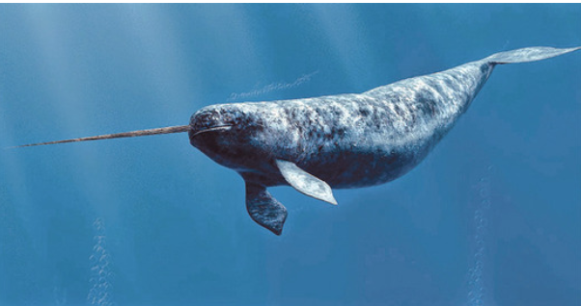
Narwhale
Type: Mammal
Diet: Carnivore
Size: 13-20 Feet

Slide 7
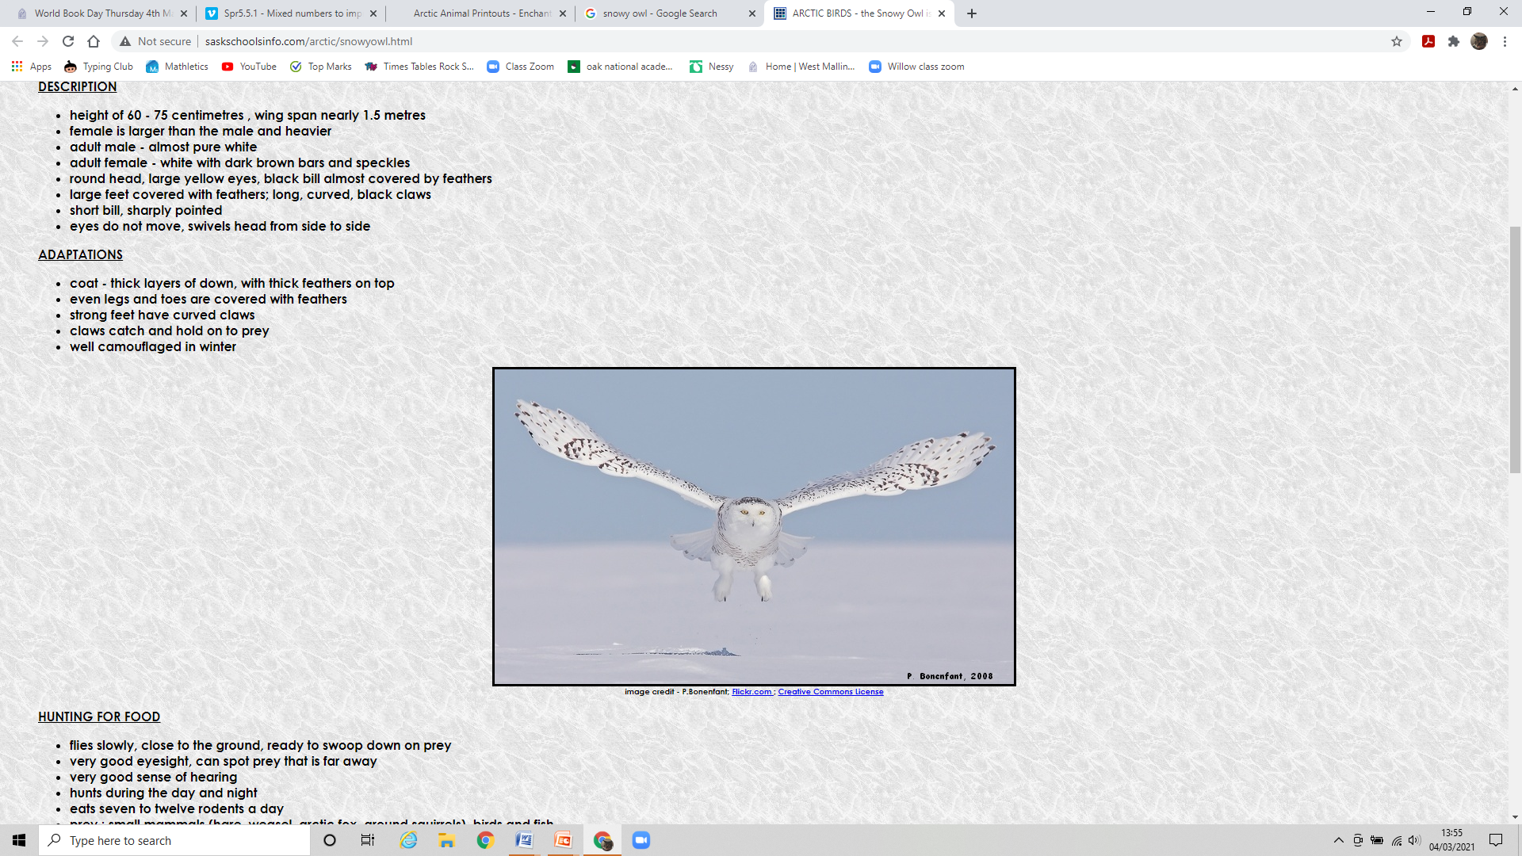
Snowy Owl
Type: Bird
Diet: Carnivore
Size: 63-73 cm

Slide 8
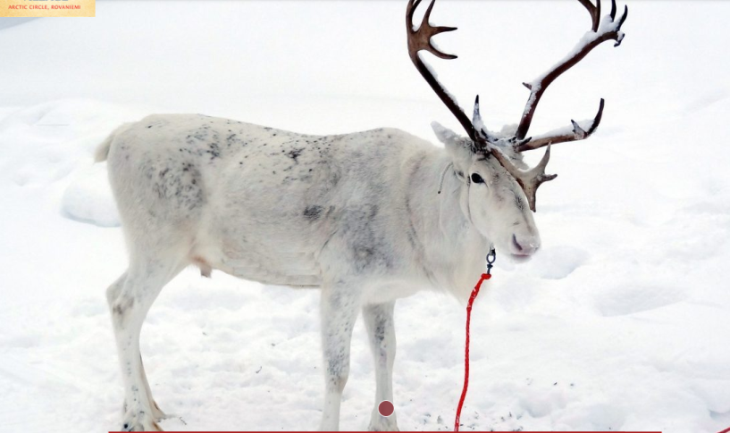
Arctic Reindeer
Type: mammal
Diet: Herbivore
Size: 5.3-6.3 Feet

Slide 9
Interview
With somebody who`s been to the arctic circle

Slide 10
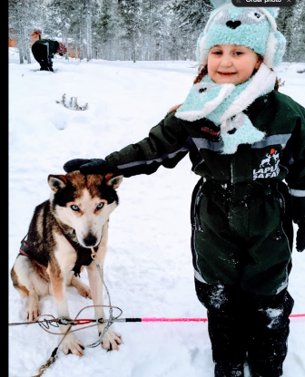
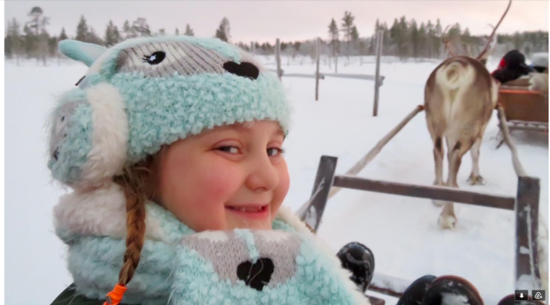
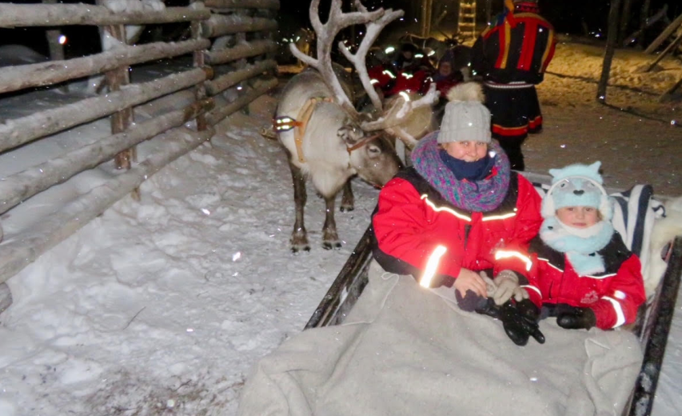
Interview with Phoebe Boyer ( me )
How cold was it?
It was between -5 –24 degrees.
What time of year did you go in?
I went in the December solstice so the sun never rose above the Horizon.
What did you see?
Santa, Huskies, Reindeers and lots of snow.

Slide 11
Fun facts
Scientific interest

Slide 12
Reasons for study in the Arctic
The state of the ocean
State of ice
  Climate Change
Study of feeding frenzy
  In the summer any creatures stuck in glaciers will come out so Marine life eat them
  And there`s normally a lot

