Slide 1
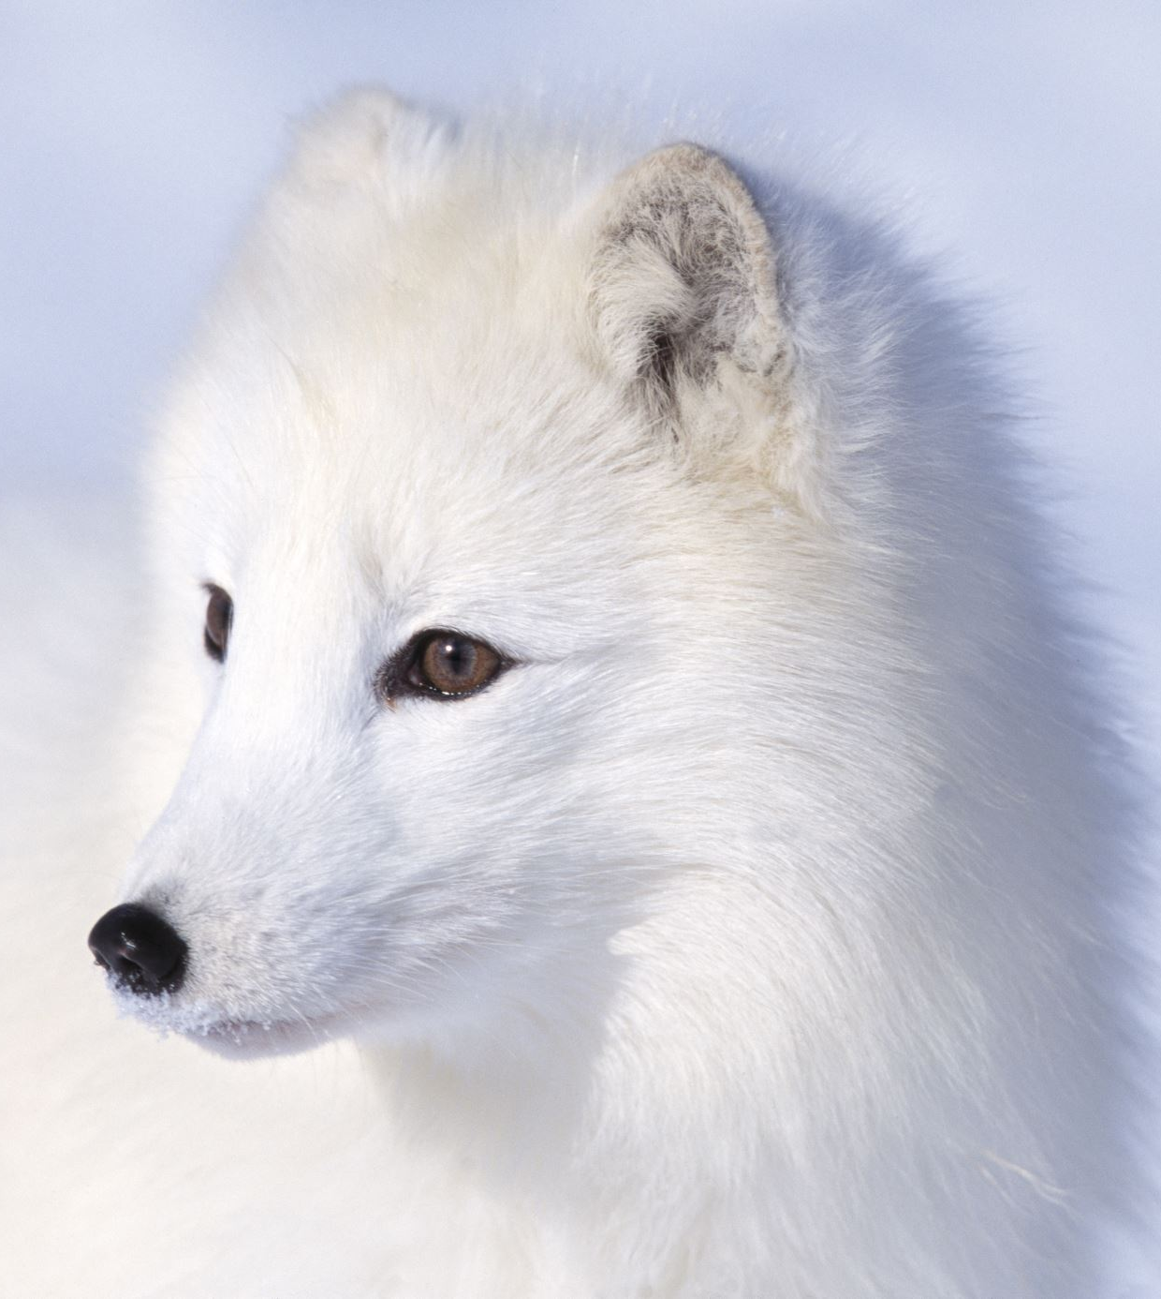
Arctic
Emily

Slide 2
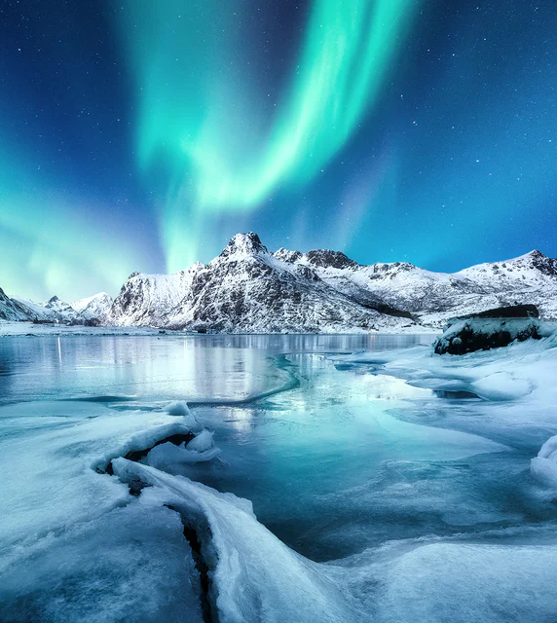
The Arctic
The Arctic is located at the north part of our planet and is covered by ice and snow.
The Arctic also consists of parts of Canada, Russia, The USA, Greenland, Norway, Finland, Sweden and Iceland.
The arctic is surrounded by the Arctic Ocean.

Slide 3
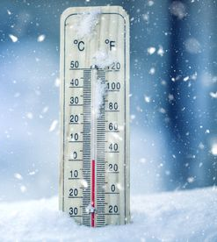
Climate
The average winter temperature can can as low as -40 degrees Celsius. The coldest temperature recorded is -68 degrees celcius. In the summer the average temperature is 10 degrees celcius.

Slide 4
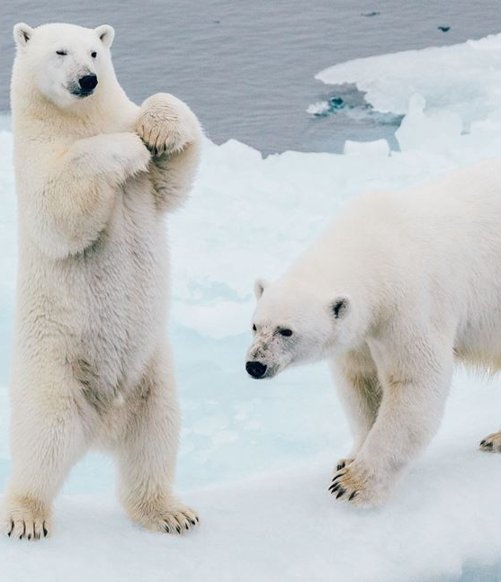
Animals in the Arctic
Animals that live in the Arctic include polar bears, seals and Arctic foxes.

Slide 5
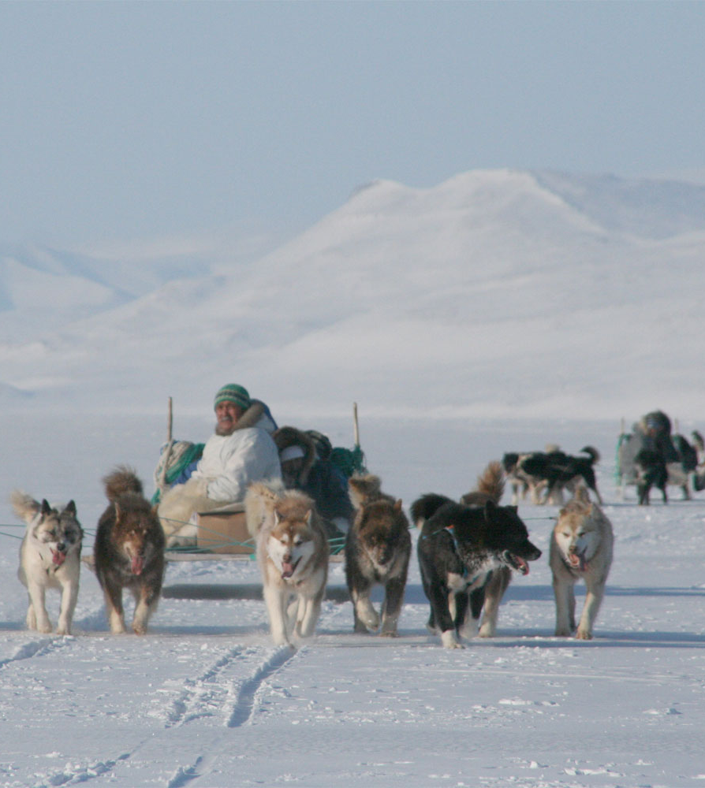
Arctic facts
Around 4 million people live in the Arctic
For at least one day a year there is entire darkness.
Some parts of the Arctic have small flowers that grow in the summer.

