Slide 1
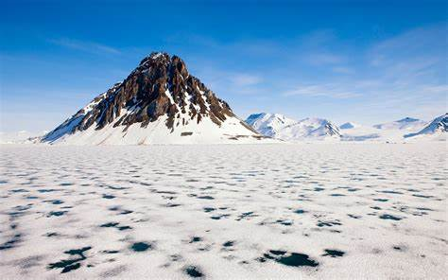
Arctic facts

Slide 2
Where to find Arctic
The Arctic is located on the northern most part of our Planet. Scientists usually define this area above the arctic circle as an imaginary line that circles around the top of the globe.

Slide 3
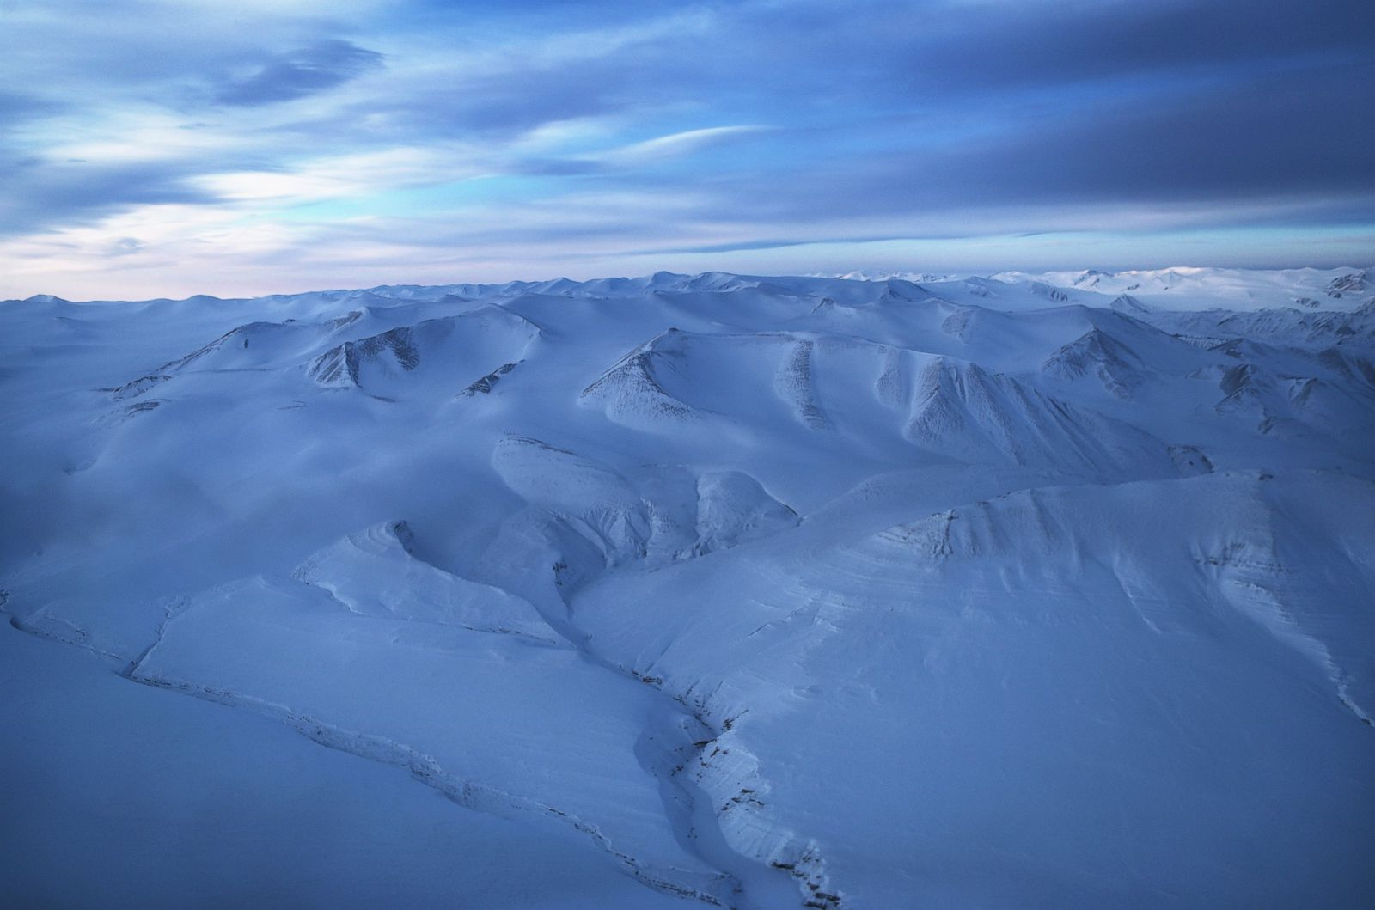
The arctic consists of the Arctic Ocean and parts of Canada , Russia , the USA , Greenland, Northway , Finland , Sweden and Iceland.

Slide 4
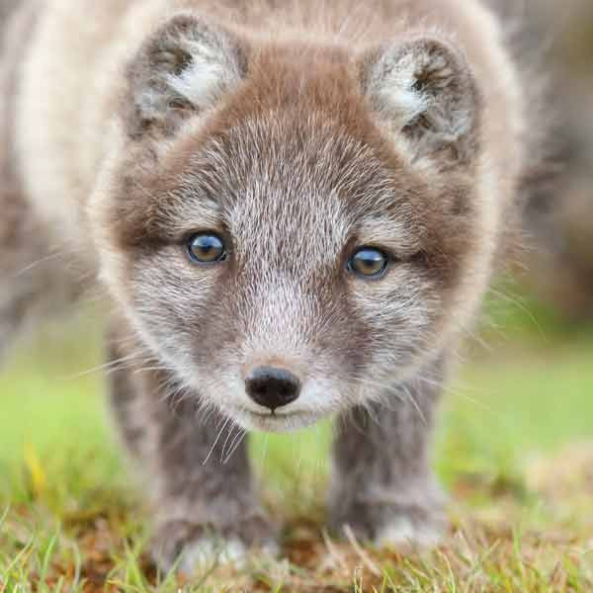
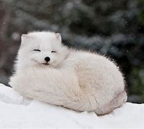
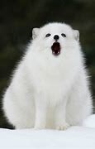
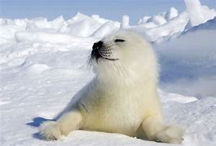
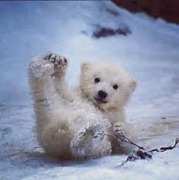
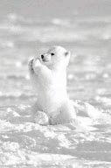
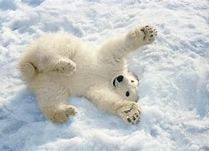
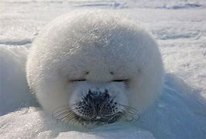
These animals are cute on the outside, but mean on the inside!

Slide 5
Interesting facts about the arctic…mmm?!
Despite the freezing-cold temperatures, approximately four million people call this wintery wonderland home! Amongst these are the indigenous people of the Arctic, called the ‘Inuits‘. They’ve found ingenious ways to survive in one of the harshest environments on our planet.

Slide 6
THE END

