Slide 1
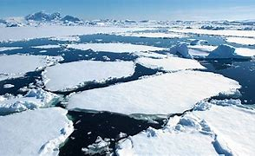
The Arctic
By Jack

Slide 2
Arctic facts
.Temperature as low as 70% have been recorded in northern Greenland brrrrr!
. There’s one day which doesn’t have a night and there’s a day with no light.

Slide 3
Funny facts
.If a bird poos in the sea it makes the waters warm and cool
.if you look at space you can see a trail of penguin poo

Slide 4
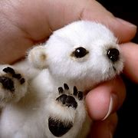
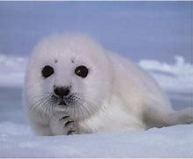
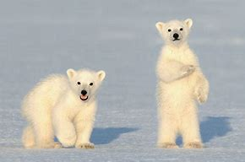
Cute animals

Slide 5
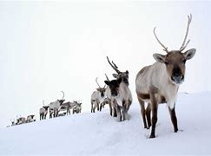
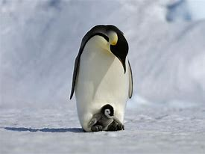
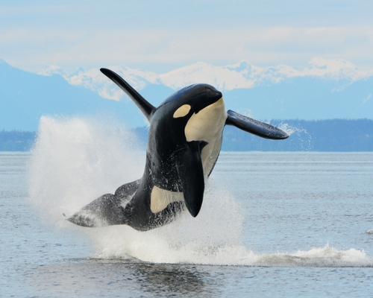
My favourite animals in the artic

Slide 6
The End

