Slide 1
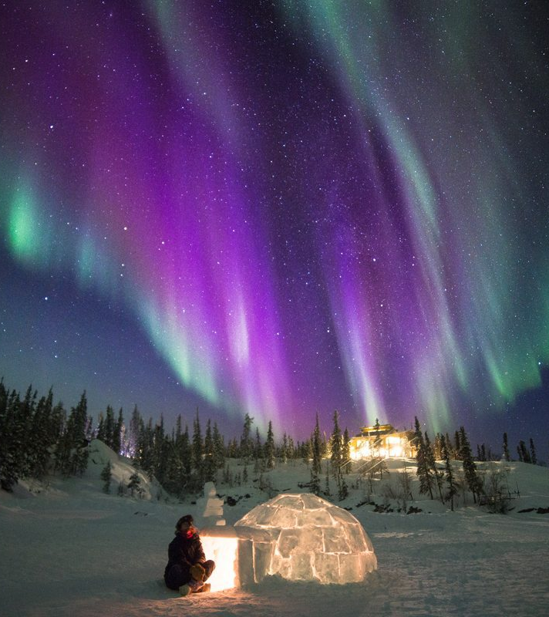
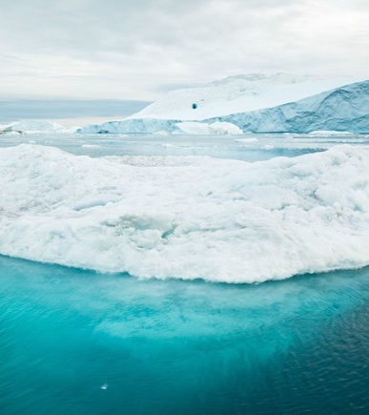
Arctic

Slide 2
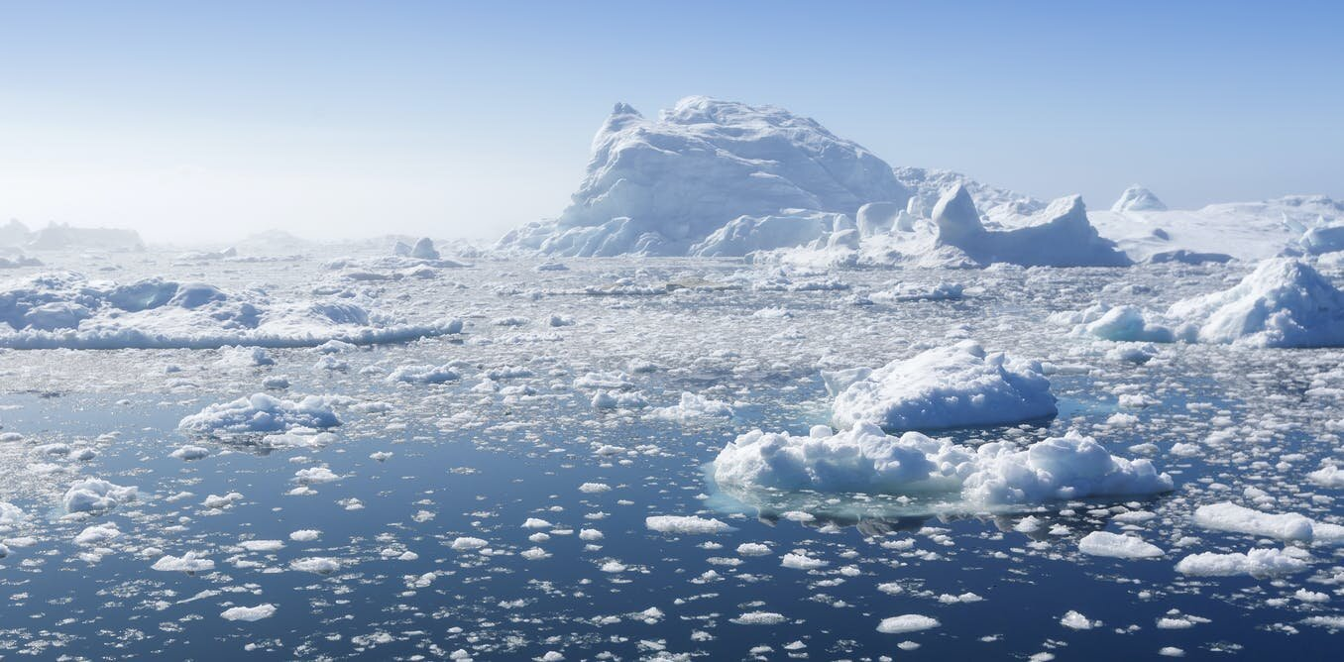
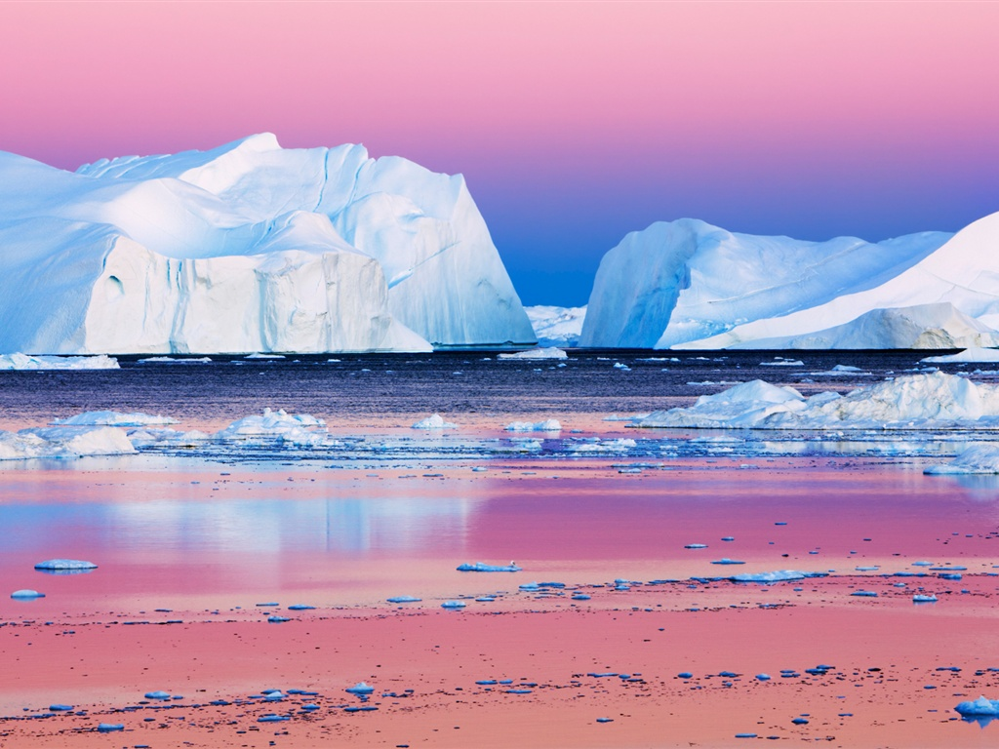
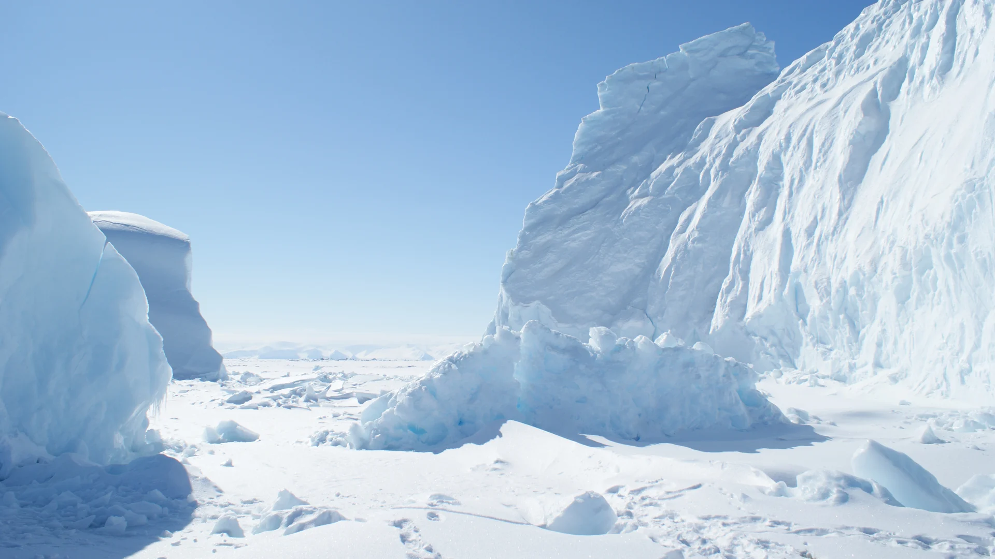
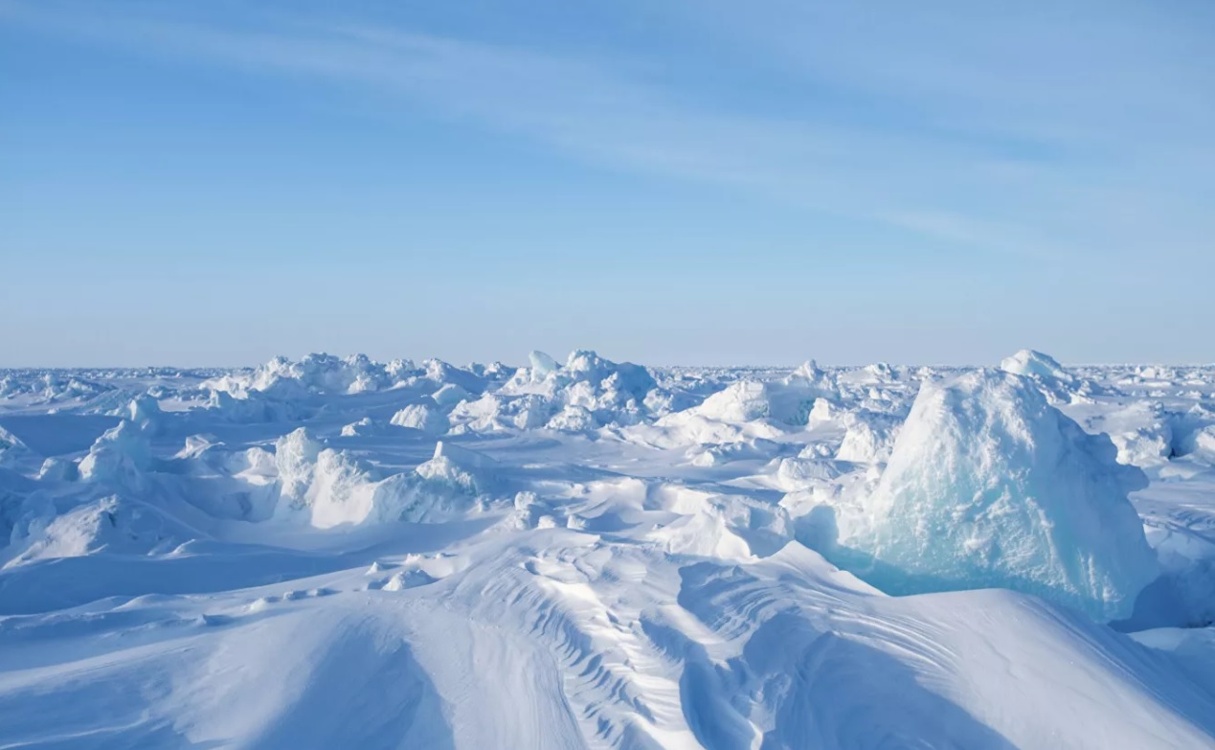
Arctic Facts!
The artic has parts of Russia, Canada, Usa, Greenland, Norway, Sweden, Finland and Iceland
Temperatures can get to -70 degrees
The Arctic has wild life such as Polar Bears, Arctic Foxes, Walruses, Seals, Whales and Narwhales
The ice of the Artic contains about 10% of the worlds fresh water
The Arctic is located at the Northern most part of our planet

Slide 3
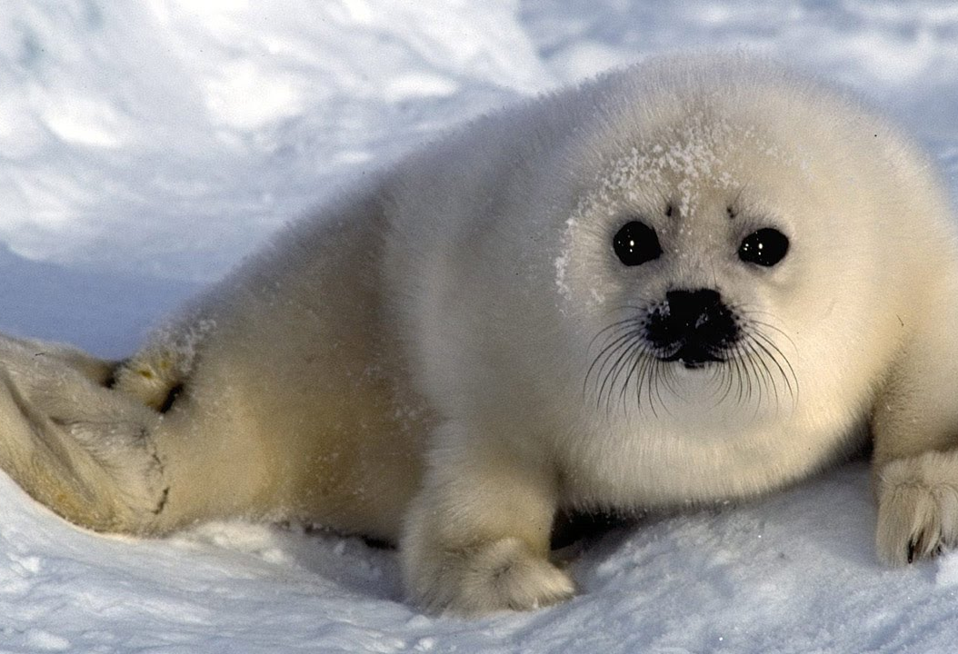
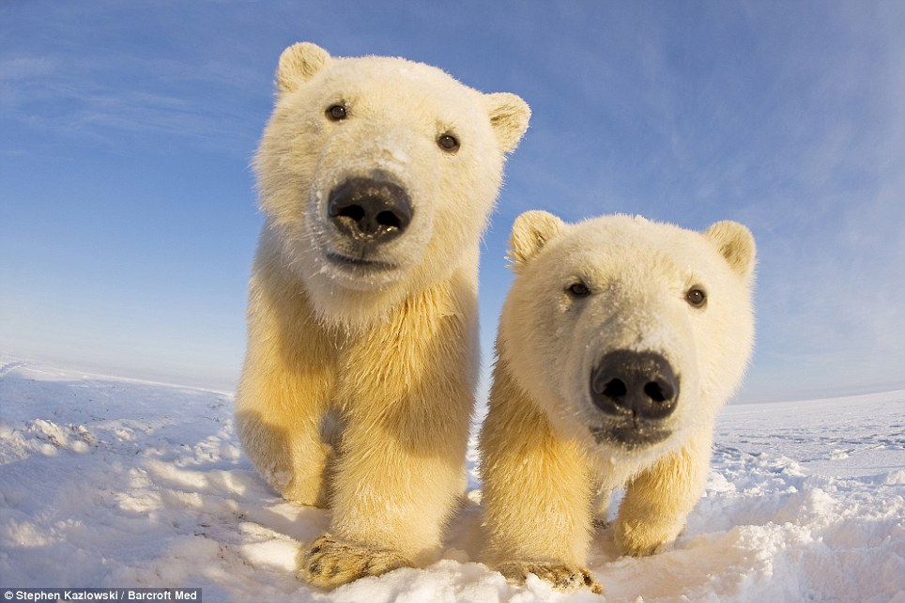
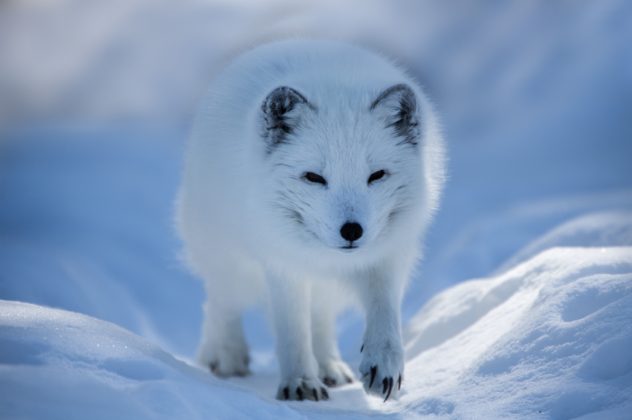
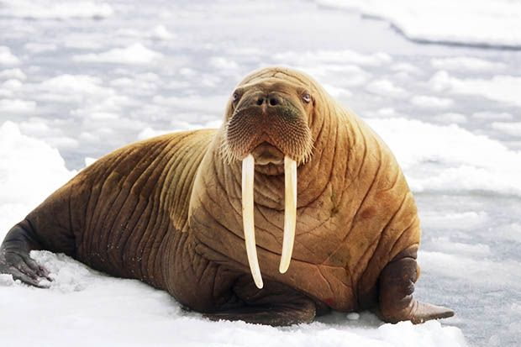
Arctic Animal facts
Walruses can weigh up to 1,700kg
The Arctic fox has incredible sense of smell
The longest humpback whale was 14 meters long with a weight of around 36 tons!
The Harp Seal can stay underwater for 15 minutes!
The Polar Bear is one of the strongest Arctic Animals

