Slide 1
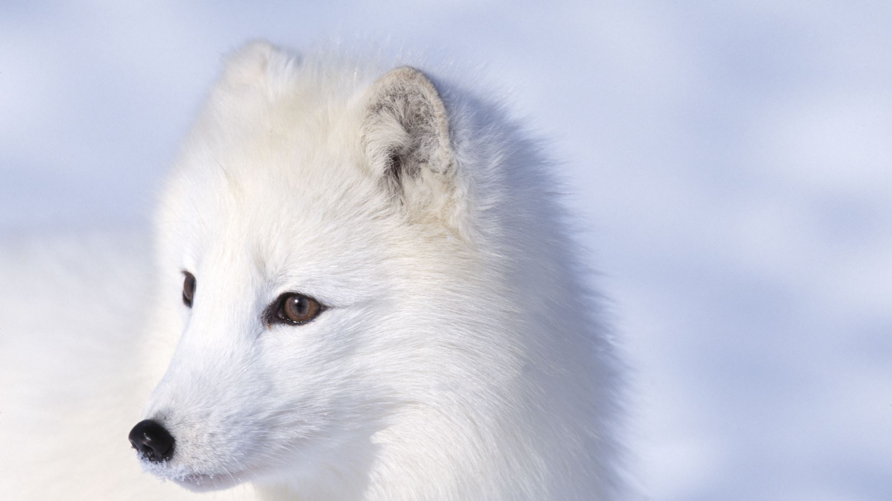
ARCTIC
By Hannah

Slide 2
Arctic
The Artic is the Earth’s northern tip, here and the southern tip are the coldest places, where temperatures can fall as low as -85%C.
With an area of 15,100,000 sq km , it is the smallest ocean on the planet.
The waters are mainly covered in ice.

Slide 3
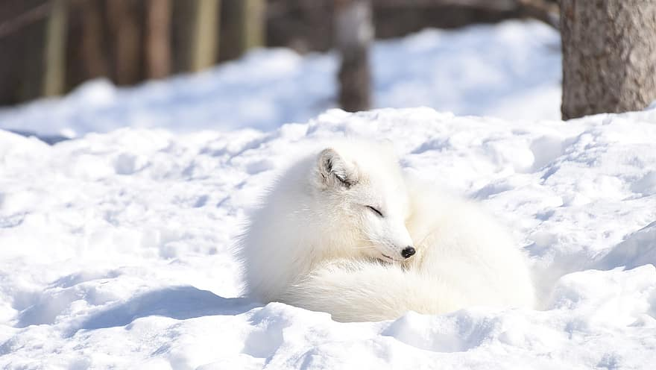
This is a Arctic fox, other animals found are polo bear , beluga whale and seals.

Slide 4
Arctic
Even though it has a harsh climate people do live there.
These people make their living from herding, hunting and fishing.
There are stocks of cod , plaice and haddock in unfrozen arctic waters, but numbers have fallen over the years.
There are mines and wells in the coastal regions, but these cause pollution and threaten the area’s unique wildlife.
It’s expensive to mine here

Slide 5
One fact about Arctic.
The Arctic is surrounded by lots of countries .

Slide 6
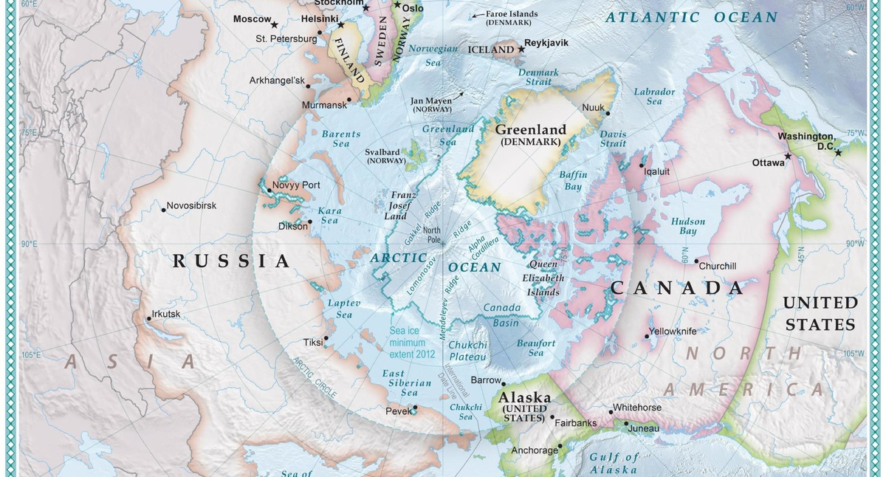
This Photo by Unknown Author is licensed under CC BY-SA

Slide 7
The end

