Slide 1
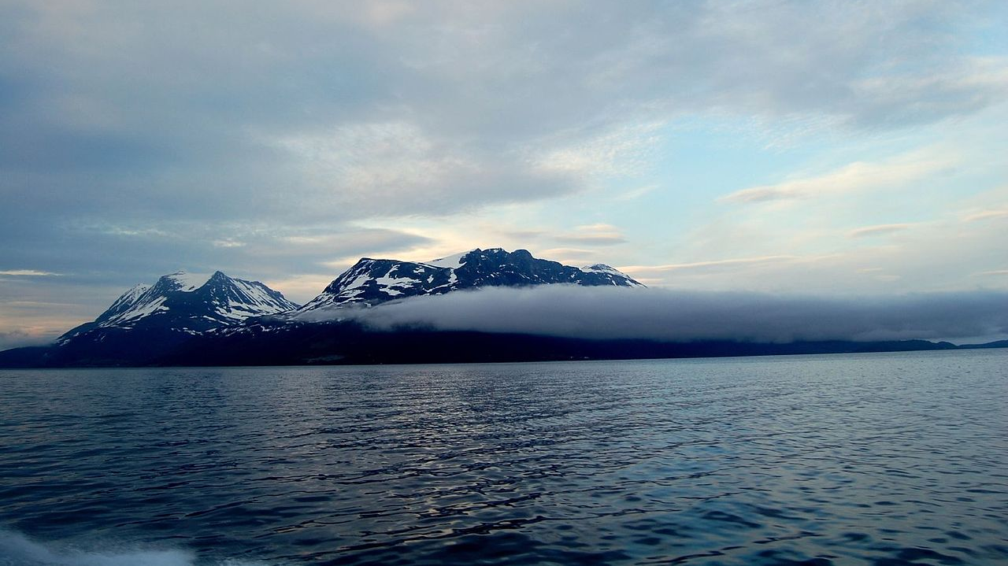
The Arctic
By Freddie

Slide 2
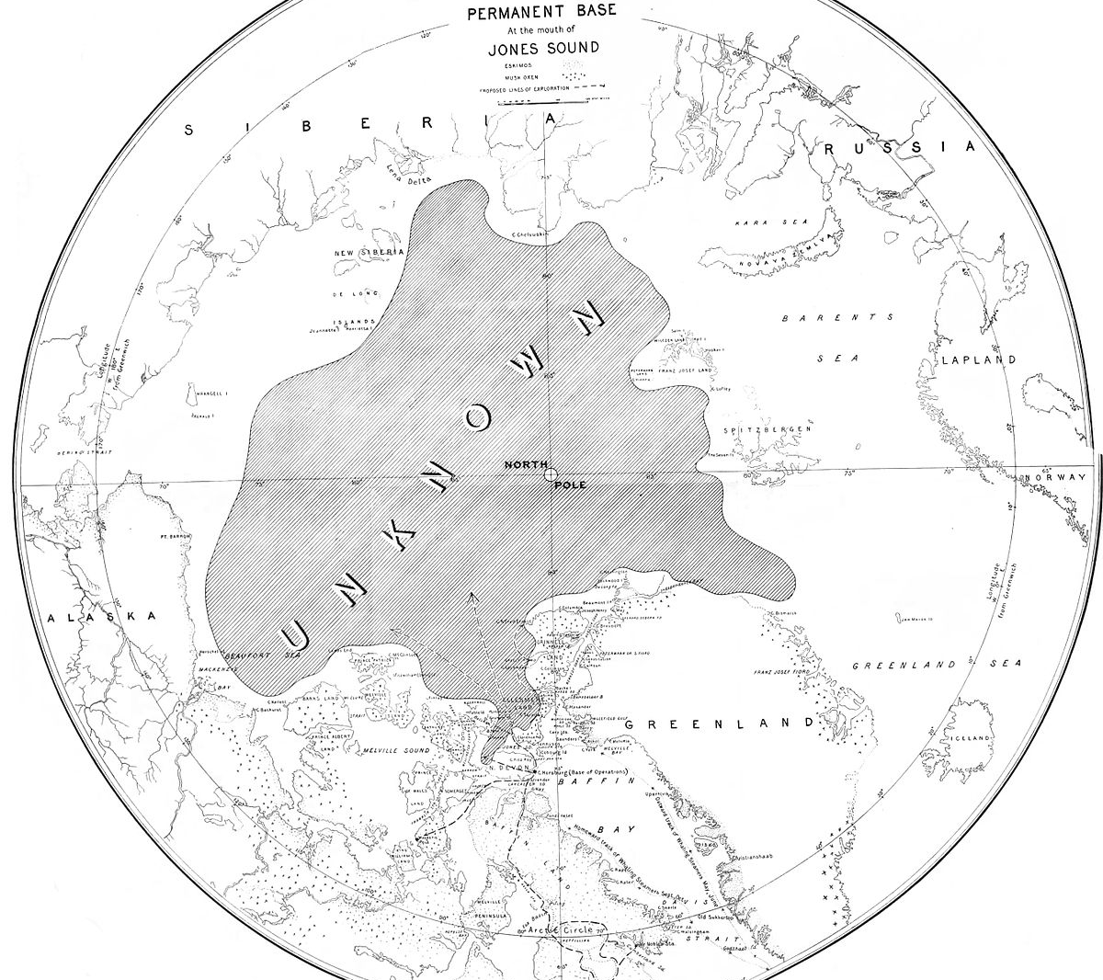
Where is it?
The Arctic is the most northern region of Earth. Most scientists define the Arctic as the area within the Arctic Circle. The Arctic includes parts of Russia, Alaska, Canada, Greenland, Lapland and Svalbard as well as the Arctic Ocean.

Slide 3
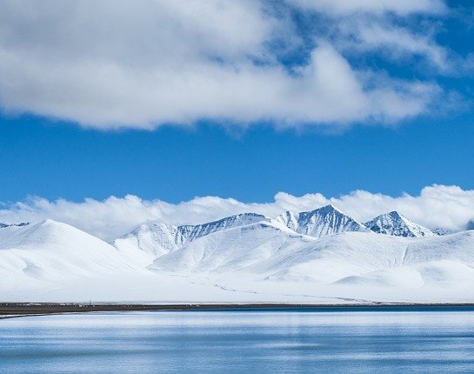
What is it?
The Arctic is a polar region located at the top of the earth. It is the opposite to the Antarctic located at the bottom of the world in the south pole.

Slide 4
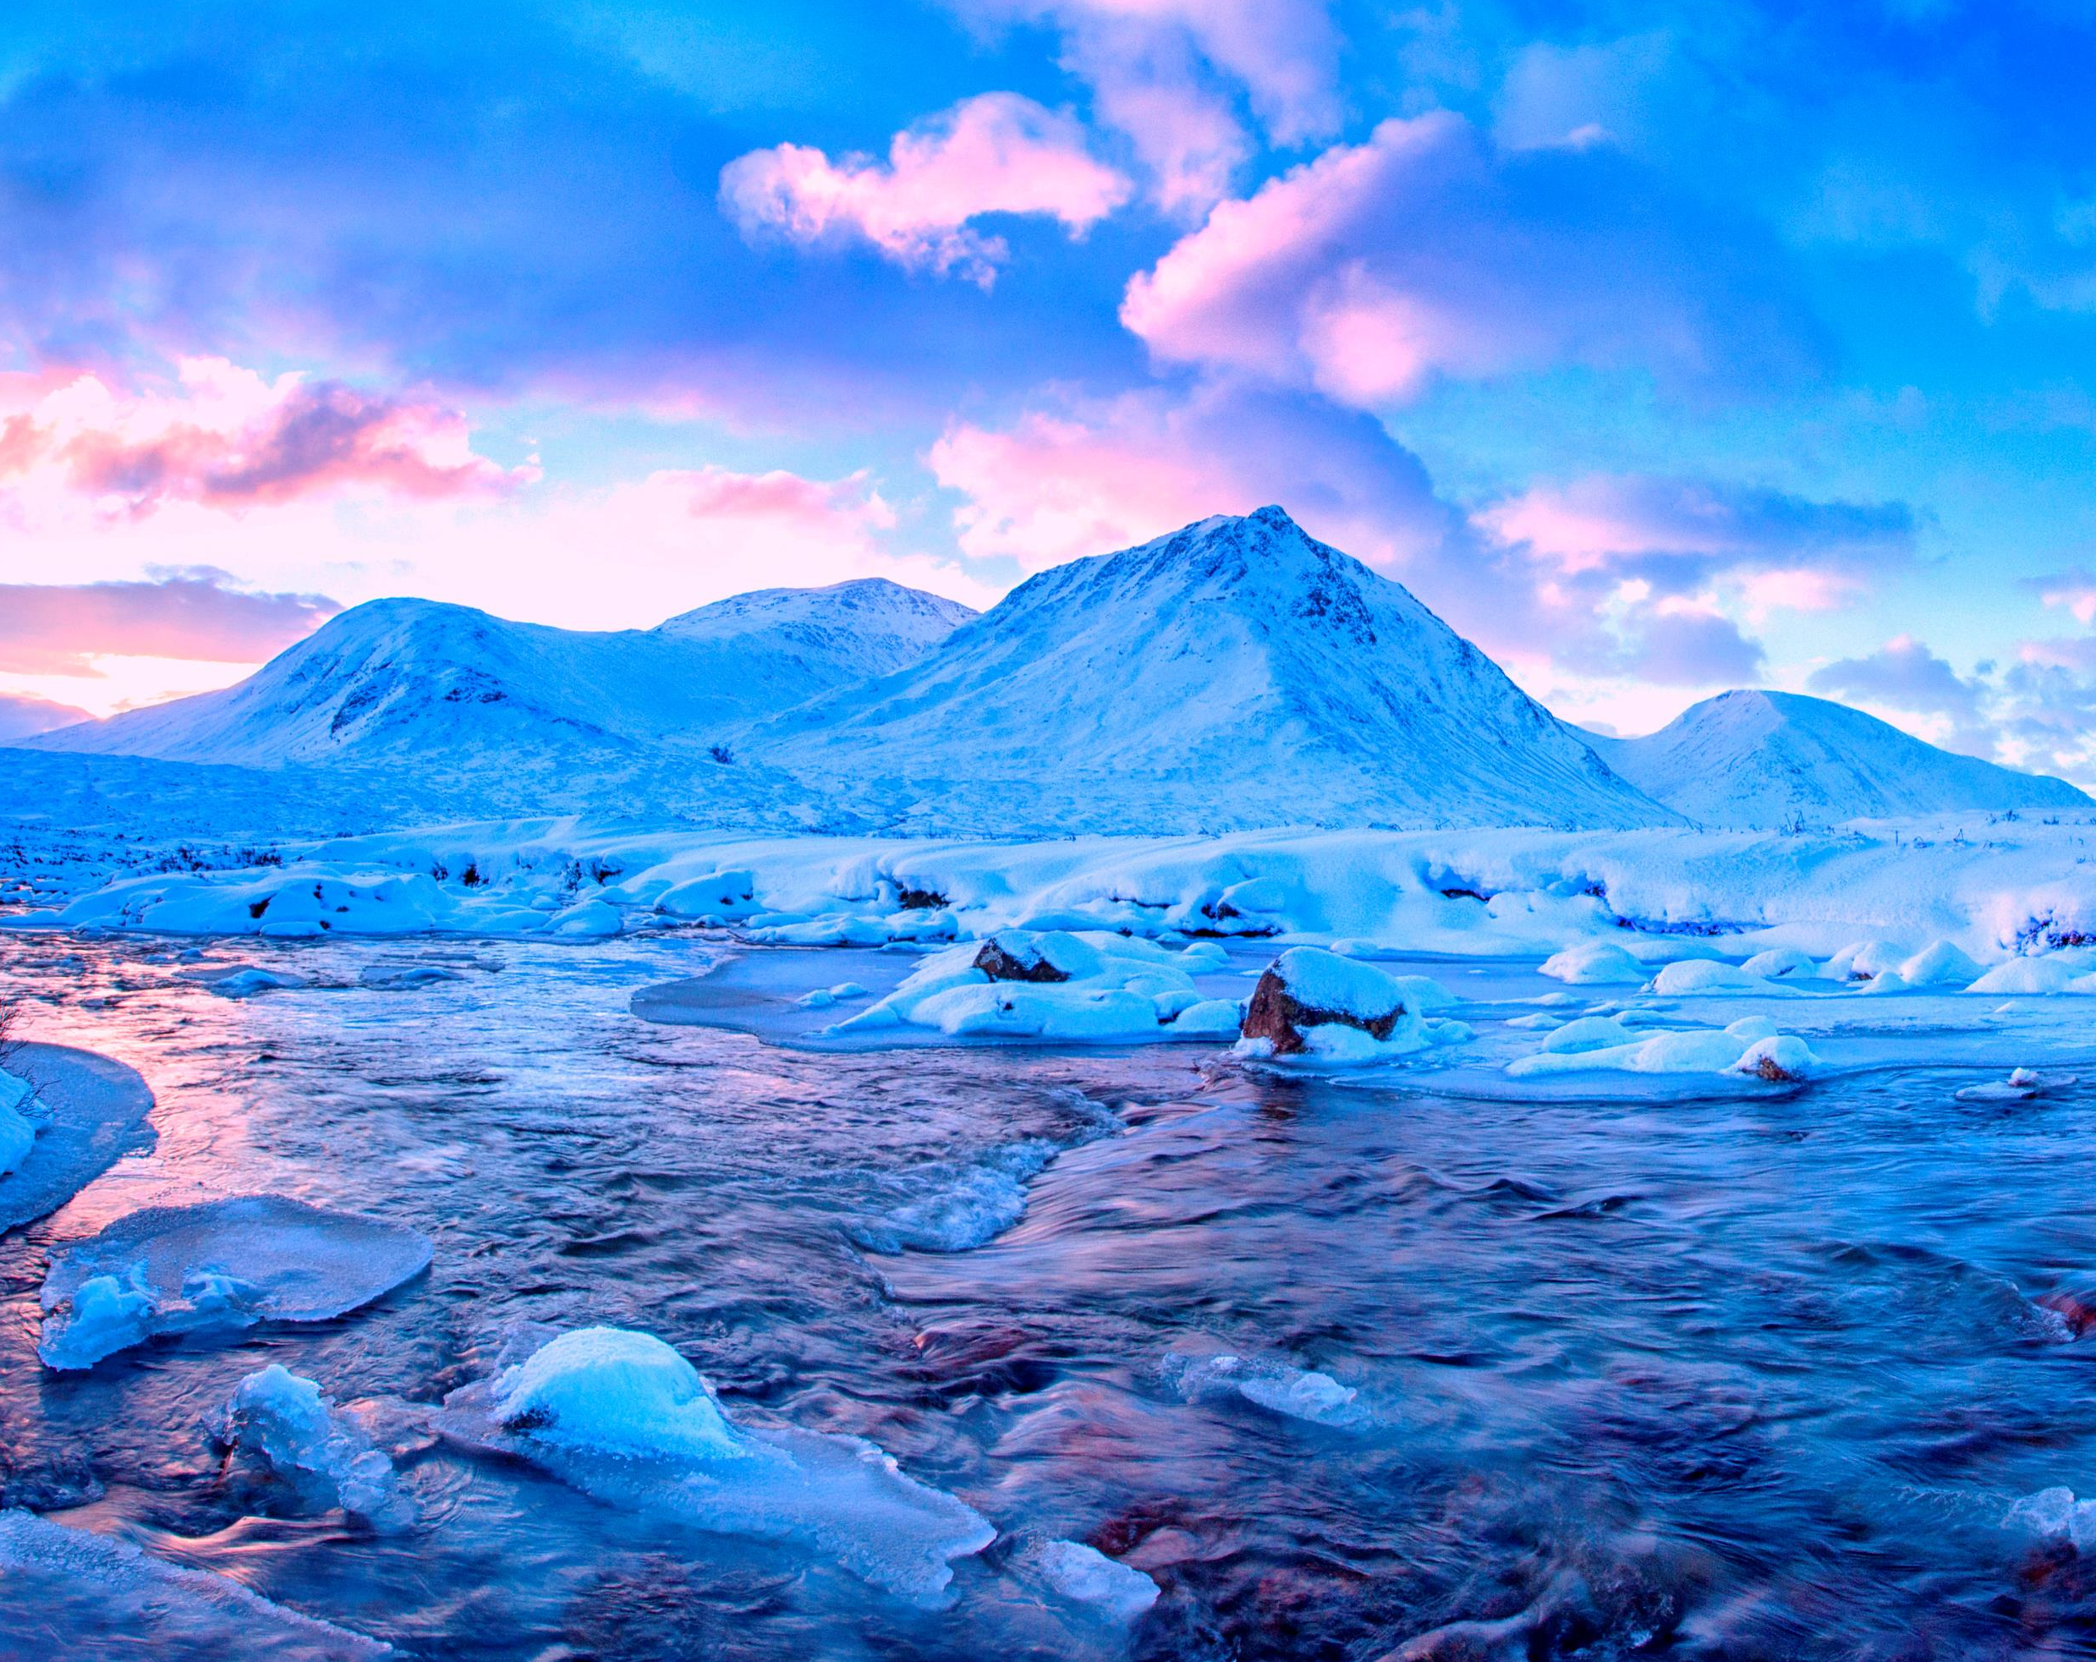
What is the weather like?
The climate of the Arctic is characterized by long, cold winters and short, cool summers. The Arctic consists of ocean that is largely surrounded by land. As such, the climate of much of the Arctic is moderated by the ocean water, which can never have a temperature below −2 °C

Slide 5
What lives there?
Polar bear
Walrus
Musk ox
Arctic wolf
Svalbard reindeer
Bearded seal
Arctic fox
Arctic hare

Slide 6
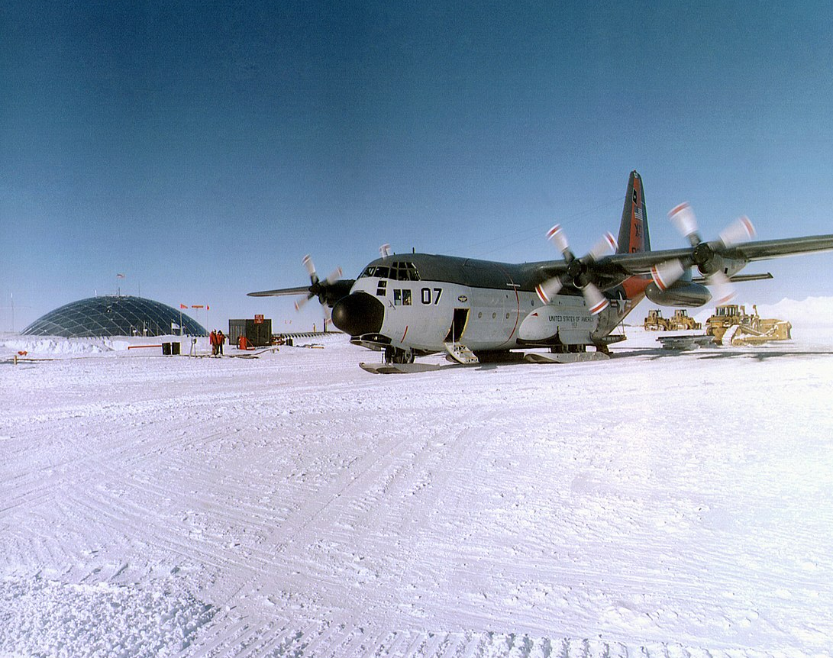
Who was the first person to explore it successfully?
Robert Peary
On April 6, 1909, Robert Peary claimed to be the first person in recorded history to reach the North Pole. He traveled with the aid of dogsleds and three separate support crews who turned back at successive intervals before reaching the Pole

Slide 7
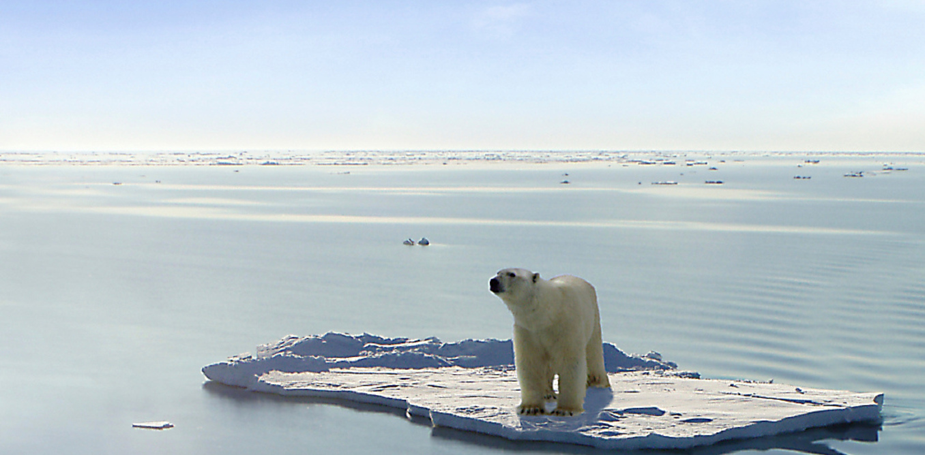
Fun Facts that you didn’t know about the arctic
Bird poo helps keep the area cool.
The Arctic comes to life during the Winter.
It’s home to the biggest, most secure seed storage facility
The first man to reach the North Pole was overlooked for decades
4 million people live there
There is an Intergovernmental Arctic Forum between Arctic states where they come together on common issues such as sustainable development and environmental protection
The word Arctic is derived from the Greek word Arktos
The Arctic Ocean is the world’s smallest Ocean
The North Pole is much warmer than the South Pole.

