Slide 1
The Arctic/ The North Pole
By Alexandra

Slide 2
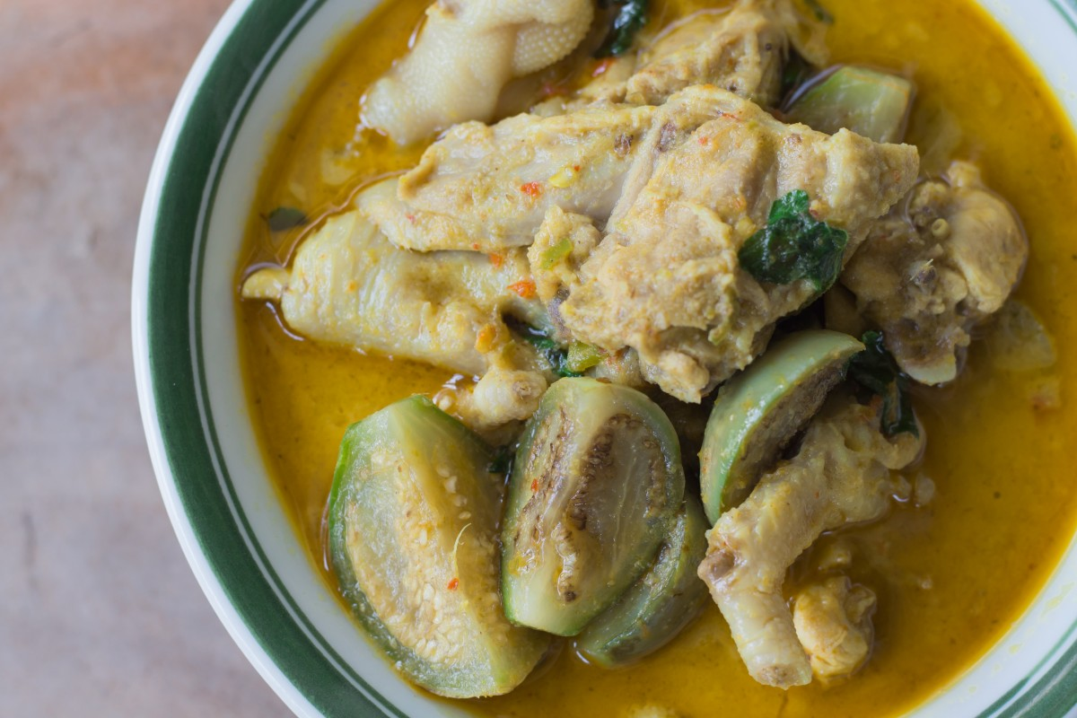
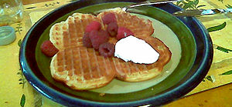
Food
Here are a few dishes that people eat in the Arctic. Lapskaus is a type of Norwegian stew. It is made with meat, potatoes and other vegetables. Vaffelkake is waffles often in the shape of a heart and served with jam. Reindeer, Snow Hares and Ptarmigan bird are a few more dishes.
This Photo by Unknown Author is licensed under CC BY-SA

Slide 3
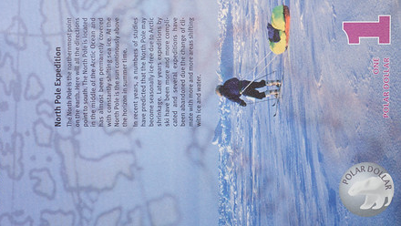
Currency
The Arctic currency is the Polar Dollar.
This Photo by Unknown Author is licensed under CC BY-NC

Slide 4
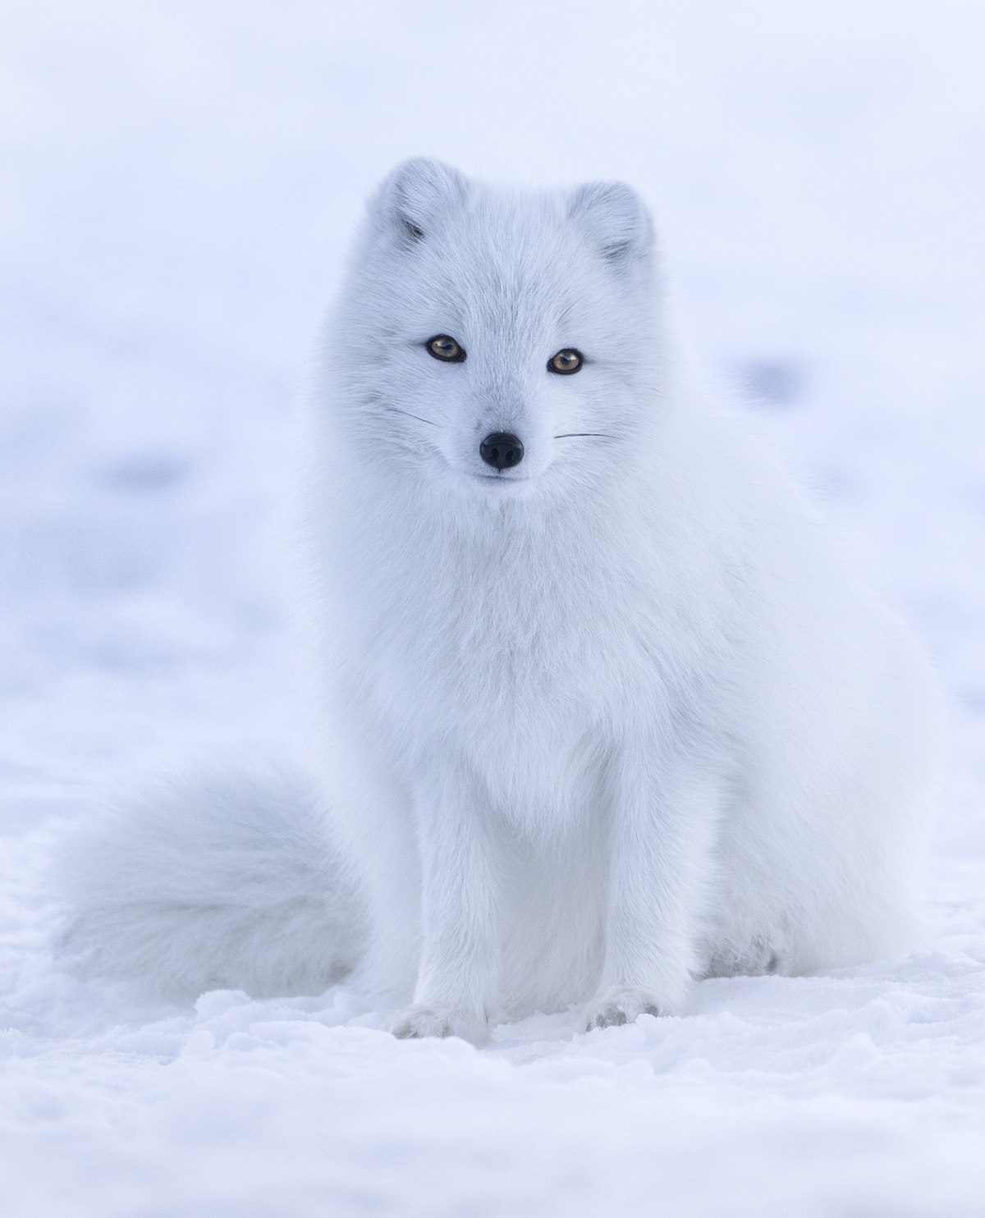
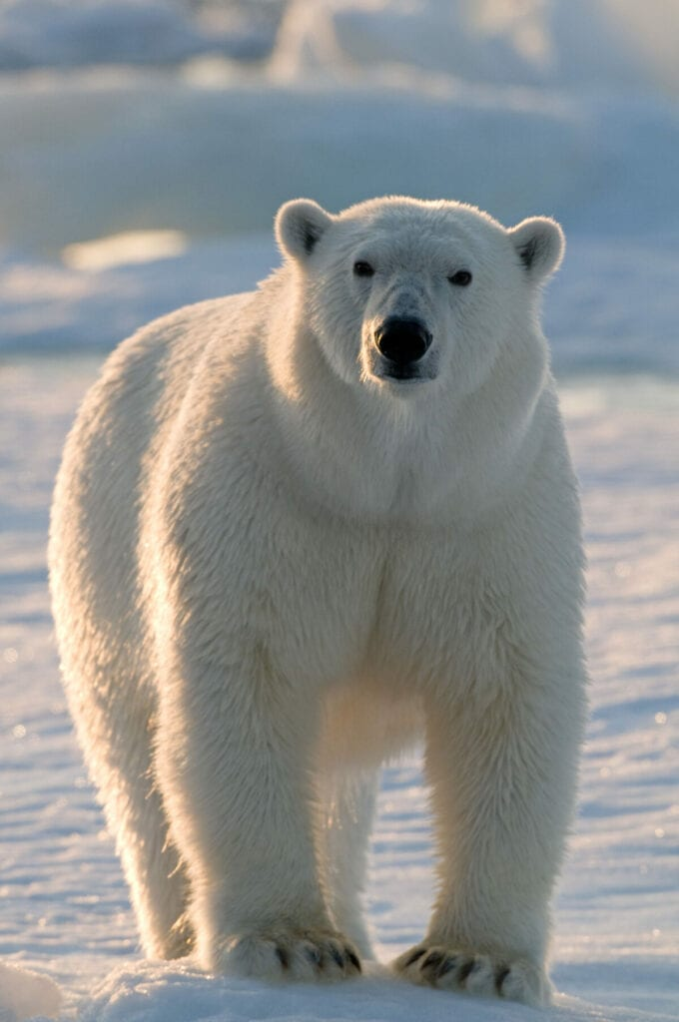
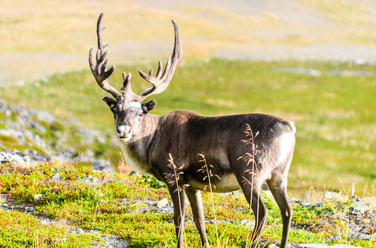
Animals
There are lots of animals in the Arctic but these 3 are some of my favourites.
The polar bear as they always look so fluffy. Did you know their skin is actually black.
The arctic fox as it looks like it is covered in snow. Their scientific name is Vulpes Lagopus.
The reindeer as they have very hard antlers. They also guide Santa’s sleigh.
This Photo by Unknown Author is licensed under CC BY-NC
This Photo by Unknown Author is licensed under CC BY-SA
This Photo by Unknown Author is licensed under CC BY-SA-NC

Slide 5
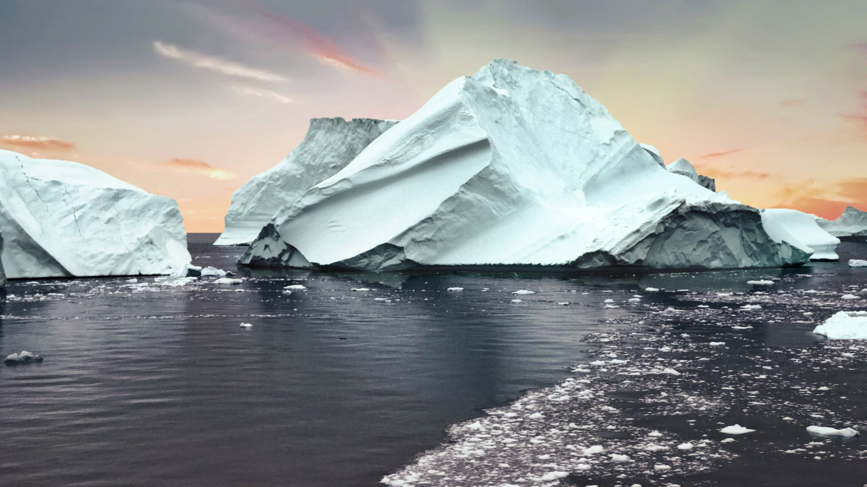
Climate
The climate of much of the arctic is moderated by the ocean water, which can never have a temperature below -2ºC ( 28ºF)

Slide 6
Population
There are 4 million people in the arctic. That is not a lot.

Slide 7
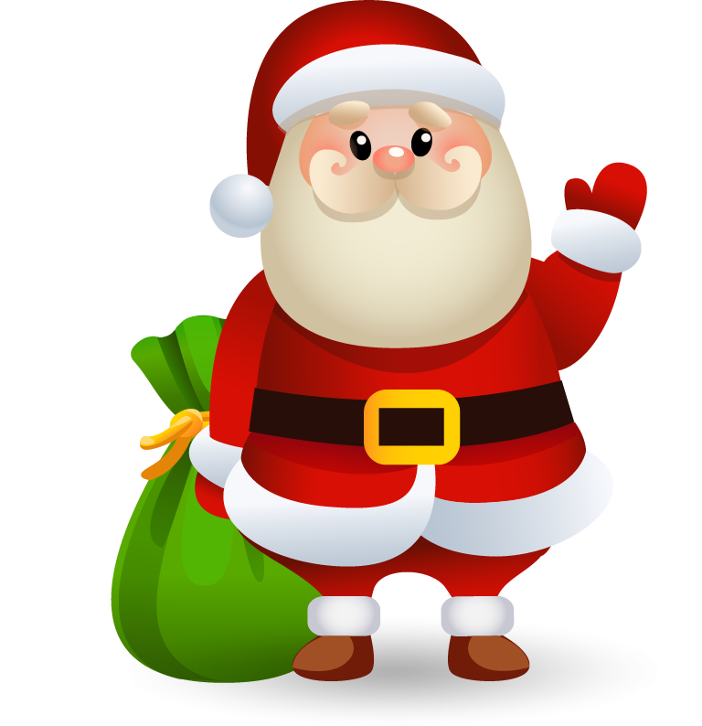
FATHER CHRISTMAS!
As you all might know Father Christmas works in the North Pole. The North Pole is the Arctic so I thought I should mention Santa.
This Photo by Unknown Author is licensed under CC BY-NC

