Slide 1
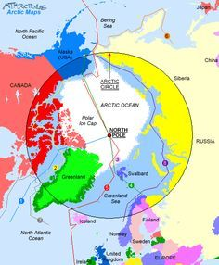
The Artic ( The North Pole).
The artic consists of the Artic ocean and parts of Alaska ,Canada, Greenland, Iceland, Russia, Finland and Sweden. The Artic Circle is One sixth of the earth Surface.

Slide 2
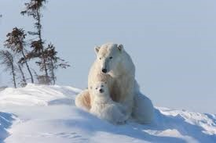
The Largest Predator the Polar Bear comes from the North Pole.
Polar bears are very good swimmers.

Slide 3
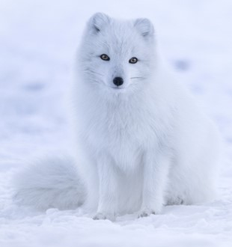
The Artic fox lives for 3-6 Years.
In the summer, its fur is a dark grey to Brown put turns creamy white in the winter.

Slide 4

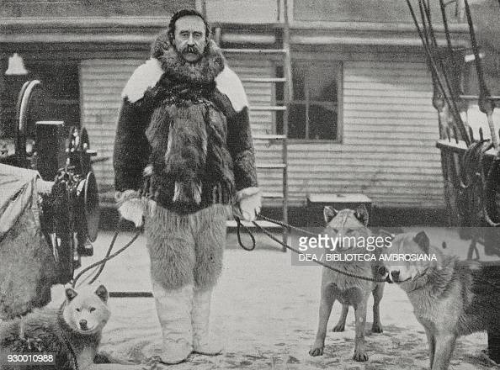
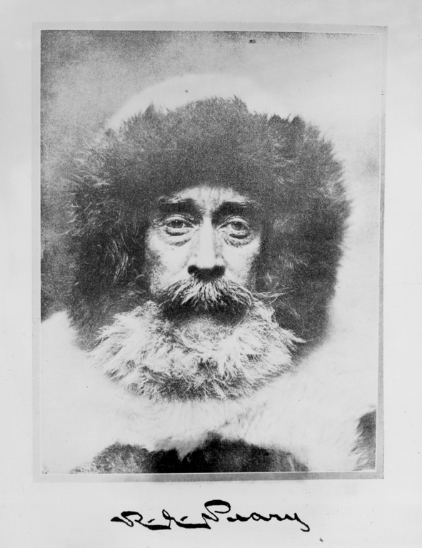
Robert Pearly traveled much of the Artic by Dogsled.
He was famous for being first person to reach the North Pole

Slide 5

Father Christmas
( Santa ) comes from the North Pole.
By Taylor

