Slide 1
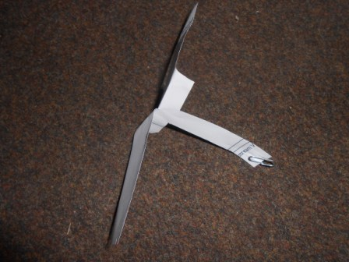
 | Width | Length | Area
Spinner 1 blade surface area | 3.3 cm | 6 cm | 19.8cm²
Spinner 2 blade surface area | 5.1 cm | 8.9 cm | 45.39 cm²
Spinner 3 blade surface area | cm | cm | cm²
Notes:
To prepare for our investigation, I would like you to make two more spinners. The spinners should have different surface areas for each spinner. Please record how you worked out the surface area of your blades on this table.

Slide 2

Results
Surface area of blades (cm squared) | Time taken to fall (seconds) | Time taken to fall (seconds) | Time taken to fall (seconds) | Average time taken to fall (seconds)
19.8 | 1.3 | 1.75 | 1.65 | 1.57
45.39 | 1.85 | 1.9 | 1.98 | 1.91
Show your working out. To find the average add the time taken to fall for each blade, for each spin and then divide the answer by 3.
1.3
+ 1.75
1.65
4.70
1.85
1.9
1.98
4.73
4.7/3=1.57
6.73/3=1.91
Notes:
Now it is time to investigate. Remember to hold your spinners at the same height. Start the stop watch as soon as you drop the spinner. The weight at the bottom of each spinner should be the same. Please record your results on the table. I have also asked you to work out the average time taken to fall. To do this add all three times spinner 1 took to fall and then divide by three. Repeat this for spinner 2 and 3.

Slide 3
Write a prediction:
The smaller helicopter has less air resistance due to less surface area therefore the speed and force of gravity is greater.

Slide 4
Write a conclusion
What did you say would happen in your prediction? Smaller helicopter will fall quicker
Were you correct? Yes
What did happen? The smaller helicopter fell quicker
Why did it happen? Because the surface area was less and therefore the resistance was less
PROVE IT! The mean speed of the smaller was 1.57 secs (faster) whereas the larger was 1.91
Finally summarise what happened in your investigation. We dropped 2 helicopters, I with a larger surface area and timed them. We calculated the mean time to fall and then saw which was fastest.
Would you do anything differently next time? I would make a huge one to see a bigger difference in speed. I could also add different weights to the paperclips to see what happened.

