Slide 1



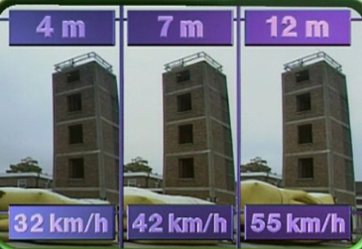
Tuesday 5th January 2021
LI: To be able to explain that unsupported objects fall towards the Earth because of the force of gravity acting between the Earth and the falling object.
Success criteria:
I can explain what happened
I can use scientific vocabulary
The stunt woman jumped from the building block from different heights to test the affect of gravity. When she jumped from the 2nd block she went 32km/h but when she jumped from the 4th block she went 55km/h. This is because she was in the air for a longer time so she gained more speed because of the gravity.
Notes:
Leave this slide on display, when class are working

