Slide 1
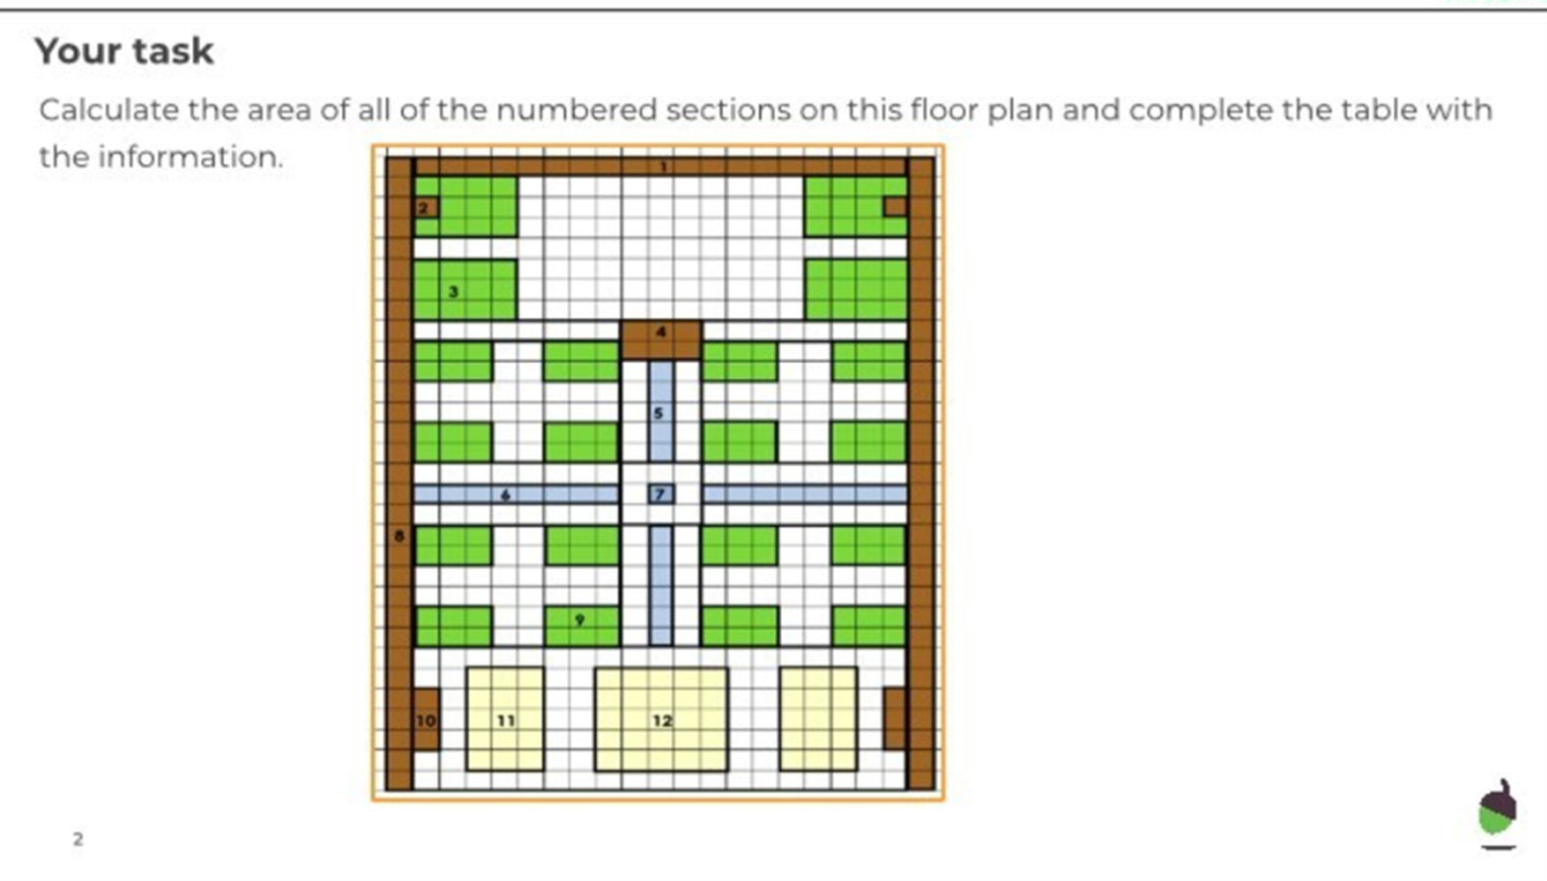
Monday 11th January
Oak Academy Lesson 2 Activity 1

Slide 2
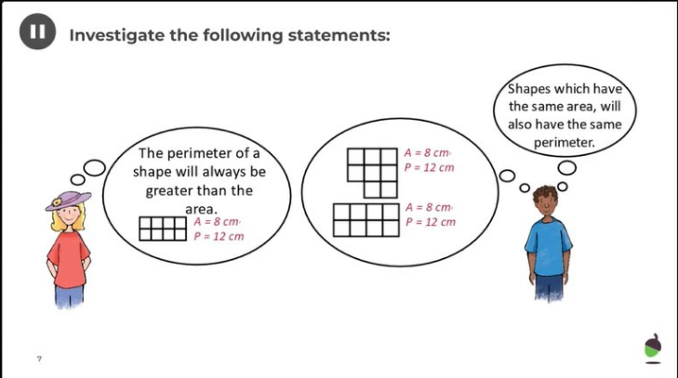
Tuesday 12th January
Oak Academy Activity

