Slide 1
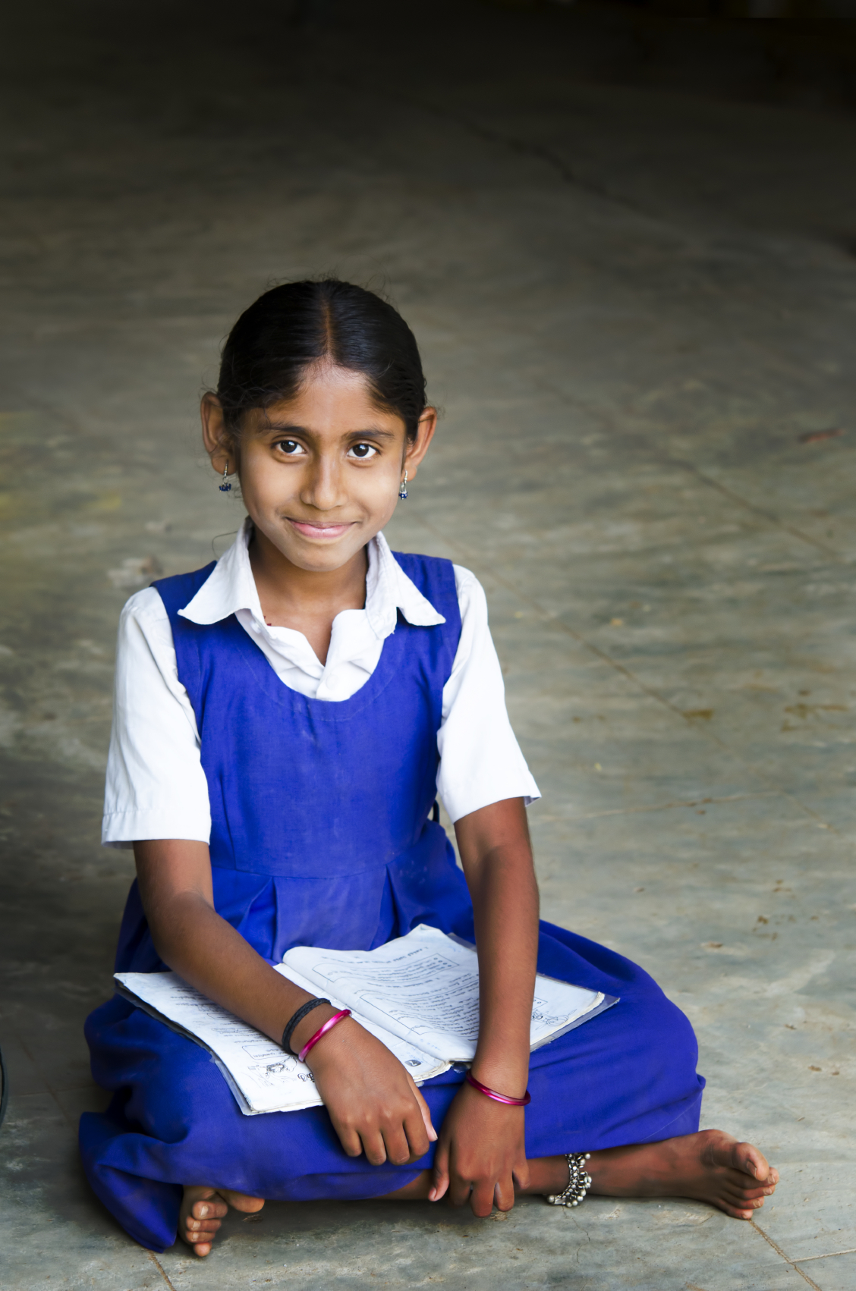
What might the dreams/aspirations of these children be?
How might they differ from yours?

Slide 2
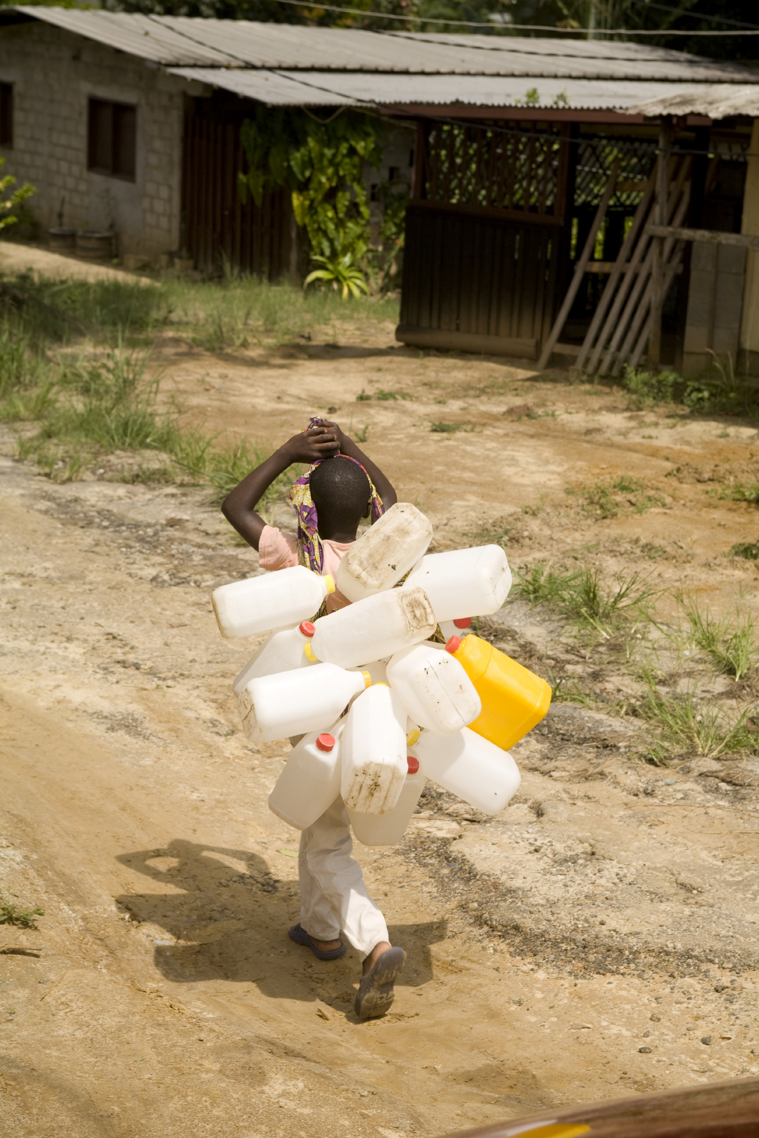
What might the dreams/aspirations of these children be?
How might they differ from yours?

Slide 3
How might it feel to be the child in the photo ?
How realistic are their dreams and goals?

