Slide 1

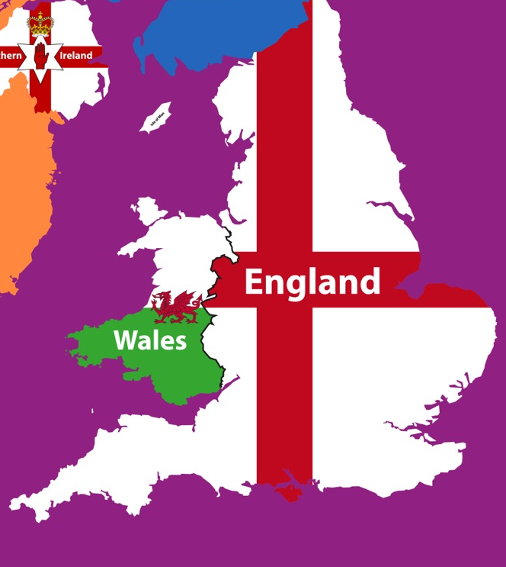

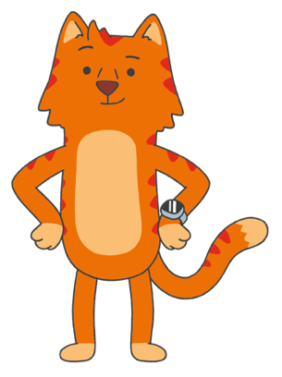
What is the census?
The census is a count of all people and households in England and Wales.
The last census was held on
27 March 2011. The next census will be held on Sunday 21 March 2021.
A census has been held throughout England and Wales every 10 years since 1801 (apart from in 1941 due
to the Second World War).

Slide 2
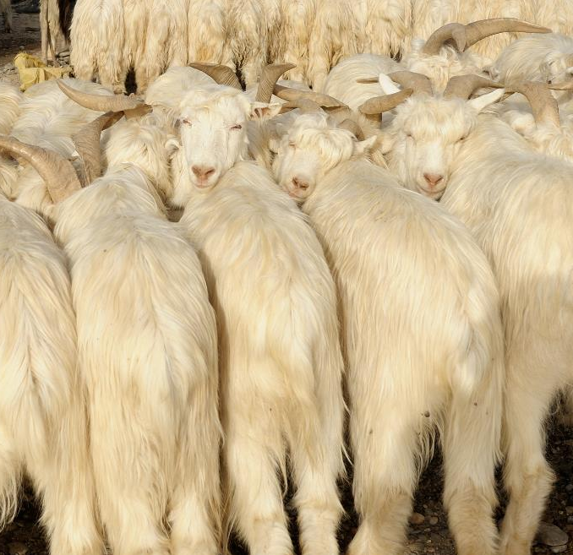

What is the census?
In 3800BC the Babylonian Empire (who lived in what we now call Iraq) took the first known census. They counted livestock and quantities of butter, honey, milk, wool, and vegetables.

Slide 3
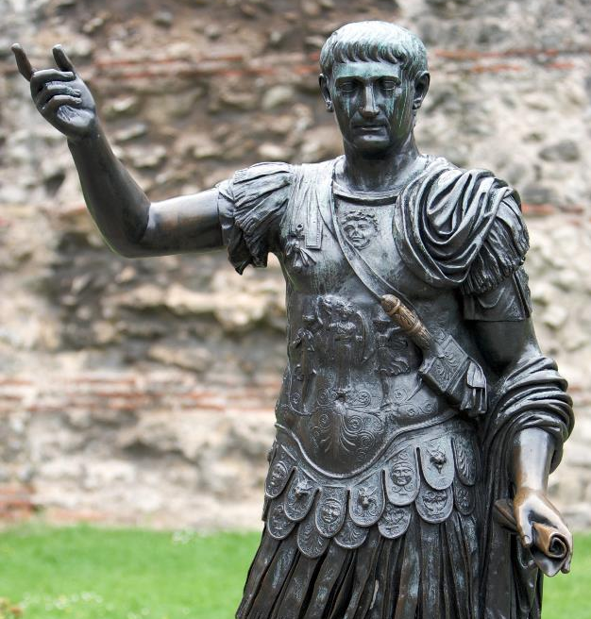
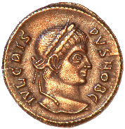
What is the census?
The Romans used a census to assess the population and work out how much tax they could raise.
The word assess or assessing comes from a Latin word, and in the olden days meant to ‘fix to the amount’. So it’s linked to the origin of the word census.

Slide 4
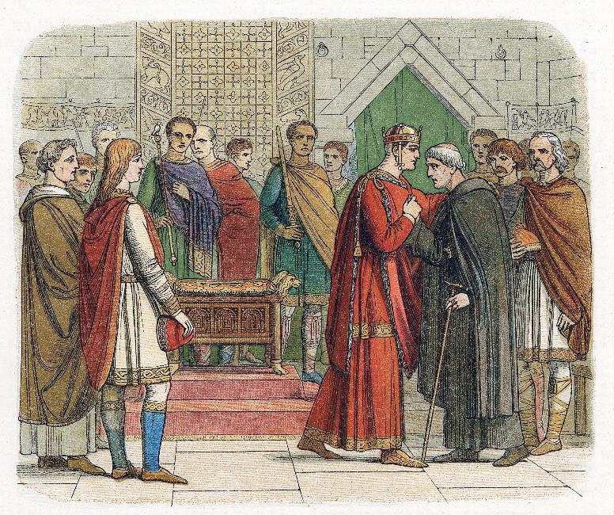
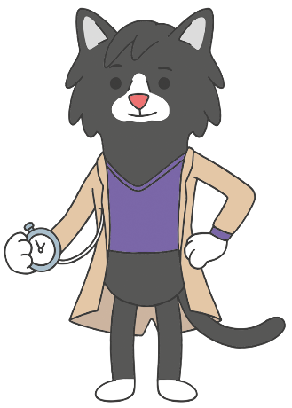
What is the census?
William the Conqueror created the Domesday Book in 1085 to find out how much tax he could raise across the country.

Slide 5
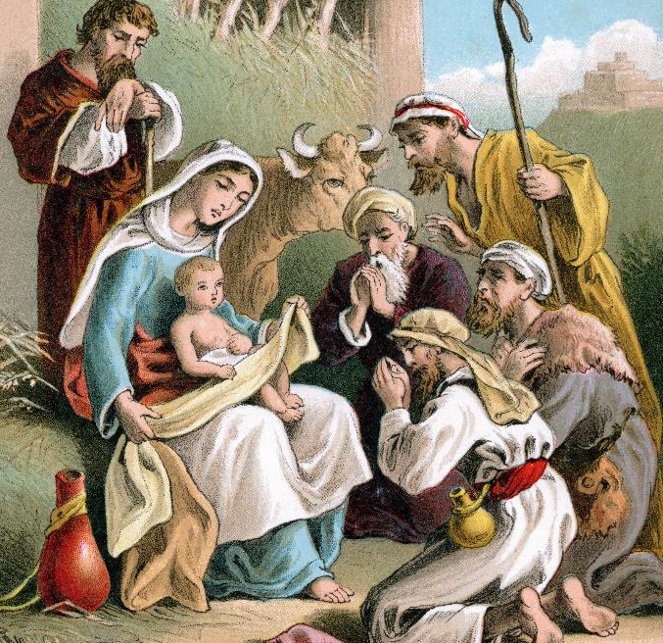
What is the census?
Mary and Joseph went to Bethlehem to be counted in a census.

Slide 6
What is the census?
The census gives a detailed picture of the population.
It is unique because it covers everyone at the same time and asks the same core questions everywhere.
This makes it easy to compare different parts
of England and Wales.

Slide 7
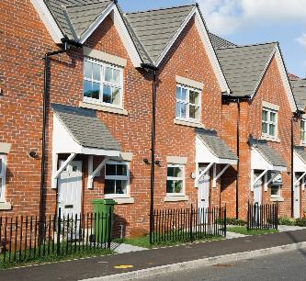
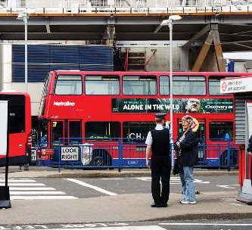

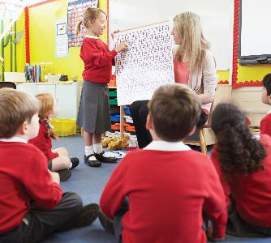

What is the census?
The census is run by the Office
for National Statistics (ONS)
The ONS prepares all the
important questions.
Then the ONS analyses statistics about the nation’s population, society and economy.
Their job is vital!

Slide 8
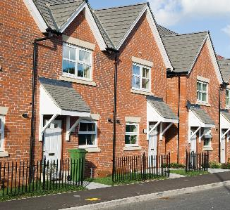


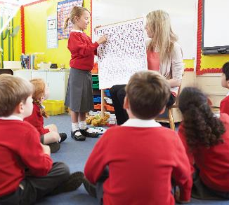

What is the census?
The census information is used by central and local government, health authorities and many other organisations.
It helps them to plan important services across the country, such as:
Housing
Schools
Hospitals and doctors
Buses and roads
These plans will helps us prepare for the next 10 years.

Slide 9

What is the census?
The census can also help
us to find out about life
in the past.

Slide 10

What is the census?
Let’s count the population in one area in 2011.
What is this data telling us?
Why might the ages be grouped in this way?
School Local Area Population | From Census 2011
Children aged 0 to 17 years | 1,387
Adults aged 18 to 29 years | 865
Adults aged 30 to 44 | 1,440
Adults aged 45 to 64 | 1,920
Adults aged 65 and over | 1,398

Slide 11
What is the census?
What do you think this data tells us about what has happened between the two censuses?
School Local Area Population | From Census 2001 | From Census 2011
Children aged 0 to 17 years | 1,340 | 1,387
Adults aged 18 to 29 years | 784 | 865
Adults aged 30 to 44 | 1,469 | 1,440
Adults aged 45 to 64 | 1,533 | 1,920
Adults aged 65 and over | 1,331 | 1,398

Slide 12
What is the census?
What do you think the numbers will be in the next census?
What about in another 10 years?
School Local Area Population | From Census 2001 | From Census 2011 | From Census 2021 | From Census 2031
Children aged 0 to 17 years | 1,340 | 1,387
Adults aged 18 to 29 years | 784 | 865
Adults aged 30 to 44 | 1,469 | 1,440
Adults aged 45 to 64 | 1,533 | 1,920
Adults aged 65 and over | 1,331 | 1,398

Slide 13

What is the census?
What do we notice about this information?
Do we think the numbers would be the same today?
What are our reasons?
Do we think the numbers would be the same 40 years ago?
What do we think the numbers will be 20 years in the future?

Slide 14
What is the census?
Let’s use census 2011 data to create charts and graphs.
What do you notice?
What questions would you like to ask?

Slide 15
What is the census?
Let’s use census 2011 data to create charts and graphs.
1.Why are there so many more people aged 45 – 64 in 2011 than 2001?
2.What happens when
people get to age 65 in this area?
3. Can we say that most
people who live here in 2011 are between 30 and 64?
4. What happens when
people get to 18 here?
5. What sort of place
do you think this
might be?

Slide 16

What is the census?
Write a letter explaining what changes will be needed in the next 10 years.

Slide 17
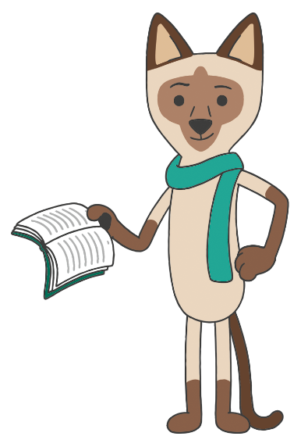
What is the census?
In your research and writing, remember to:
Identify the audience for and purpose of the writing.
Select the appropriate form and use other similar writing as models for
your own.
Select appropriate grammar and vocabulary, and understand how your choices can change and enhance meaning.
Use a wide range of devices to build cohesion within and across paragraphs.

