Slide 1
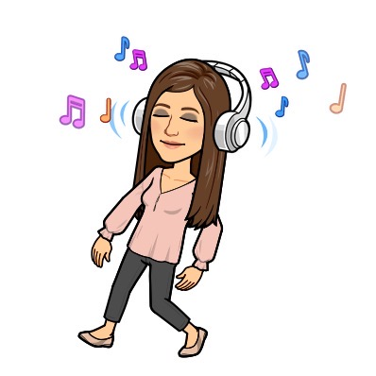
One Moment, One People
In music this week, we are going to learn how to sing the song ‘One Moment, One People’. This song is about working together and making positive connections with each other.
Click on the following link to have a listen to the song!
https://www.youtube.com/watch?v=ckNmB9S0hvI&feature=emb_imp_woyt

Slide 2

One Moment, One People
Now that you have listened to the song, let’s learn how to sing the song with singer songwriter Beccy Owen.
Click on the link below to watch a video to help you learn
the song step by step. Then go back to the first video and try to sing along!
https://www.youtube.com/watch?v=8rSjyzvix5g&feature=emb_logo

