Slide 1

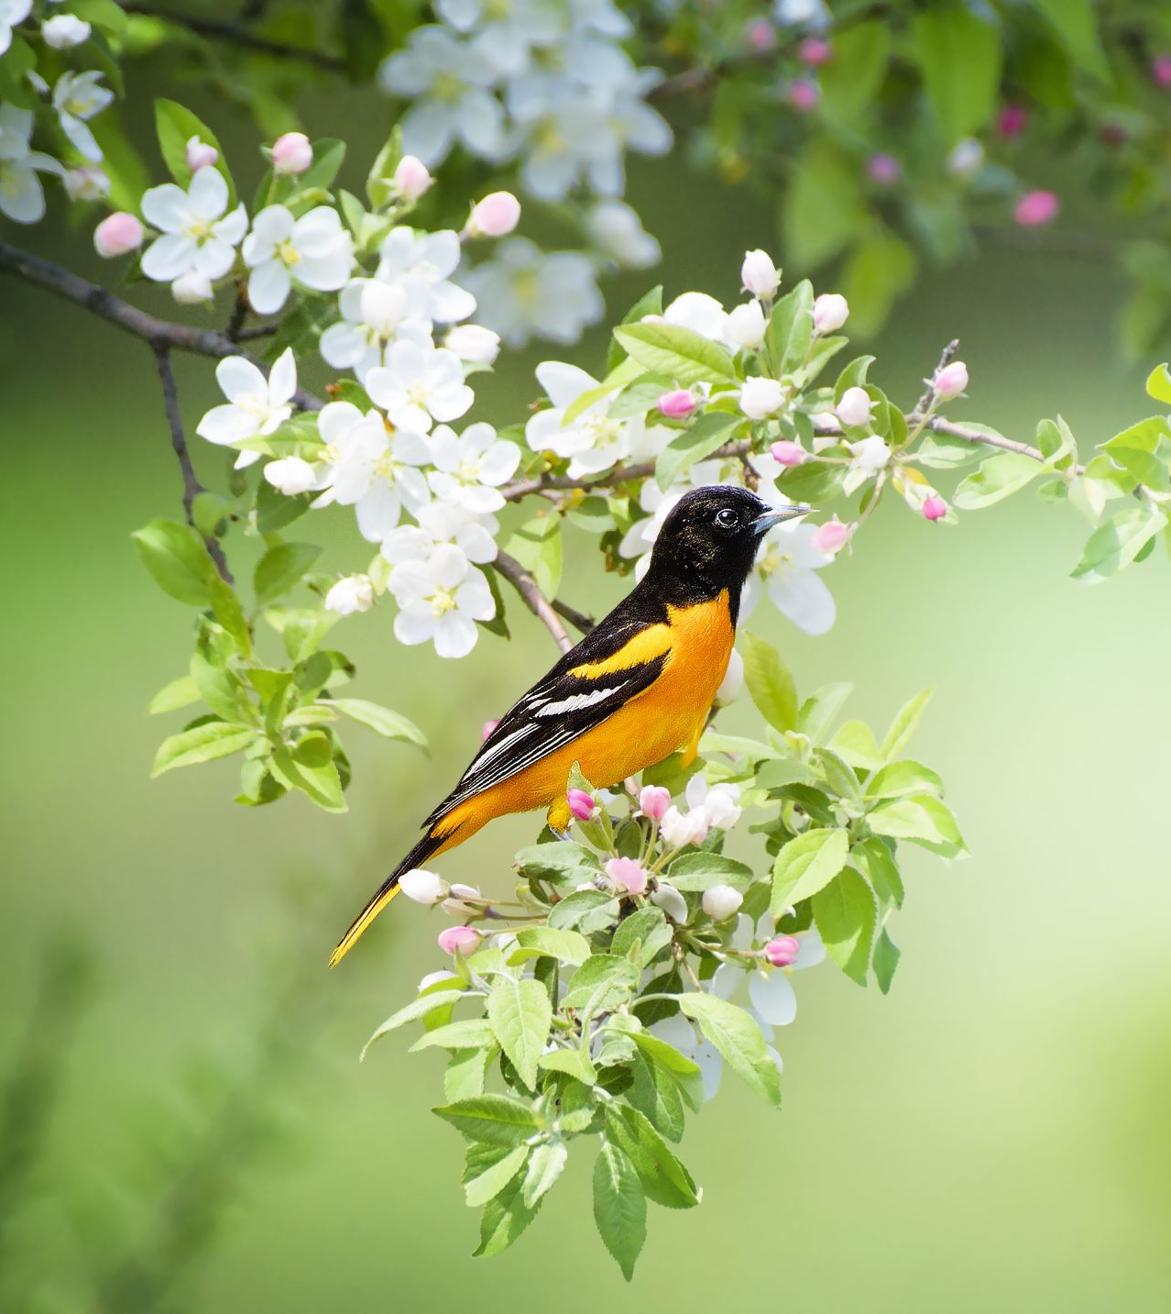
The golden key
Emily

Slide 2

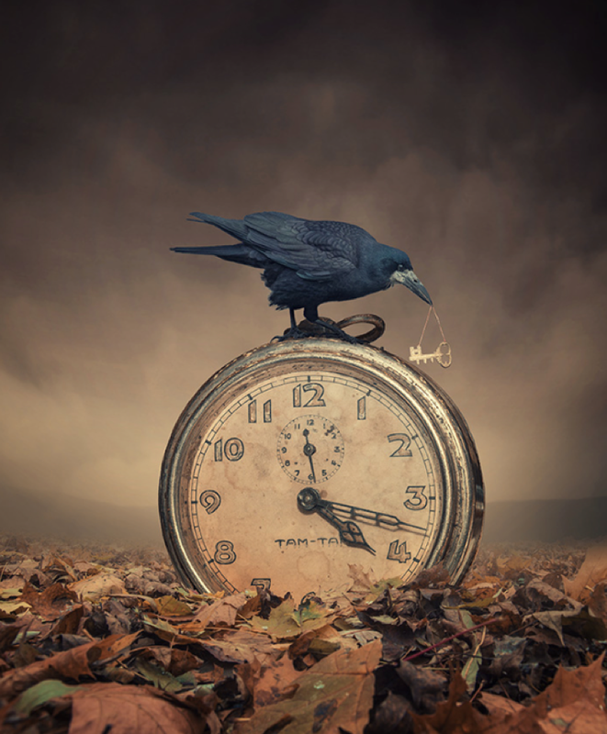
The golden key
She had been chasing it all day. Now, the crow had it.
Time was ticking. Time was running out. She tiptoed towards the creature, seeing the precious key it held precariously in its sharp, cruel beak. It let out an irritating, throaty cackle, its soot-black wings ruffling gently as it maneuvered itself on top of the clock; it was ready to take flight.
Knowing she might only have a few seconds before her opportunity disappeared, she took another cautious step forward. Time seemed to slow, her body tingled in excitement and her heart thudded in her chest. It was now or never…

Slide 3
The ending of the golden key my version
Suddenly the crow took off but then the key fell from its beak and landed in the leaves. The crow swoops down but then time stood still. Everything around the girl stopped and she was able to pick up the key. The reason she was so desperate for the key was because she was stuck in a fairy tale book and needed the key to get back to the beginning of the story so she could go home. Were time had stood still it gave her the chance to run all the way back to the beginning of the book where she could use the key to get out.

