Slide 1

Tuesday 5th January 2021
English and Science – lesson 2
Notes:
Good morning Willow Class
This is your Science and English lesson for Tuesday 5th January

Slide 2
You will need
Three pieces of paper
2 worksheets either printed or on the computer ready for you to type on after this lesson.
Notes:
You will need
Three pieces of paper
2 worksheets

Slide 3



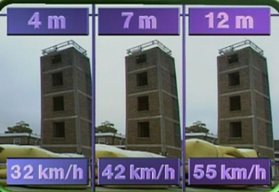
Tuesday 5th January 2021
LI: To be able to explain that unsupported objects fall towards the Earth because of the force of gravity acting between the Earth and the falling object.
Success criteria:
I can explain what happened
I can use scientific vocabulary
You will need this worksheet, for this lesson. Please do not complete until you have watched the clip, which you will see later in this presentation.
What did the stunt woman do?
What force made her speed up as she fell?
What do you need to know, to calculate the speed of the fall?
If you are high up, what does this give gravity time to do?

Slide 4

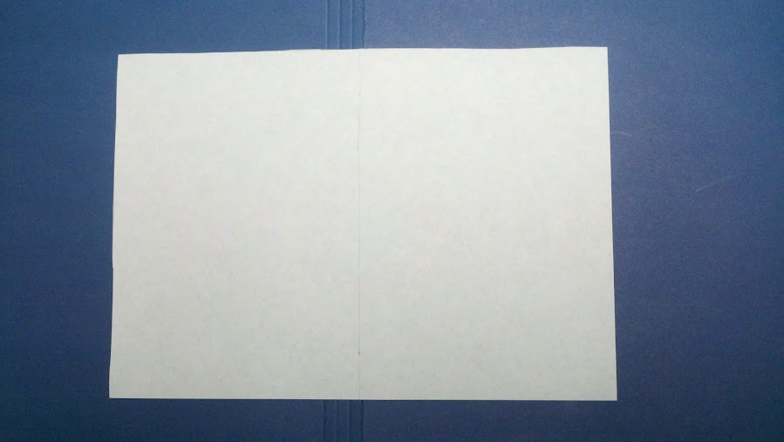

Tuesday 5th January 2021
LI: To be able to explain that unsupported objects fall towards the Earth because of the force of gravity acting between the Earth and the falling object.
Success criteria:
I can record results fairly
I can explain what happened
I can use scientific vocabulary
Illustrative fair-test – How does the surface area of a piece of paper affect how quickly it falls?
Surface Area | Test 1 | Test 2 | Test 3
crunched up
flat
folded
You will need this worksheet, for this lesson. Please do not complete until you have read or listened to the whole presentation.

Slide 5
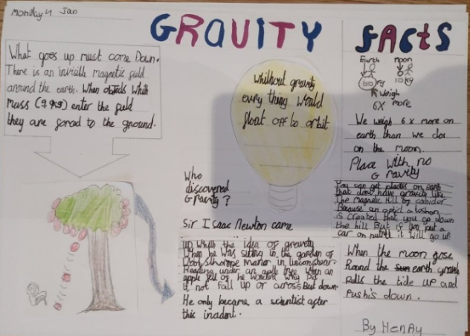
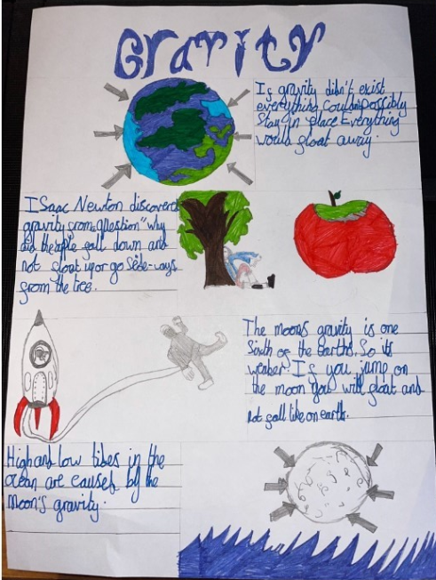
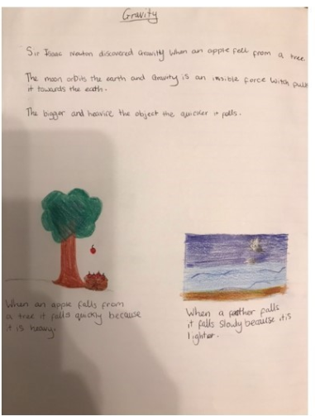
Notes:
Before starting I would like to share some of the wonderful work that was submitted yesterday.
Yesterday I asked you to research gravity, thinking about:
Who discovered gravity?
Why is gravity so important?
Facts about gravity

Slide 6
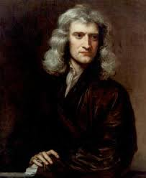
Who discovered gravity?
Notes:
It wasn’t until 1666 that Isaac Newton first mathematically described the force of gravity, creating Newton’s laws of universal gravitation.
It is said that his ideas about gravity were inspired by watching an apple fall from a tree. Newton wondered what force made the apple fall downward instead of simply floating away.

Slide 7
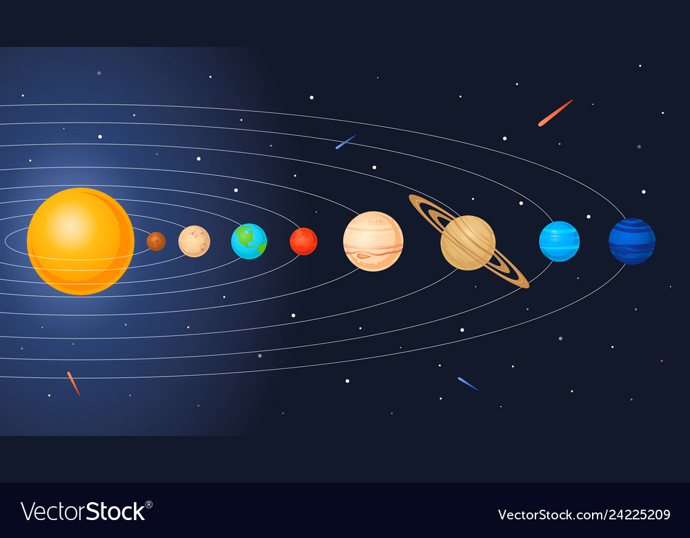
Why is gravity important?
Notes:
Why is gravity important?
We already mentioned that we wouldn’t be able to stay put on Earth’s surface without gravity. Objects would simply float away if gravity didn’t exist.
Gravity is also the force that keeps the Earth in orbit around the Sun, as well as helping other planets remain in orbit.

Slide 8
Facts About Gravity
Notes:
High and low tides in the ocean are caused by the moon’s gravity.
The moon’s gravity is 1/6 of Earth’s gravity, so objects on the moon will weigh only 1/6 of their weight on Earth.

Slide 9
Gravity in Action
https://www.bbc.co.uk/bitesize/clips/zvqd7ty
Notes:
What force made the stunt woman speed up as she fell?
What do you need to know to calculate the speed of the fall?
If you are high up what does this give gravity time to do?
After we have finished our zoom meeting today, I have emailed your parents worksheets for you to complete about the short video clip we have just watched. But now lets move onto an investigation.

Slide 10
Tuesday 5th January 2021
LI: To be able to explain that unsupported objects fall towards the Earth because of the force of gravity acting between the Earth and the falling object.
Success criteria:
I can explain what happened
I can use scientific vocabulary
What did the stunt woman do?
What force made her speed up as she fell?
What do you need to know, to calculate the speed of the fall?
If you are high up, what does this give gravity time to do?
Notes:
This is the worksheet that I emailed to your parents. Yours may look slightly different but all have the picture of the tower. Please pause the presentation and complete this worksheet.

Slide 11


Notes:
You need 3 pieces of paper. Crunch one piece into a ball, leave one piece flat and fold one piece.
Now ask the adult sitting next to you to help. Hold your pieces of paper in the air at the same height. After my count down from 5 let the pieces of paper go.

Slide 12

Notes:
What did you notice? Did one fall quicker? Did one fall slower?
Why do you think this happened? Can you think of a scientific question to ask about what just happened?

Slide 13
Tuesday 5th January 2021
LI: To be able to explain that unsupported objects fall towards the Earth because of the force of gravity acting between the Earth and the falling object.
Success criteria:
I can record results fairly
I can explain what happened
I can use scientific vocabulary
Illustrative fair-test – How does the surface area of a piece of paper affect how quickly it falls?
Surface Area | Test 1 | Test 2 | Test 3
crunched up
flat
folded
Notes:
I uploaded this worksheet you can either print, or you can type on the slide, save and send back to me. You need to record when the pieces of paper landed, 1st, 2nd and 3rd on the table. You will need to complete this table and underneath write or type what happened along with your scientific question. Before we finish today, lets quickly discuss why we should repeat a test.

Slide 14
Why bother repeating?
Because we need to make the test fair
Because we need to measure accurately
Because we need to all have a go
Because the first reading might not be right
Because readings can be different
Because things might be a little different, so we will need an average
Because we need to check our results
Because we need more evidence

Slide 15
Why bother repeating?
Because we need to make the test fair
Because we need to measure accurately
Because we need to all have a go
Because the first reading might not be right
Because readings can be different
Because things might be a little different, so we will need an average
Because we need to check our results
Because we need more evidence
Notes:
The green statements are correct. The purple statements are not.

Slide 16
Time to investigate.
Notes:
Time to investigate. I look forward to seeing your investigation.

