Slide 1
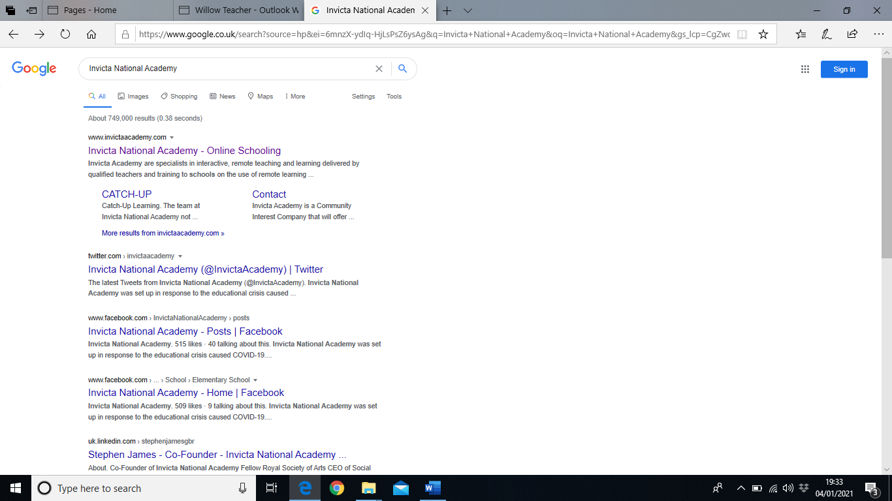
If you would like to register for the Invicta National Academy zoom lessons, type National Invicta Academy into search engine. Then select the first link.

Slide 2
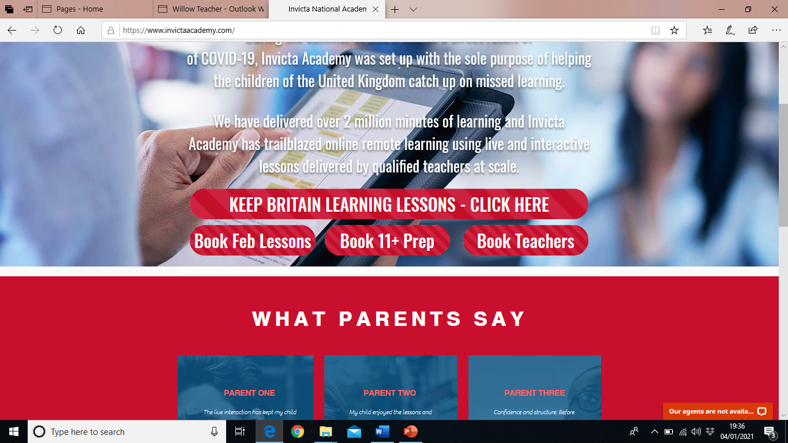
You will then be taken to this page.
Click on the first box.

Slide 3
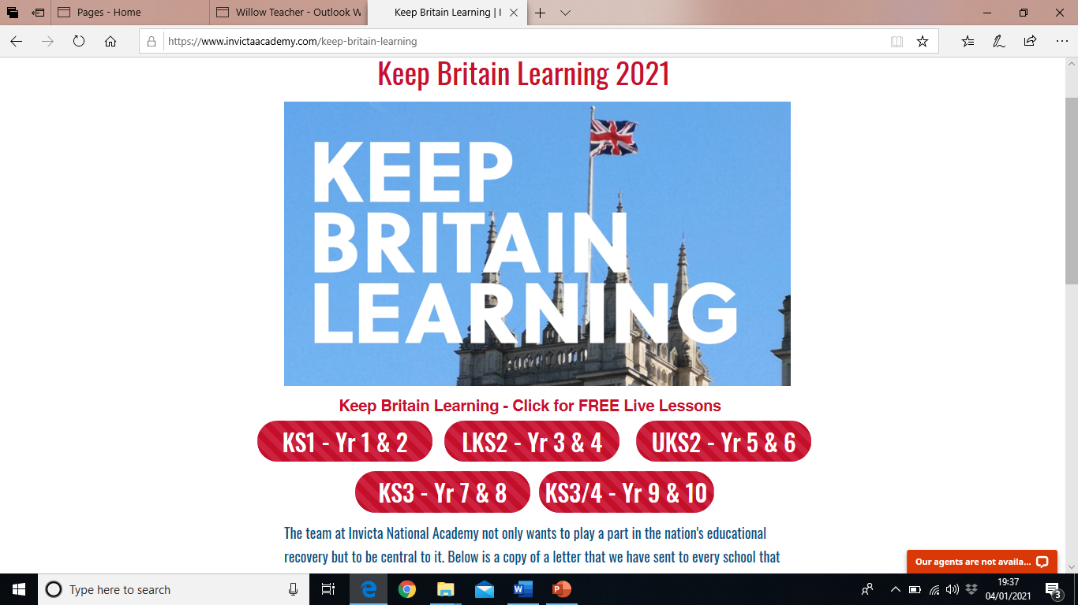
Then click this box.

Slide 4
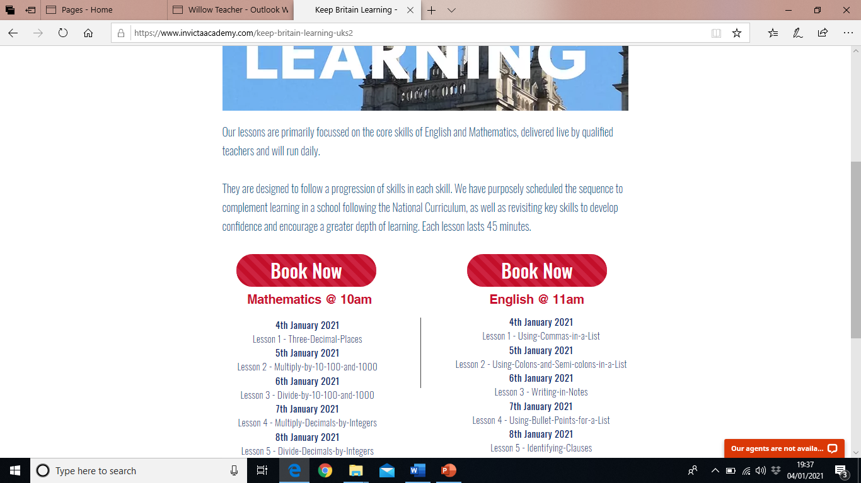
Click on Book Now
This will take you to a registration page, where you complete a short form.
Our school address is:
West Malling C of E Primary School
Old Cricket Ground
West Malling
Kent
ME19 6RL
Our school telephone number is:
01732 842061
There is a Maths option, however we are currently not covering decimals.

Slide 5
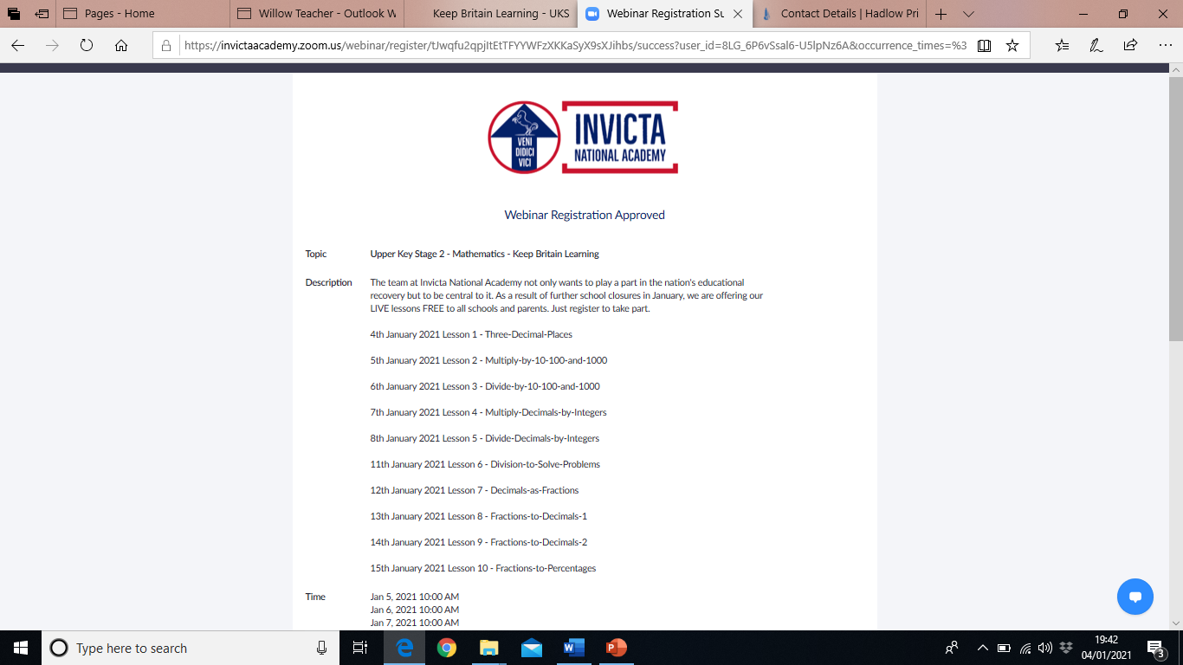
I have registered to see what happens. Once you have completed your details, it then takes you to a zoom invite. They also email the address you gave, with the zoom meeting invitation. My invitation arrived in my inbox very quickly.

