Slide 1
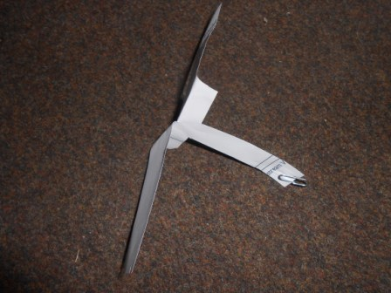
Wednesday 6th January 2021
LI: To be able to explain that unsupported objects fall towards the Earth because of the force of gravity acting between the Earth and the falling object.
Success criteria:
I can record results fairly
I can explain what happened
I can use scientific vocabulary
Illustrative fair-test – How does the surface are of the blades affect the time it takes the spinner to fall?
 | Width | Length | Area
Spinner 1 blade surface area | cm | cm | cm²
Spinner 2 blade surface area | cm | cm | cm²
Spinner 3 blade surface area | cm | cm | cm²
Notes:
To prepare for our investigation, I would like you to make two more spinners. The spinners should have different surface areas for each spinner. Please record how you worked out the surface area of your blades on this table.

Slide 2

Results
Surface area of blades (cm squared) | Time taken to fall (seconds) | Time taken to fall (seconds) | Time taken to fall (seconds) | Average time taken to fall (seconds)
Show your working out. To find the average add the time taken to fall for each blade, for each spin and then divide the answer by 3.
Notes:
Now it is time to investigate. Remember to hold your spinners at the same height. Start the stop watch as soon as you drop the spinner. The weight at the bottom of each spinner should be the same. Please record your results on the table. I have also asked you to work out the average time taken to fall. To do this add all three times spinner 1 took to fall and then divide by three. Repeat this for spinner 2 and 3.

