Slide 1


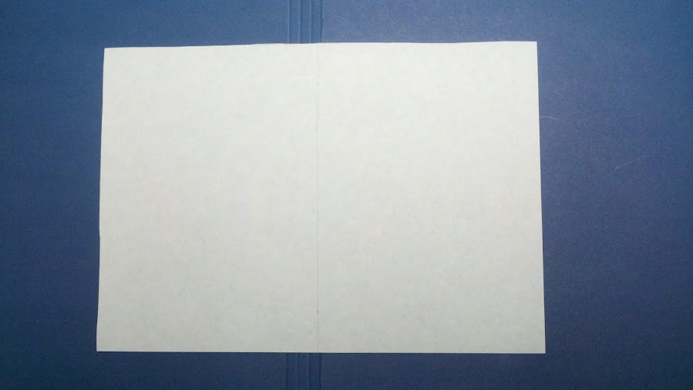

Tuesday 5th January 2021
LI: To be able to explain that unsupported objects fall towards the Earth because of the force of gravity acting between the Earth and the falling object.
Success criteria:
I can record results fairly
I can explain what happened
I can use scientific vocabulary
Illustrative fair-test – How does the surface area of a piece of paper affect how quickly it falls?
Surface Area | Test 1 | Test 2 | Test 3
crunched up | 1st | 1st | 1st
flat | 3rd | 3rd | 3rd
folded | 2nd | 2nd | 2nd
Notes:
Yesterday I asked you to crunch up a piece of paper, fold a piece of paper and have a flat piece of paper and then drop them from the same height at the same time. Hopefully, you would have found out that the crunched up piece of paper fell 1st, folded 2nd and flat piece fell 3rd., every time. But why did this happen? What’s making the different pieces of paper fall at different speeds?

Slide 2








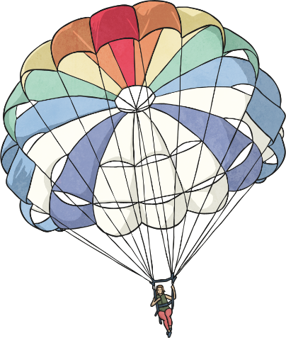
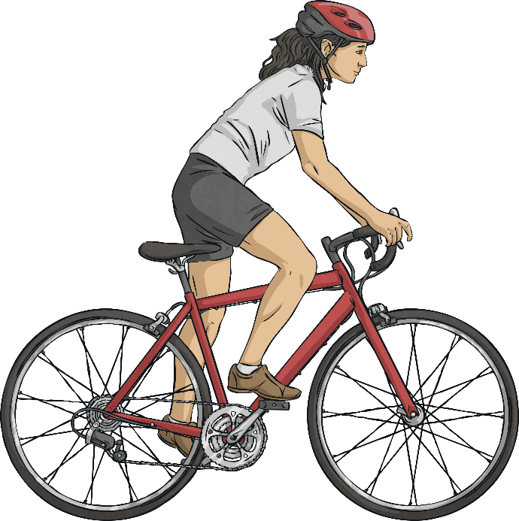
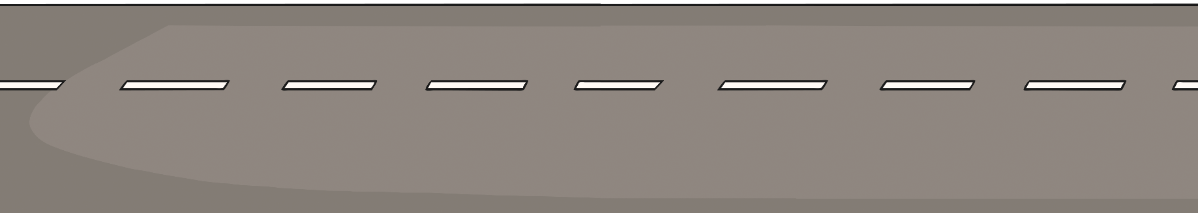
Air Resistance
gravity
Air resistance can be a useful force, but it can also be unhelpful in certain situations.
air resistance
air resistance
Look at the two diagrams below. Which one shows a useful effect of air resistance, and which one shows an unhelpful effect of air resistance?
driving force
Notes:
I read what was is on the screen

Slide 3
Air Resistance
Air resistance pushes up on the parachute, opposing the force of gravity and making the parachute and the person fall more slowly. This is a useful effect.
gravity
air resistance
air resistance
But air resistance pushes the cyclist back, opposing the cyclist’s force from them pedalling the bicycle and making the bicycle travel more slowly. This is an unhelpful effect.
driving force
Notes:
I read what is on the screen

Slide 4
Tuesday 5th January 2021
LI: To be able to explain that unsupported objects fall towards the Earth because of the force of gravity acting between the Earth and the falling object.
Success criteria:
I can record results fairly
I can explain what happened
I can use scientific vocabulary
Illustrative fair-test – How does the surface area of a piece of paper affect how quickly it falls?
Surface Area | Test 1 | Test 2 | Test 3
crunched up | 1st | 1st | 1st
flat | 3rd | 3rd | 3rd
folded | 2nd | 2nd | 2nd
Notes:
So when we think about our investigation from yesterday, we now know that air resistance is playing a part. But we still don’t know, why the pieces of paper fell at different times. Let’s investigate.

Slide 5
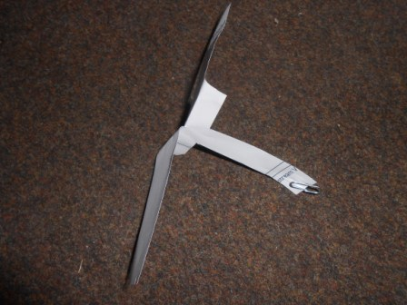
Make a spinner
Notes:
We are going to make a spinner. I have uploaded instructions and I have also added steps how to make a spinner to this PowerPoint.

Slide 6
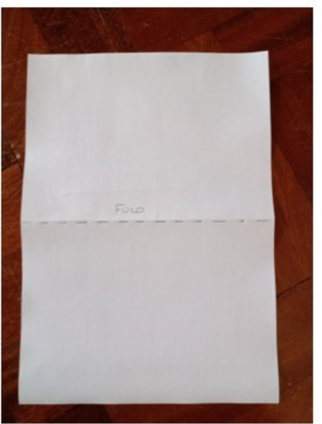
How to make a spinner
Step 1

Slide 7
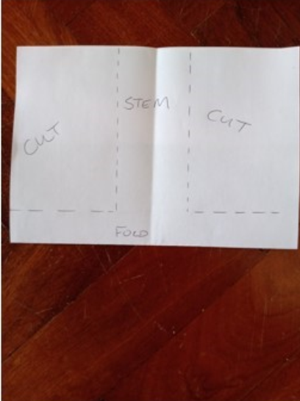
Step 2

Slide 8
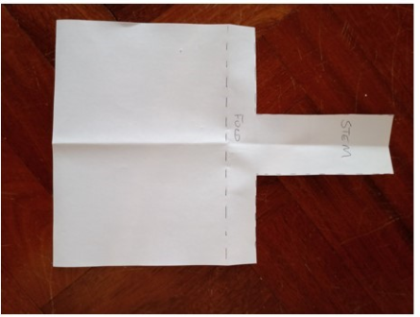
Step 3

Slide 9
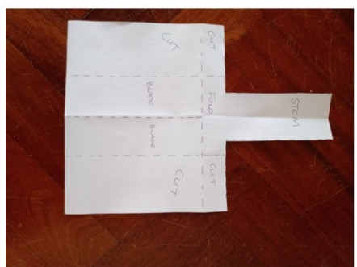
Step 4

Slide 10
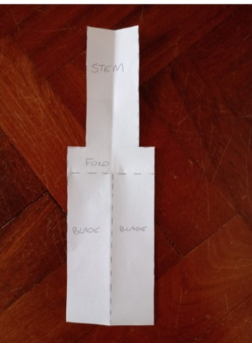
Step 5

Slide 11
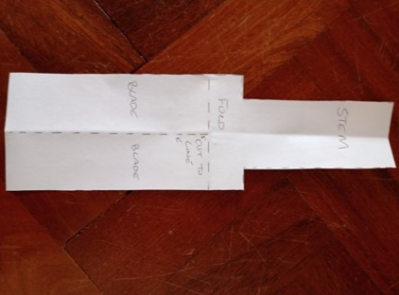
Step 6

Slide 12
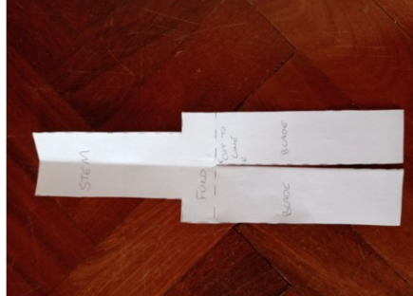
Step 7

Slide 13
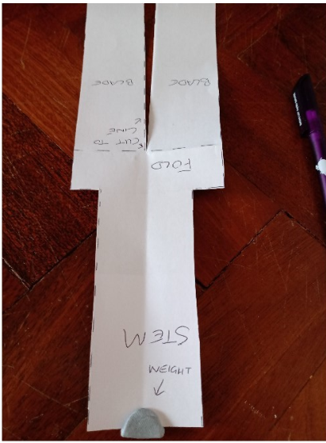
Step 8
This can be blu-tac or a paper clip

Slide 14
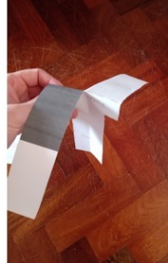
Step 9

Slide 15
Can you make it spin?
Notes:
Now that you have made your spinner stand up high, on a chair, please make sure an adult is with you and that you are safe. Hold the spinner high, let it go and it should spin to the ground.

Slide 16
What forces are in action?
Notes:
What forces are in action? Air resistance is pushing the spinner up and gravity is pulling the spinner down.

Slide 17
Can we calculate area?
Notes:
We are going to calculate the surface area of the blades on your spinner. But before we do, how do we calculate area?

Slide 18
Area measures the surface inside a shape. Click on the width and the length to add them to the calculation. Then multiply the width and length to find the area of the shape.
7cm
3cm
Show
answer
Next
?cm
21cm²
7cm × 3cm =
?cm
Menu
Notes:
Area measures the surface inside a shape. To calculate area we multiply the width by the length. So let’s have a look at the rectangle. The width is 3cm and the length is 7cm. To calculate the area we multiply 7cm by 3cm which is 21cm².

Slide 19
Area measures the surface inside a shape. Click on the width and the length to add them to the calculation. Then multiply the width and length to find the area of the shape.
5cm
4cm
Show
answer
Next
?cm
?cm
20cm²
5cm × 4cm =
Menu
Notes:
Let’s look at this rectangle. The width is 4cm and the length is 5cm. We multiply 4cm by 5cm which is 20cm²

Slide 20
Now you try and calculate area by yourself.

Slide 21
Area measures the surface inside a shape. Click on the width and the length to add them to the calculation. Then multiply the width and length to find the area of the shape.
9cm
1cm
Show
answer
Next
?cm
9cm²
9cm × 1cm =
?cm
Menu

Slide 22
What is the surface area of a single blade on your spinner?
Notes:
To measure the surface area of your blade, you will need to measure the length and width of one blade on your spinner. Now multiply the two measurements together. You now know the surface area of your blades on your spinner.

Slide 23
Wednesday 6th January 2021
LI: To be able to explain that unsupported objects fall towards the Earth because of the force of gravity acting between the Earth and the falling object.
Success criteria:
I can record results fairly
I can explain what happened
I can use scientific vocabulary
Illustrative fair-test – How does the surface are of the blades affect the time it takes the spinner to fall?
 | Width | Length | Area
Spinner 1 blade surface area | cm | cm | cm²
Spinner 2 blade surface area | cm | cm | cm²
Spinner 3 blade surface area | cm | cm | cm²
Notes:
To prepare for our investigation, I would like you to make two more spinners. The spinners should have different surface areas for each spinner. Please record how you worked out the surface area of your blades on this table.

Slide 24
Write a prediction
Think about using these words
Force of gravity
Pull down
Speed
Air resistance
Surface area
Less
Greater
Notes:
You should now have three spinners. Before we do our investigation, please write a prediction. What do you think will happen and why?
Words you should use are: Force of gravity, pull down, speed, air resistance, surface area, less and greater.

Slide 25

Results
Surface area of blades (cm squared) | Time taken to fall (seconds) | Time taken to fall (seconds) | Time taken to fall (seconds) | Average time taken to fall (seconds)
Show your working out. To find the average add the time taken to fall for each blade, for each spin and then divide the answer by 3.
Notes:
Now it is time to investigate. Remember to hold your spinners at the same height. Start the stop watch as soon as you drop the spinner. The weight at the bottom of each spinner should be the same. Please record your results on the table. I have also asked you to work out the average time taken to fall. To do this add all three times spinner 1 took to fall and then divide by three. Repeat this for spinner 2 and 3.

Slide 26
Write a conclusion
What did you say would happen in your prediction?
Were you correct?
What did happen?
Why did it happen?
PROVE IT!
Use the data from your table to prove what you are saying is correct.
Finally summarise what happened in your investigation.
Would you do anything differently next time?
Notes:
Hopefully you have all had fun investigating. Now it is time to write a conclusion. Your conclusion should include:
What did you say would happen in your prediction?
Were you correct?
What did happen?
Why did it happen?
Prove it!
Use the data from your table to prove what you are saying is correct.
Finally summarise what happened in your investigation.
Would you do anything differently, next time?

