Slide 1

Friction is the resistance of motion when one object rubs against another. Anytime two objects rub against each other, they cause friction. Friction works against the motion and acts in the opposite direction.
Notes:
I read the above explanation of friction. Let’s see friction in action on the next slide.

Slide 2
Friction https://www.bbc.co.uk/bitesize/clips/zcx76sg
https://www.bbc.co.uk/bitesize/clips/z462tfr
https://www.bbc.co.uk/bitesize/clips/zkhxpv4
Notes:
Hover over the hyperlinks, right click and select open hyperlink. Watch all three BBC clips.

Slide 3
Time to investigate!
Notes:
Please read the rice bottle instructions and watch the you tube videos. Then choose one or two of the investigations to try at home. Please ask an adult to record your investigating or if an adult is unable to record you, please write about the investigations you chose to perform. We hope you have fun and look forward to seeing your work.

Slide 4
Do you think you can lift a bottle of rice with a chopstick?

Slide 5
Materials for Friction Experiment
Enough rice to fill a medium-sized plastic bottle
Pencil or chopstick
Funnel to get rice into the bottle
Medium sized plastic or glass bottle
A scoop to get rice to the funnel

Slide 6
Steps to friction experiment

Slide 7
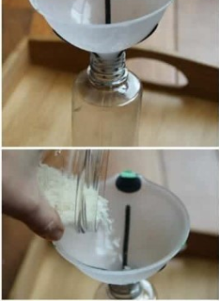
Place the funnel into the bottle
Scoop rice and pour into the funnel (that is already in the opening of the bottle

Slide 8
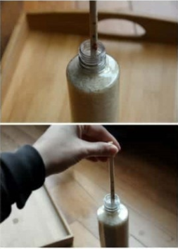
Bang the bottle gently on the table to settle the rice (key point)
Continue until mostly full
Place the chopstick into the bottle
Work it into the rice, gently banging the bottle to get the chopstick worked well into the rice
Once worked into the rice, grab the chopstick and try to lift the bottle

Slide 9
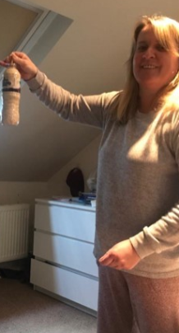
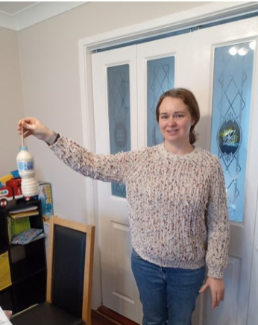

Why were you able to pick up a bottle of rice by the chopstick or pencil inside?

Slide 10
What is Friction?
Friction is a force we experience every day, all day. We can’t see it. So, we tend not to notice it. Friction is the force that opposes the movement of one substance against another. In this case, we had rice and a chopstick. As the rice sits in the bottle, there are air pockets around most grains, which prevents friction.
Notes:
I read what is on the slide

Slide 11
https://www.youtube.com/watch?v=24f_cKLJRNY
If you would like to try this experiment you will need:
A calculator and a book

Slide 12
https://www.youtube.com/watch?v=wwO2KQ7uZxY
If you would like to perform this experiment you will need a piece of card, aluminium foil and bubble wrap an object like a piece of wood. You could put the different materials on your ramp and have an object that you use to slide down the ramp if you haven’t got a piece of wood (or something similar) to wrap in the different materials.

Slide 13
https://www.youtube.com/watch?v=_LdcxCdB-s8
If you would like to perform this experiment you will need a balloon, a straw and string (or fishing wire).

Slide 14
I have also uploaded some other investigations about what we have been learning this week onto our class page.

