Slide 1
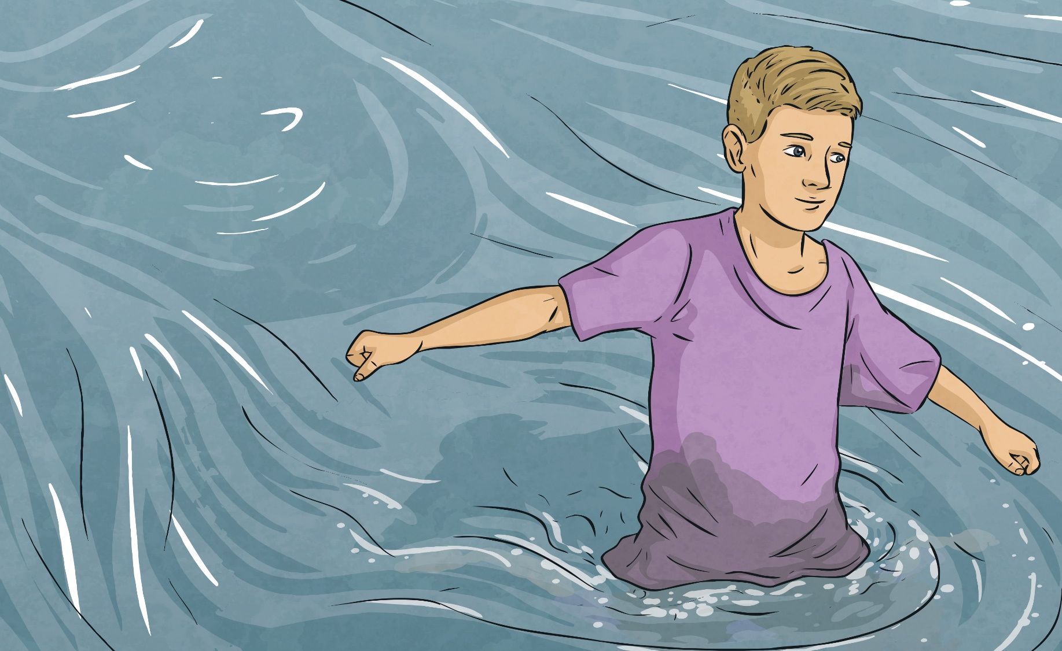
Water Resistance
How does it feel to walk through deep water?
Think of some words and phrases to describe the feeling.

Slide 2







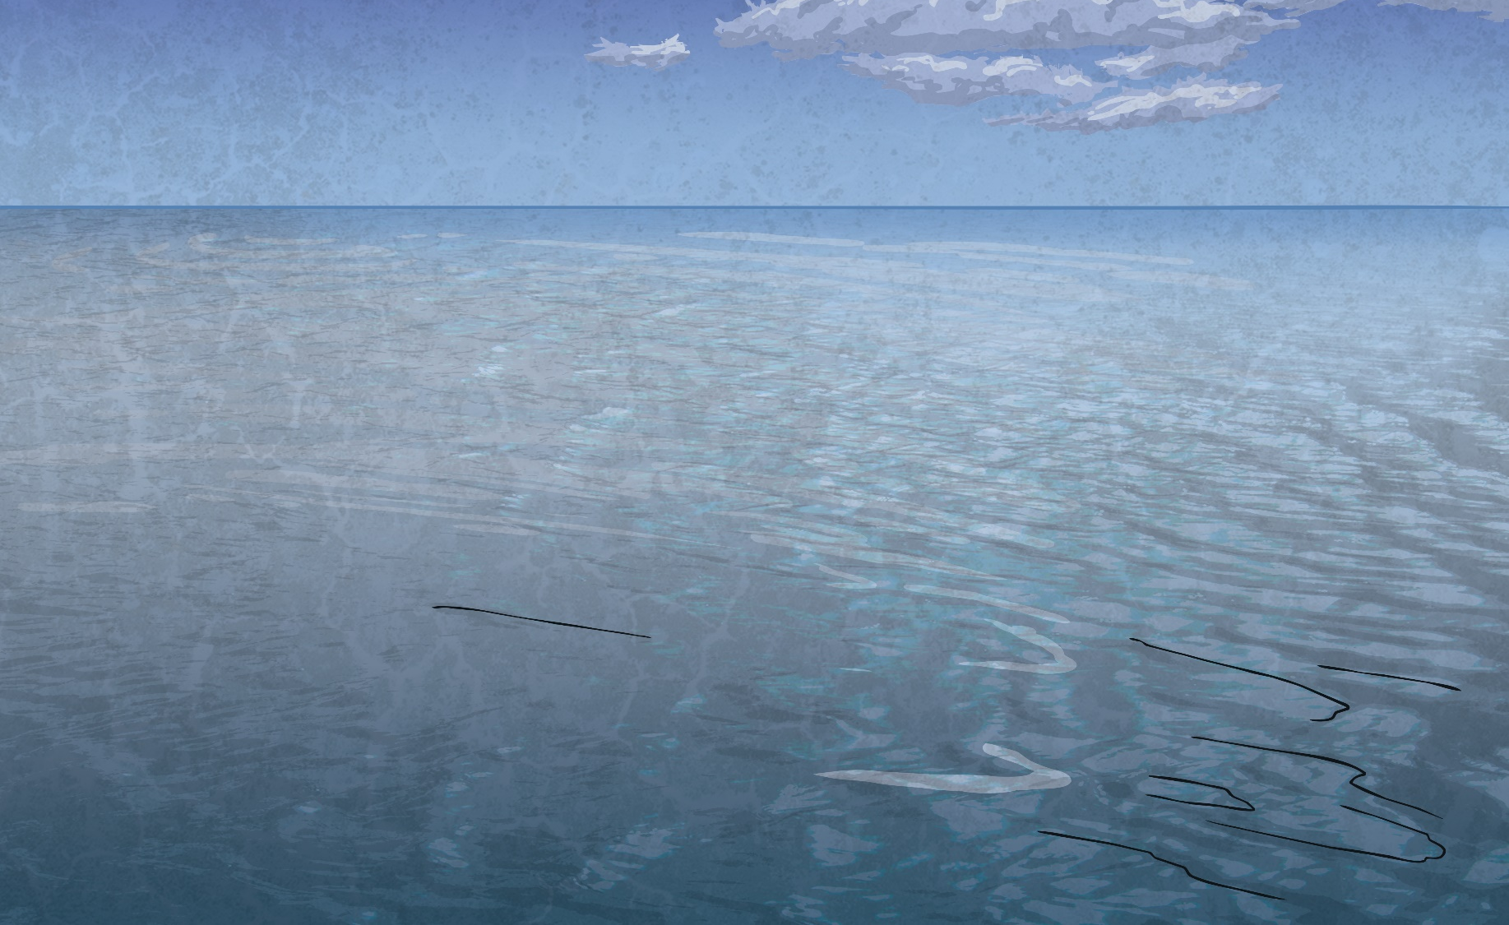
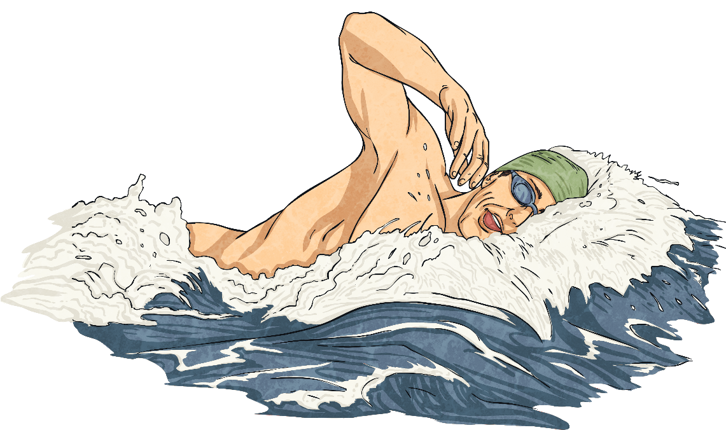
Water Resistance
If you have ever walked through water, you will have felt the effects of water resistance pushing against you.
However, this also helps you to swim, as when you push against the water with your hands, the water resistance pushes back and helps you to move forward, like using oars to push against the water to row a boat.
water resistance
Whenever an object moves through water, it experiences the force of water resistance. Water resistance pushes against objects, making it hard for them to move through water.
swimmer’s force

Slide 3
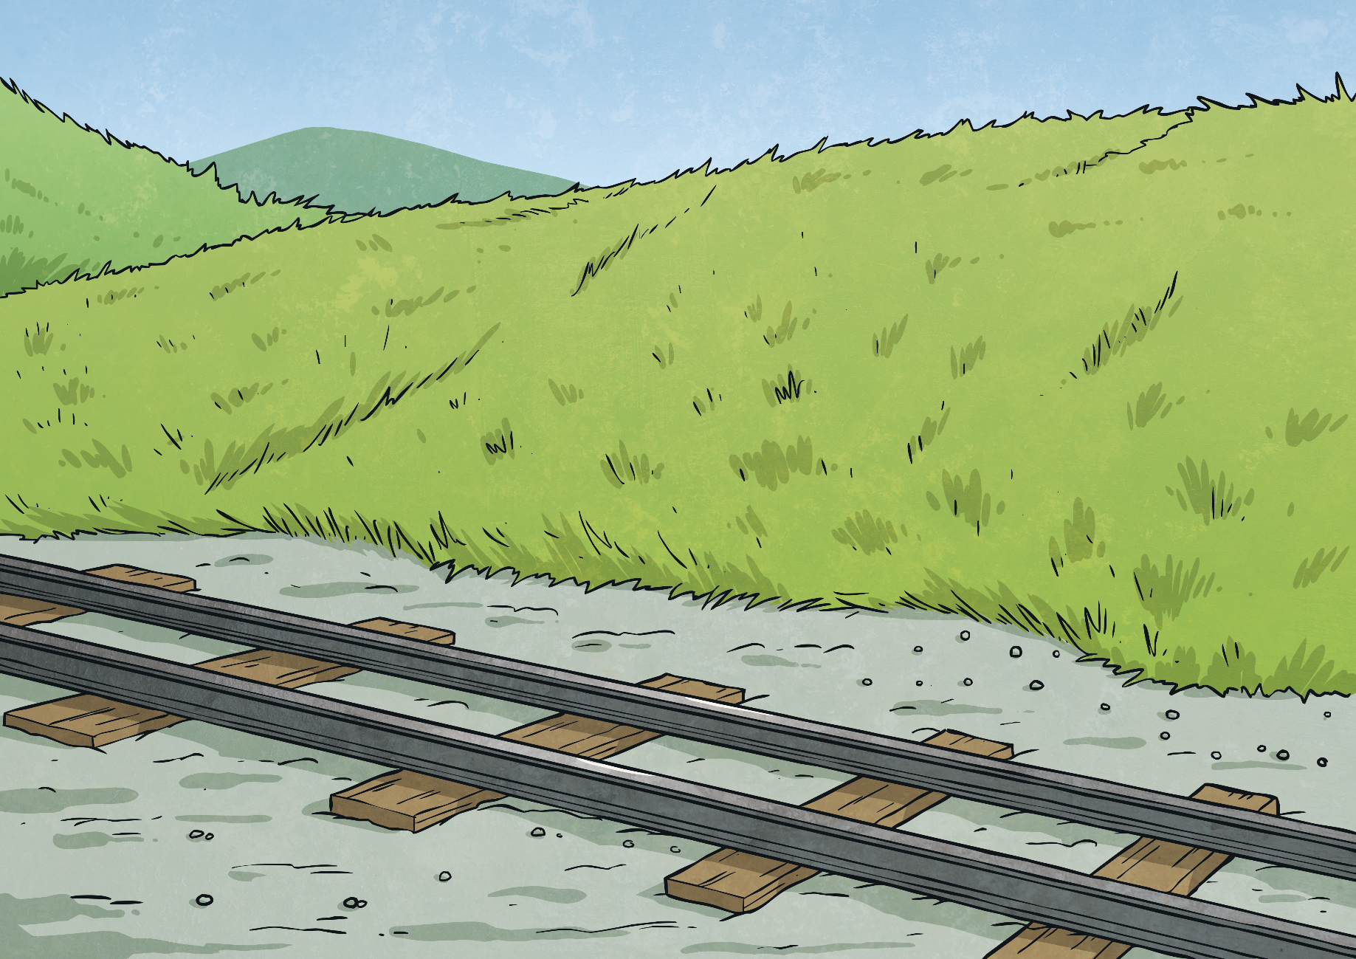
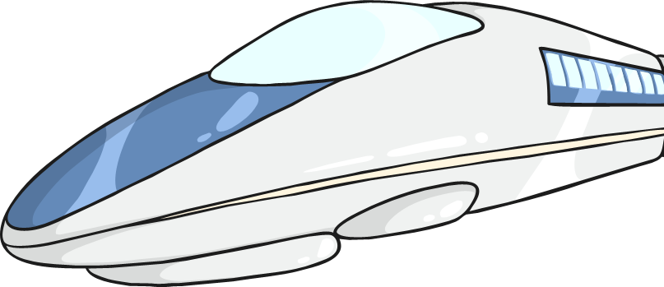
Streamlined Shapes
It is possible to reduce the effects of water and air resistance.
Objects that do not experience much water or air resistance are described as streamlined.

Slide 4
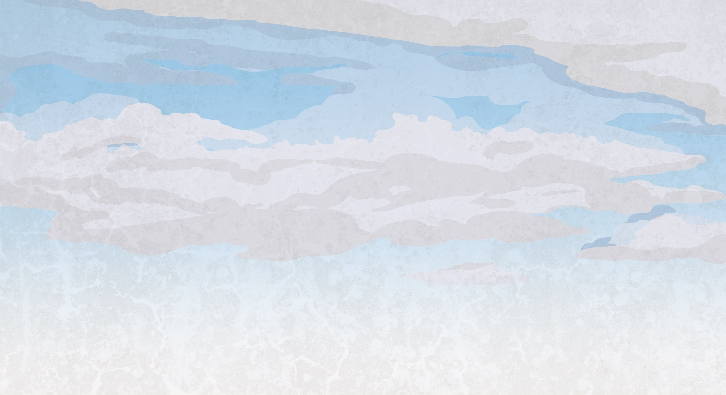
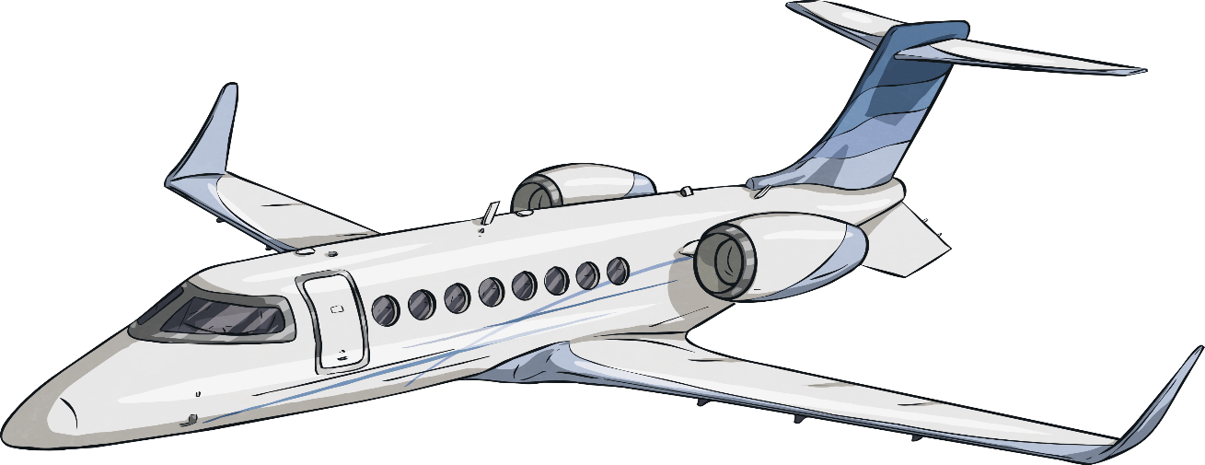
Streamlined Shapes
This aeroplane is streamlined.
Its nose is pointed so that it can cut through the air, and it has a smooth, low, curved back to allow the air to flow over and around it.
It does not create much air resistance so it can move through the air easily.

Slide 5
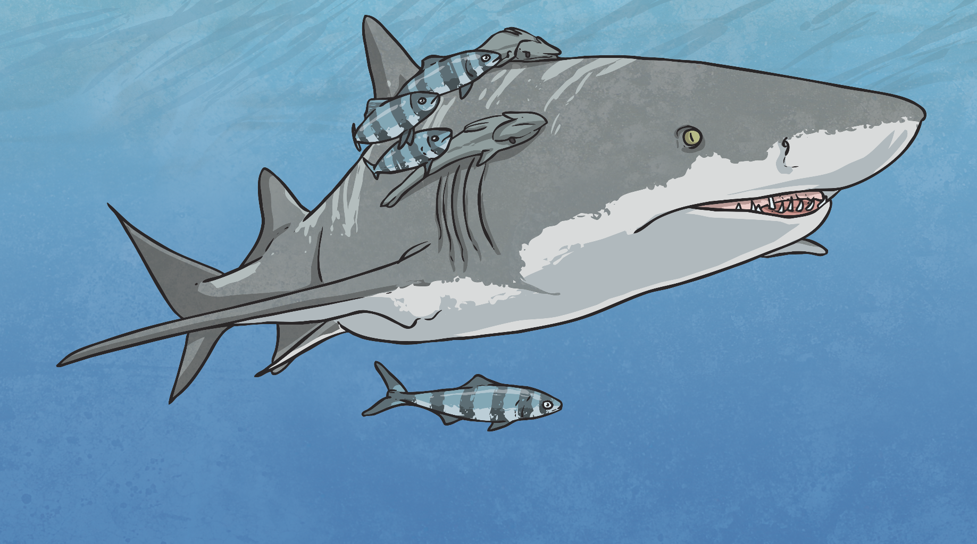
Streamlined Shapes
This shark is streamlined.
It has a pointed nose to cut through the water, and a smooth, low, curved back to allow the water to flow over and around it.
It does not create much water resistance so it can move through the water quickly.

Slide 6
https://www.youtube.com/watch?v=a85Qepkt6J0

Slide 7
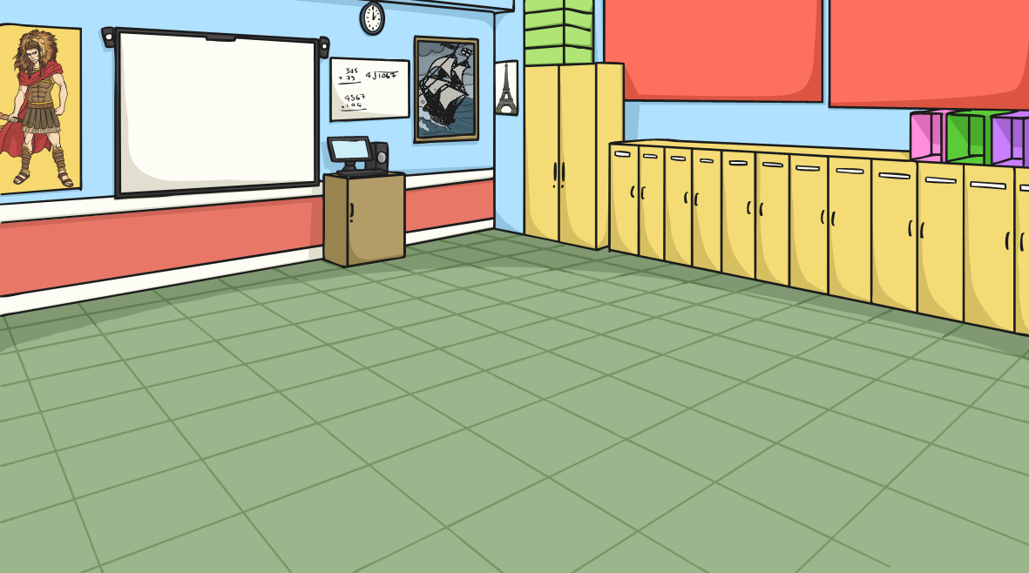
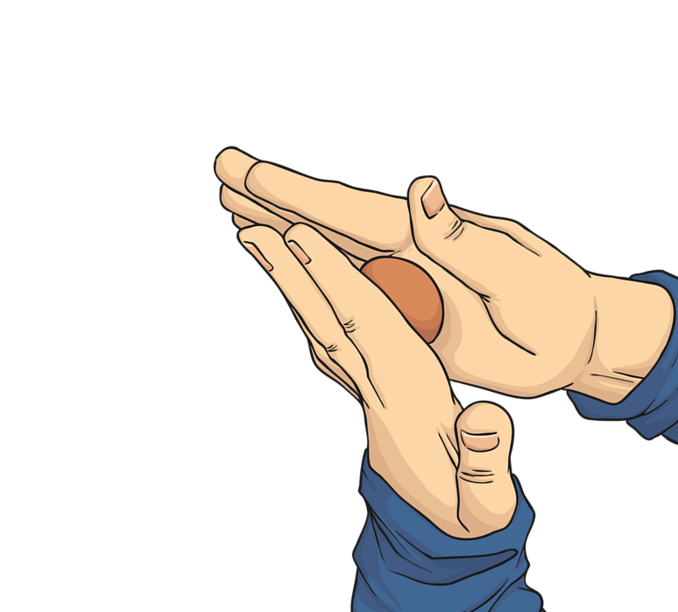
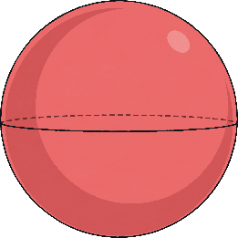
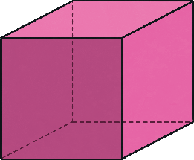
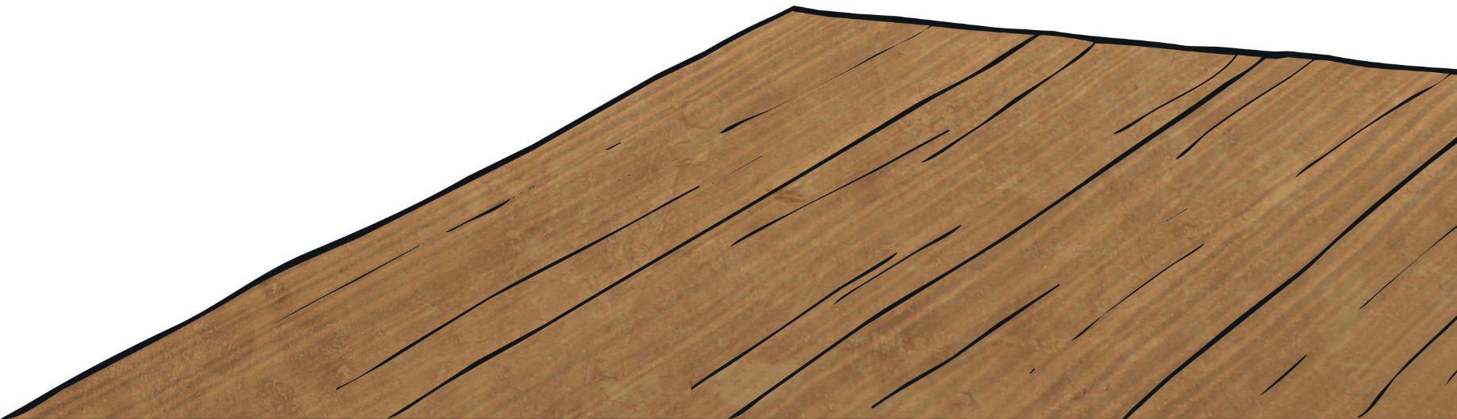
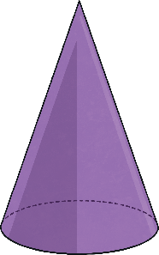
Streamlined Shapes
Try this mini-investigation to explore streamlined shapes.
Weigh out three equal pieces of modelling clay.
Then mould each piece into one of the three different shapes shown below.
sphere
cube
cone
If you do not have blu-tac, modelling clay or plasticine, please look around your home for objects of different shapes.

Slide 8
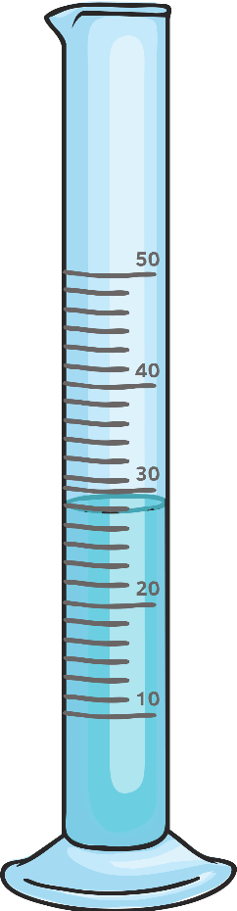
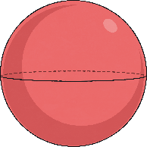
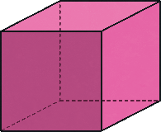
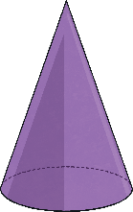
Streamlined Shapes
Which shape do you think will fall the fastest? Which will fall the slowest?
Try it out!
You will drop each shape into the water and use a stopwatch to time how long it takes to fall through the water.
Fill three identical measuring cylinders with the same amount of water.
You can use a water jug, a vase, a milk bottle, cut the top of an empty squash bottle or something else you can think of that is appropriate.

Slide 9
Streamlined Shapes
Can you give an example of an animal that has a streamlined shape?
The cube should have fallen the slowest through the water. It is the least streamlined shape because it has a flat surface which creates a lot of water resistance. The water pushes against the flat surface, slowing it down.
The cone should have fallen the fastest through the water. It is the most streamlined shape as it has a pointed end to cut through the water.

Slide 10
Please write or type a short paragraph to explain what happened in your investigation.

