Slide 1
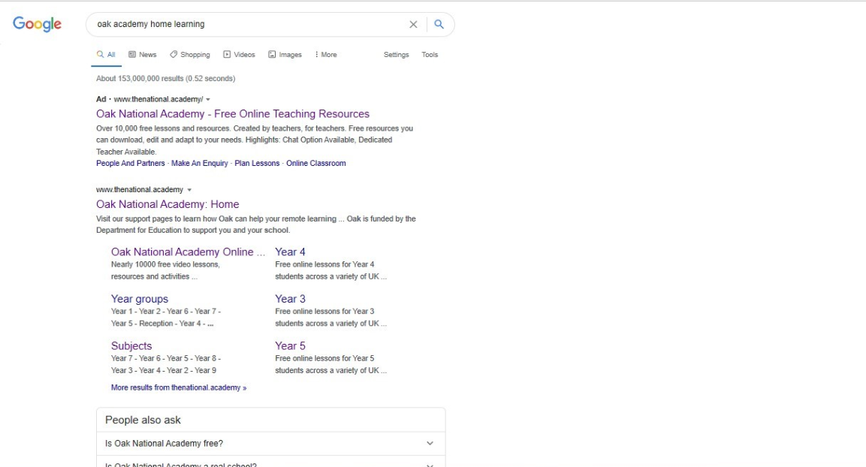
Type Oak Academy home learning
Click on this link

Slide 2

Click on learning

Slide 3

Click on subjects

Slide 4
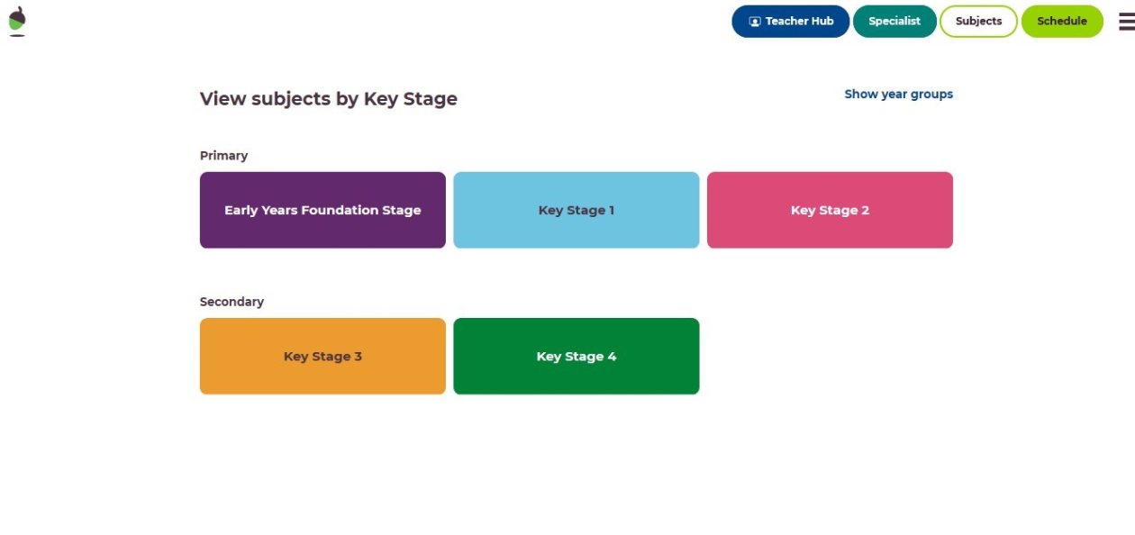
Click on Key Stage 2

Slide 5
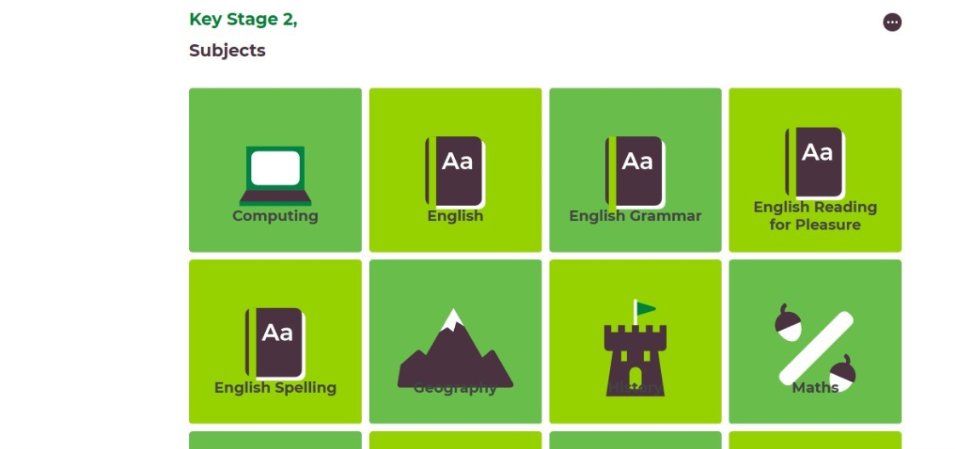
Click on Maths

Slide 6
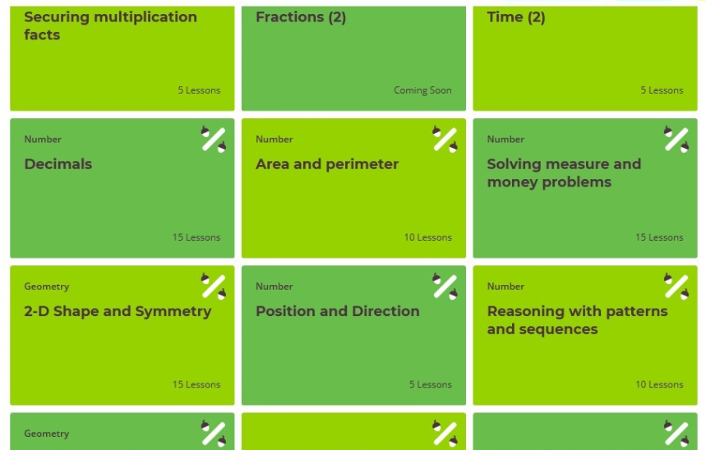
Click on Area and Perimeter

Slide 7
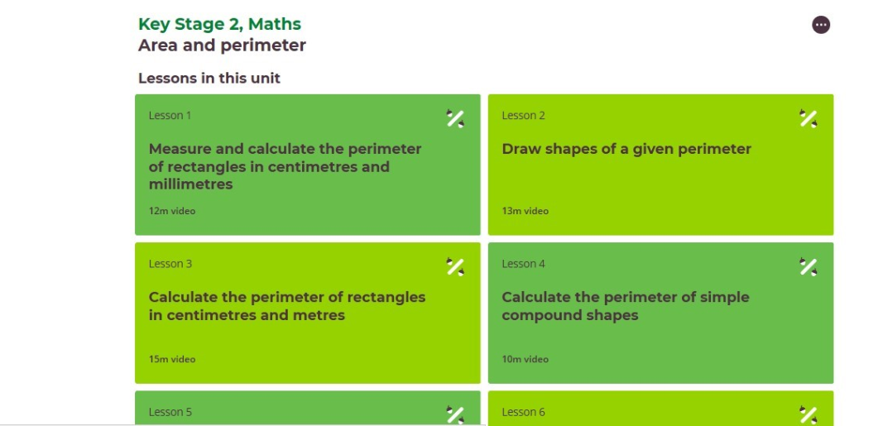
This page will then be on your screen. Please scroll down to find the lessons.

Slide 8


