Slide 1
Design Task
Choose one of the following
(…or both if you really want to!)
Think about what you have learned about farming, can you design a machine or vehicle that would really help a farmer? Draw it out and label it. Write a few sentences to explain what it does.
Design a farm! Will it be arable, pastoral or both? Think about all the buildings you might need -spaces for animals and for machinery. Draw it out on squared paper like a plan. Perhaps you could create a key. Colour the animal areas one colour, storage another, crops another.

Slide 2
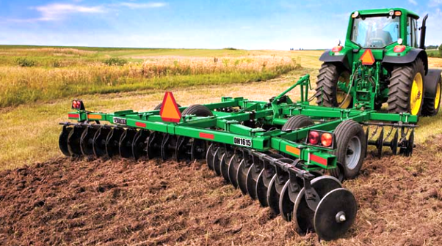
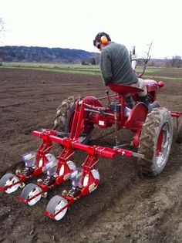
Machinery
We know that farmers need a LOT of different pieces of machinery. Some things are HUGE..
..but other things are not so enormous.
Can you design a useful piece of machinery that could make a farmer’s life easier? This doesn’t have to be a massive tractor – maybe it could be something for the tractor? Could your invention make the farmer’s early mornings a little easier?

Slide 3
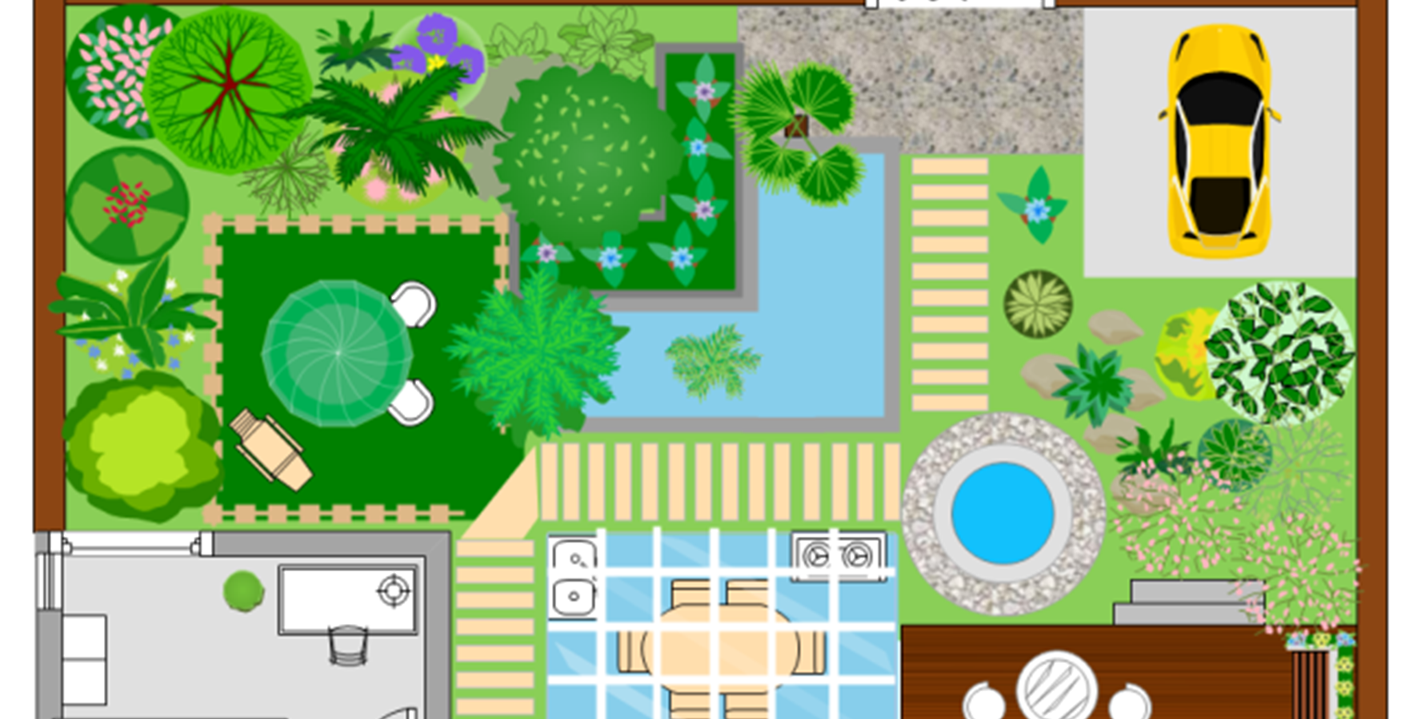
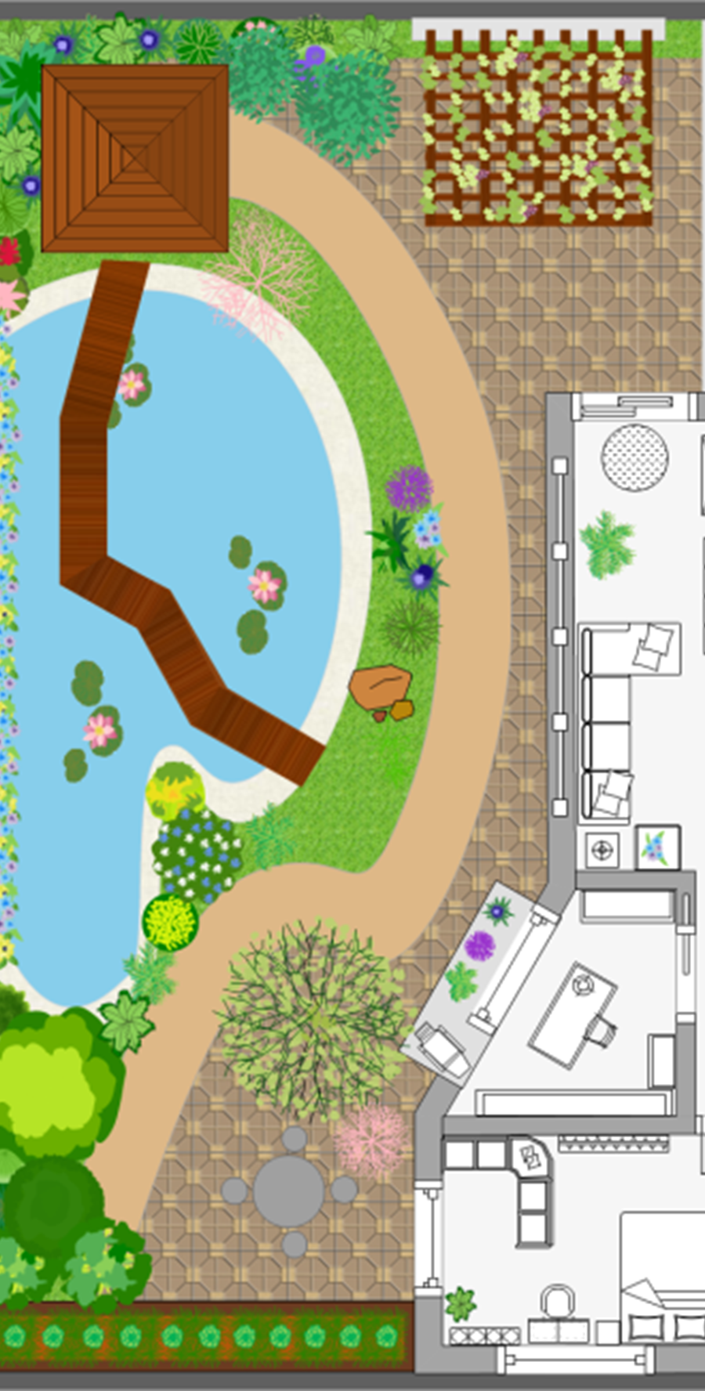
Design your very own farm!
Will it be pastoral? Arable? A mix of both?!
Draw it as a plan – like these pictures here. Label everything that you include –challenge yourself to use a key to help me see what you have designed.
You could draw your plan like these pictures here (these are gardens, not farms) or like my idea on the next slide where I used the computer to draw coloured boxes.
Think which style you prefer, which is nicer and clearer to look at? Make a decision and then…design!!

Slide 4
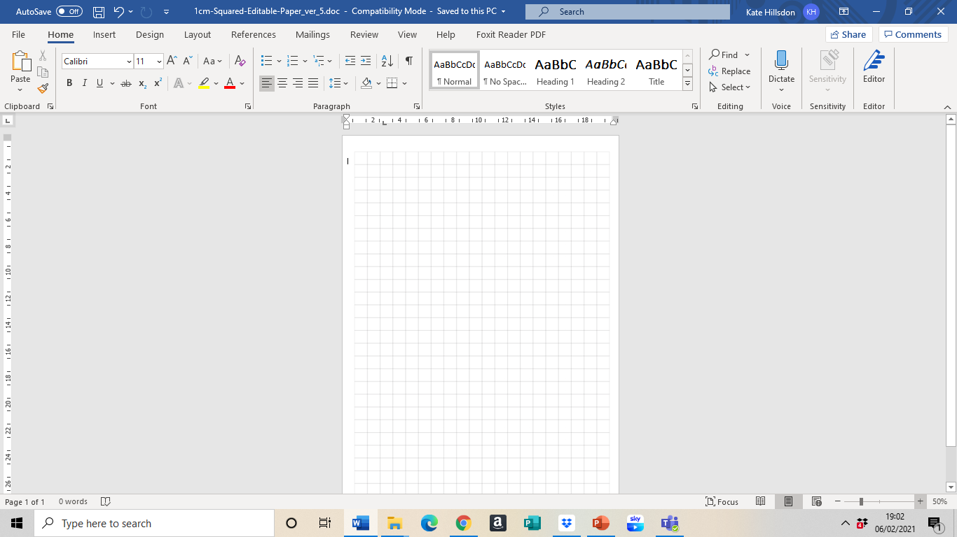













Key
Farm Shop
Farm House
Garden
Cows
Milking room
Dairy
Tractor shed
Fruit orchard
Vegetable fields
Chicken Coop
Pond

Slide 5

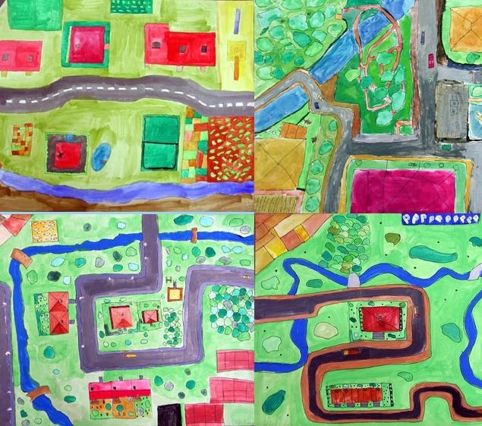




Some other ideas

