Slide 2
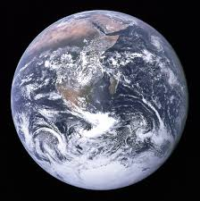


What is a fraction?
A fraction means part of a whole.
Here are some whole things…what could be a part of them?

Slide 3
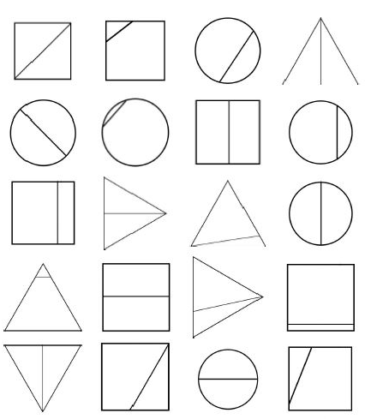
The parts of a fraction must be equal.
Which of these shapes is split into fractions?
(There are 9!)

Slide 4
The whole is 10 rectangles.
What equal parts can we make from it with no pieces left over?

Slide 5
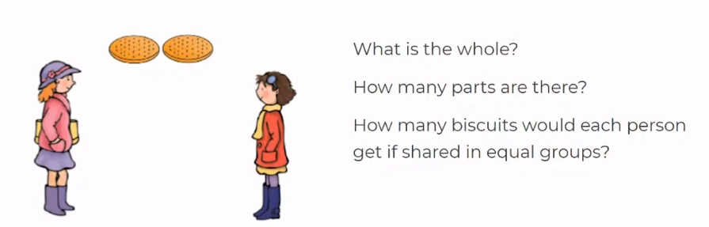
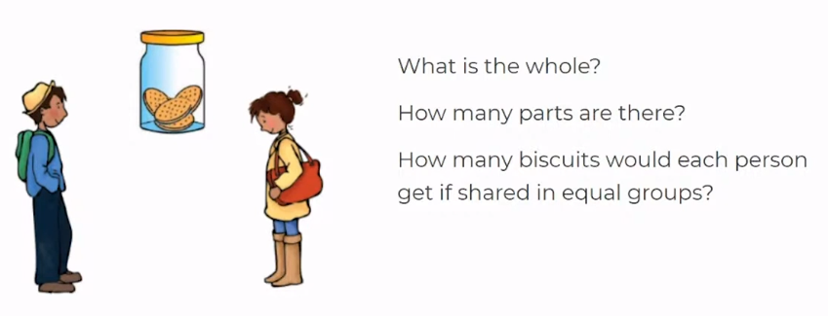

Slide 6
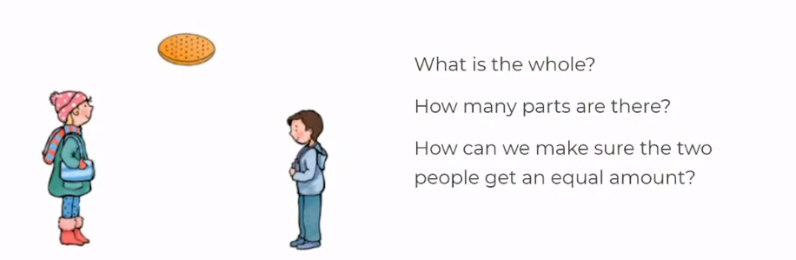
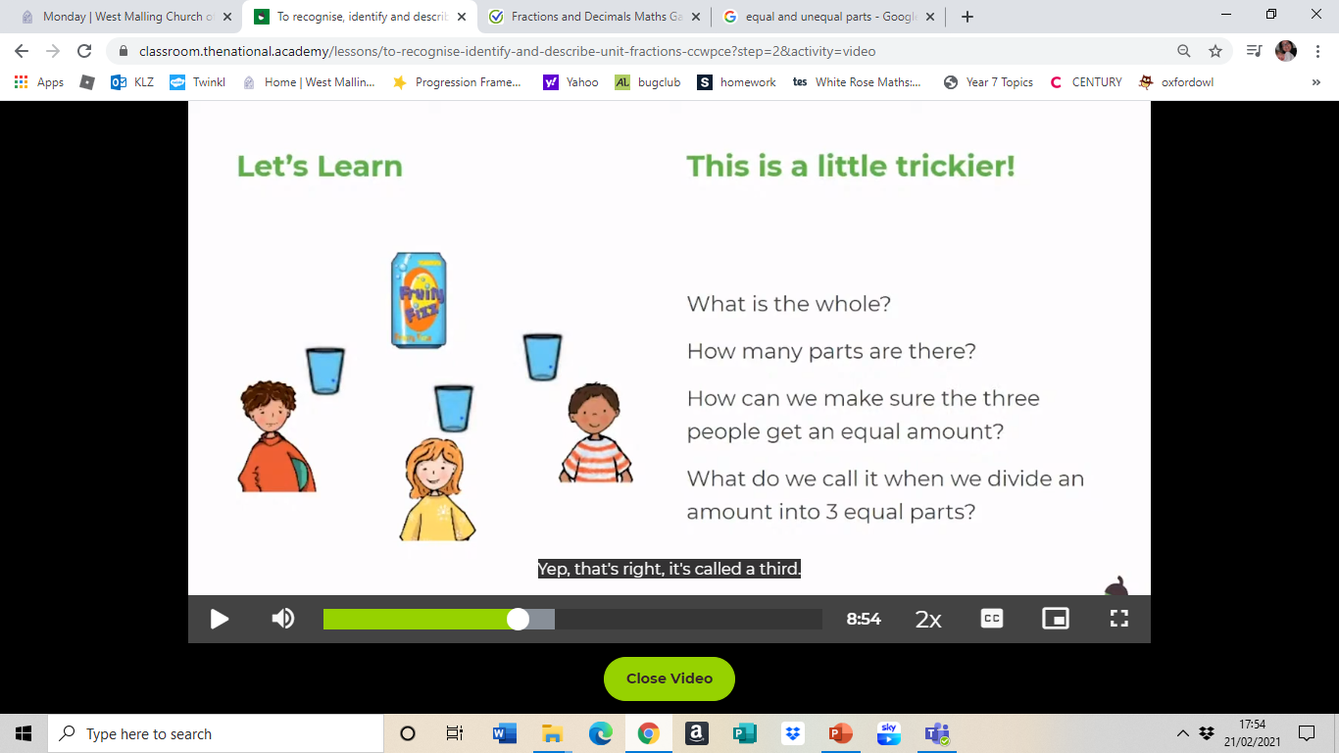

Slide 7
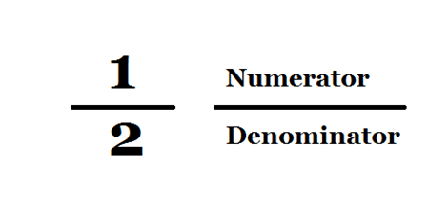
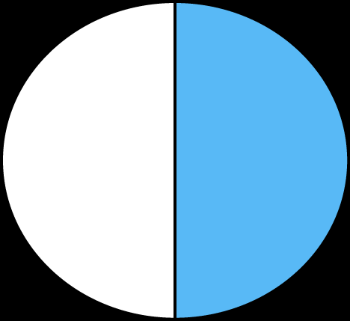
The part
The whole

Slide 8
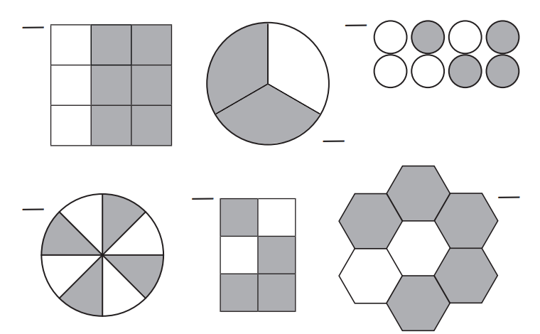
What fraction is white?

Slide 9
1/5
1/10
½
1/3
¼
1/8
smallest
largest

Slide 10
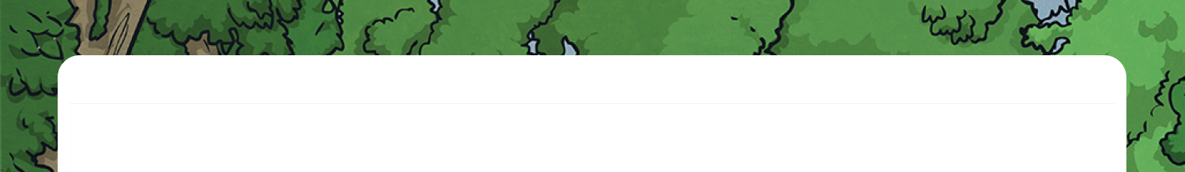


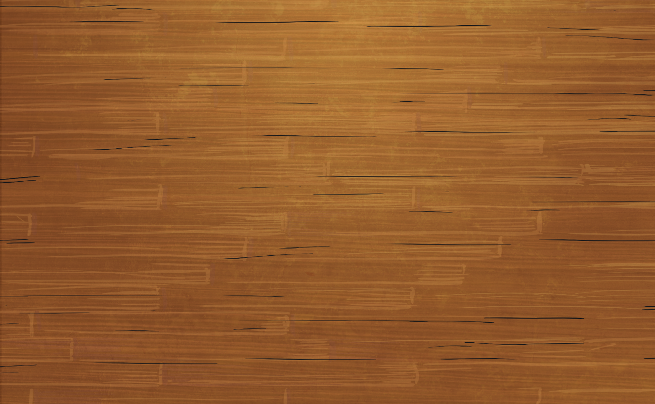

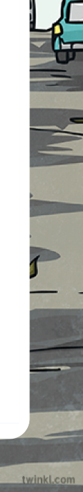
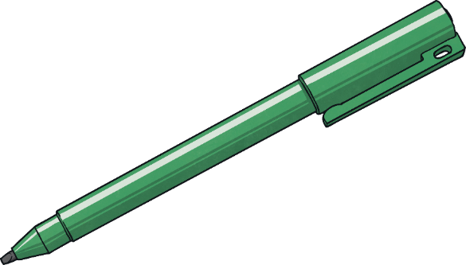
What Is a Fraction?
Diving
Have these shapes been split into fractions?
Yes, these are fractions. The four smaller triangles are identical.
No, these are not fractions because each part is not the same size.
Yes, these are fractions as the two halves are the same size.
No, these are not fractions as the sections are different sizes.

