Slide 1
Arable Farming
Arable farming involves growing crops such as wheat and barley.

Slide 2
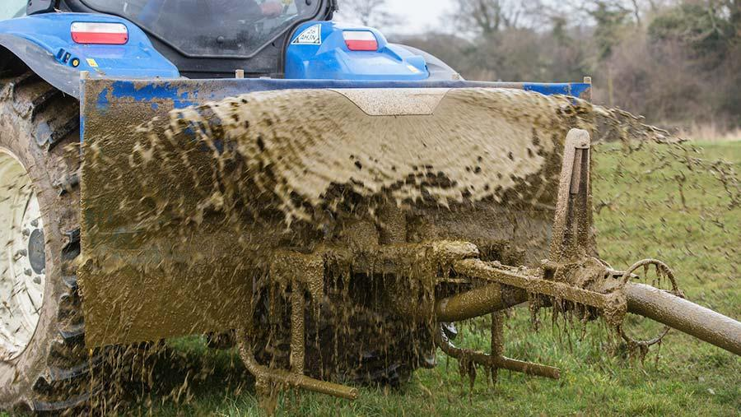
What is slurry and how is it used?
Slurry is water and manure mixed together to give nutrients to the plants. It is sprayed out to the plants by the tractor.

Slide 3
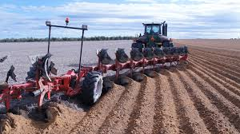
Why does soil need to be ploughed?
When the soil is ploughed it takes the bottom soil to the top and helps the water drain to give the crops a drink. The birds like it because the worms come to the top of the soil - its a bird buffet!

Slide 4
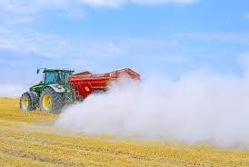
What does liming do to the soil?
Liming improves the soil and helps it get more nutrients to help the plants grow.

Slide 5
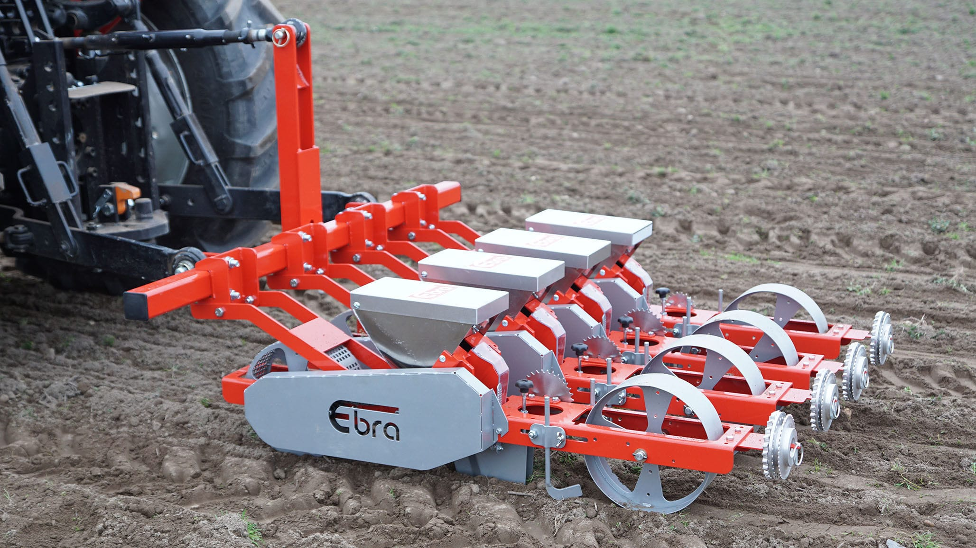
How are the seeds planted on a farm?
A tractor drills into the soil to make holes for the seeds to go in.

Slide 6
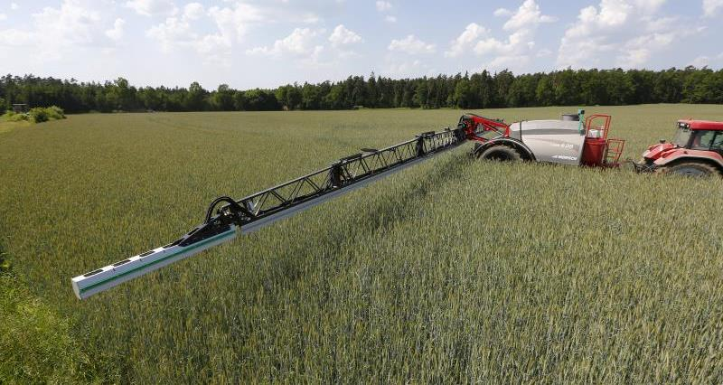
How are crops protected?
Crops are sprayed to help kill the weeds just in case they take over the plant and stop it growing.

Slide 7
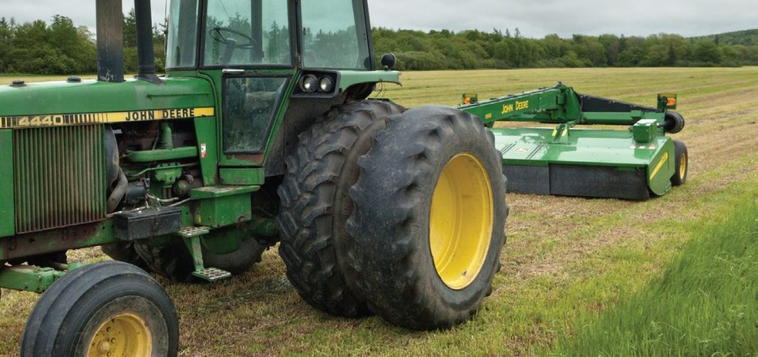
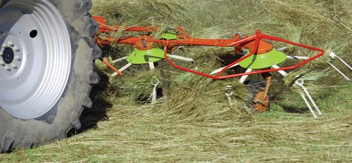
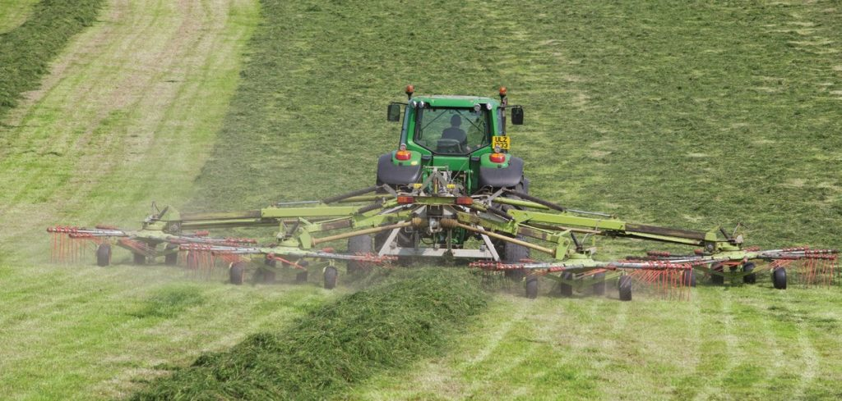
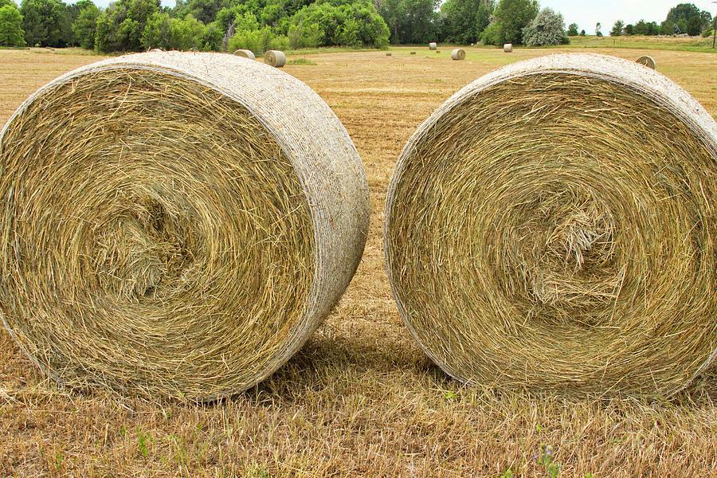
What are the 4 stages of creating silage or haylage?
For Silage: Mowing, Tedding, Raking and Foraging.
For Haylage: The grass is left to dry for longer and it is made into hay bales.

Slide 8
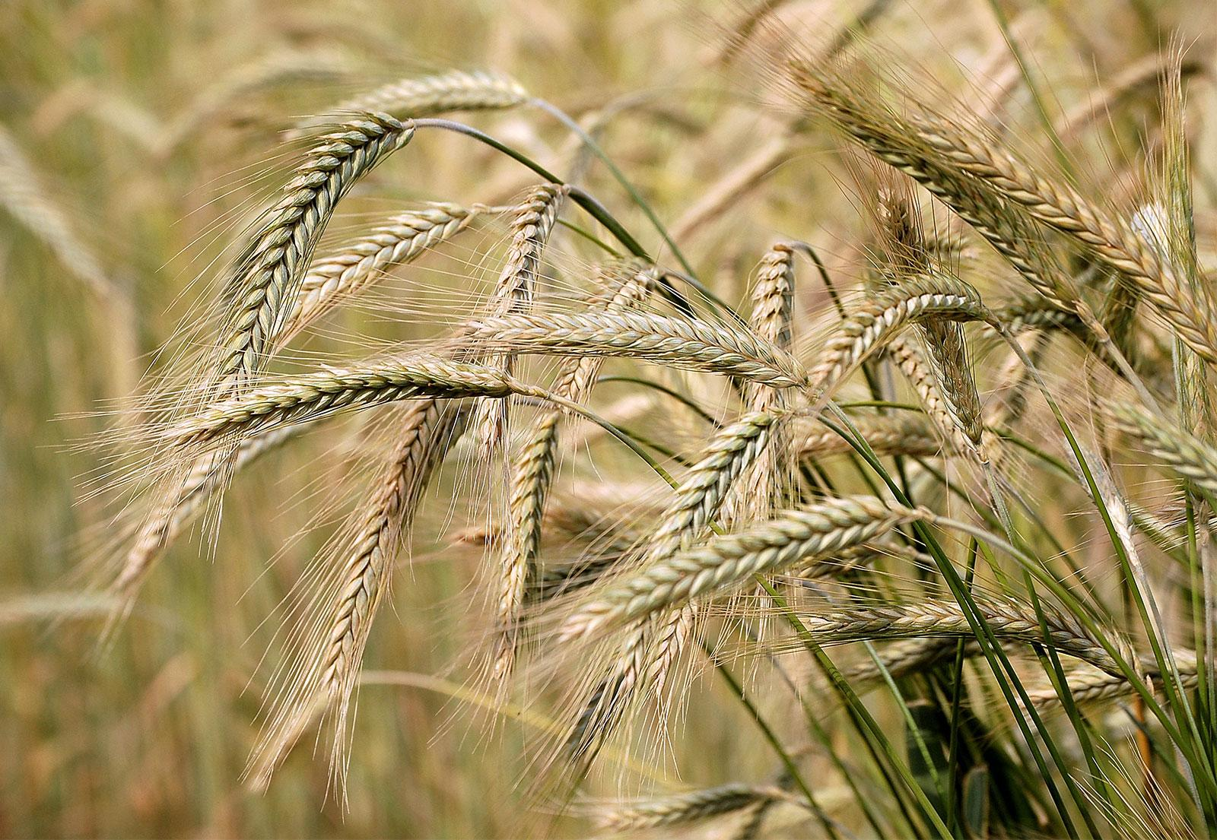
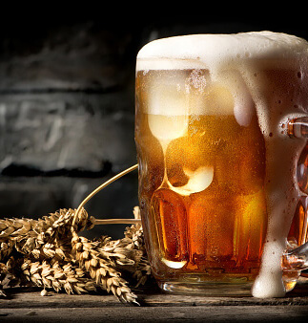
All about Barley...
Barley is used in human and animal food. It is used to make beer too. They remove the seeds that go to the farm. And the straw is used as bedding for the animals.

Slide 9
By Joshua Hook

