Slide 1
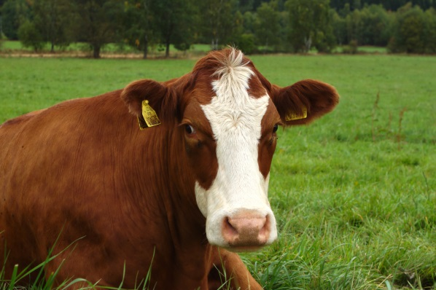
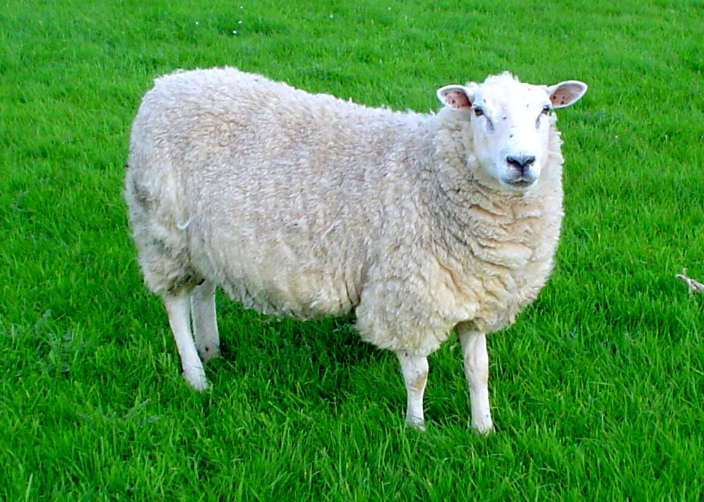
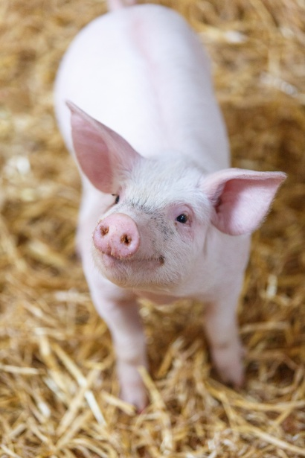
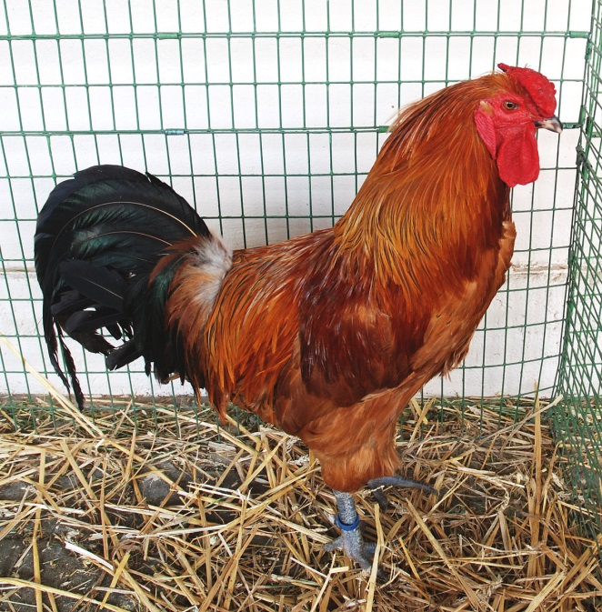
Pastoral Farming

Slide 2
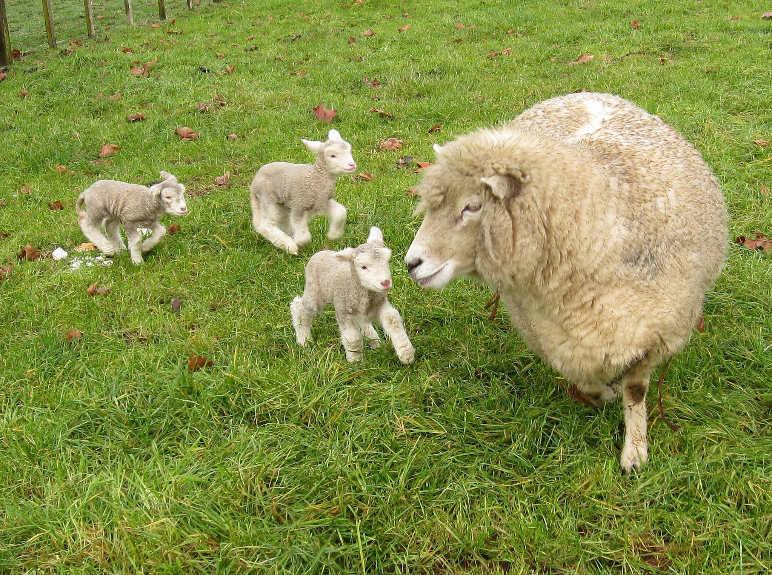
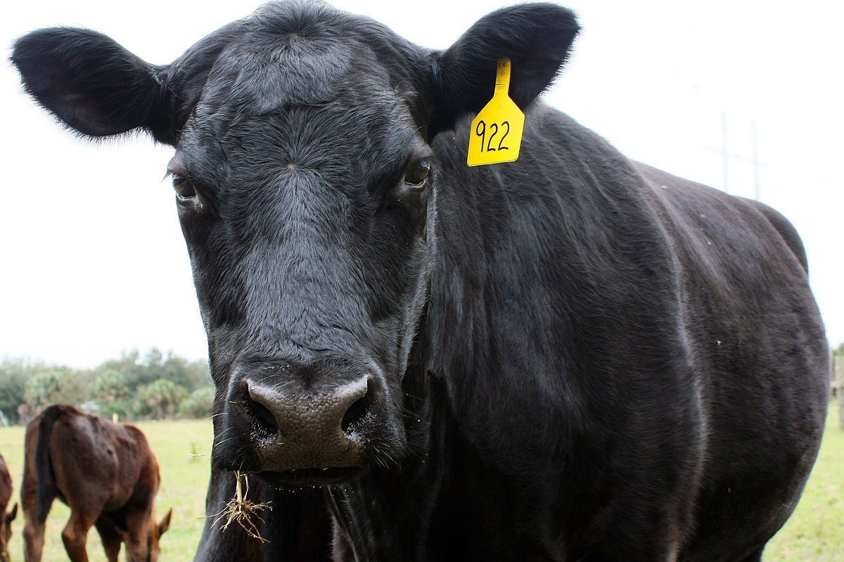
What does Pastoral farming mean?
Pastoral farming is aimed at producing livestock rather then growing crops. The livestock is fed naturally grown grass or leaves but mostly grass. This is for food. It also includes dairy farming which is to produce milk.

Slide 3
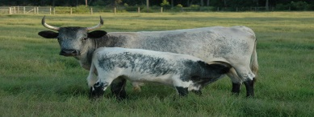
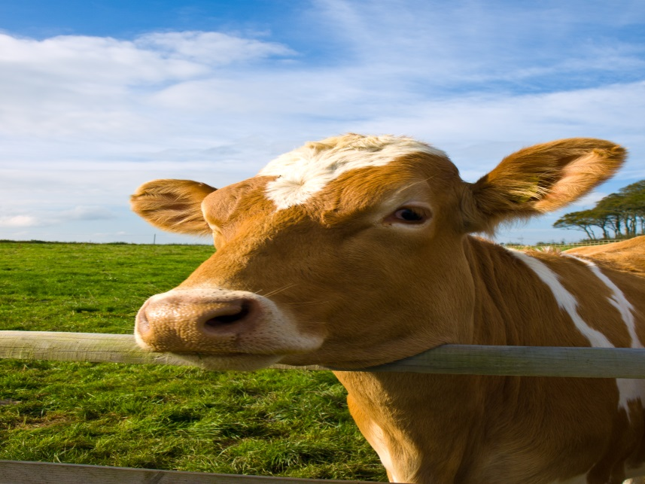
Dairy farming

Slide 4
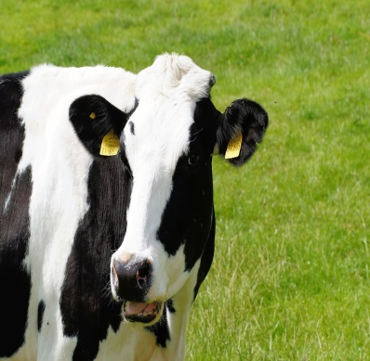
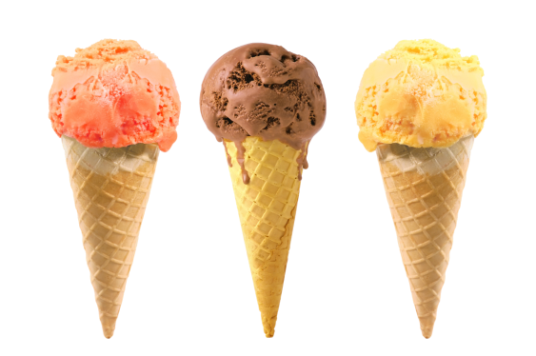
Dairy farming
They milk cows by putting a suction machine onto the cows udder. It lightly sucks out the milk by recreating what a calf would do. This takes about 5 minutes.
They can also milk cows by using a robot so the cow can choose when it wants to be milked. Lasers position the suction cups onto the udders
things made from milk
Cream
Ice cream
Cheese
Butter
Ice cream
Ice cream is made by putting cream into pots. Then the containers are put into the large freezer where they are frozen

Slide 5
Livestock Farming
Livestock farming is keeping animals for food or other products.
Cattle
Cows are used for making meat. Some breeds of cows are easier for the farmers to handle. Cows are herbivores so they eat grass and other vegetation. The meat is called beef and it can be served as mincemeat or joints or steak.
Sheep
Female sheep are called ewes. Giving birth to twins and triplets is not unusual
Sheep are herbivores like the cows and eat the same. Sheep are kept for their wool and their meat. Sheepskin is used to make things like boots and rugs.
The meat is called mutton or lamb
Pigs
A female pig is called a sow and male pigs are called boars. Piglets in a week can grow double their weight. Pigs are omnivores which means they eat everything like plants and worms and small rodents. Mud protects their skin when it is sunny.
The meat is called pork and the long side meat is thinly sliced into bacon. Some of the bits are made into sausages or chops .

