Slide 1
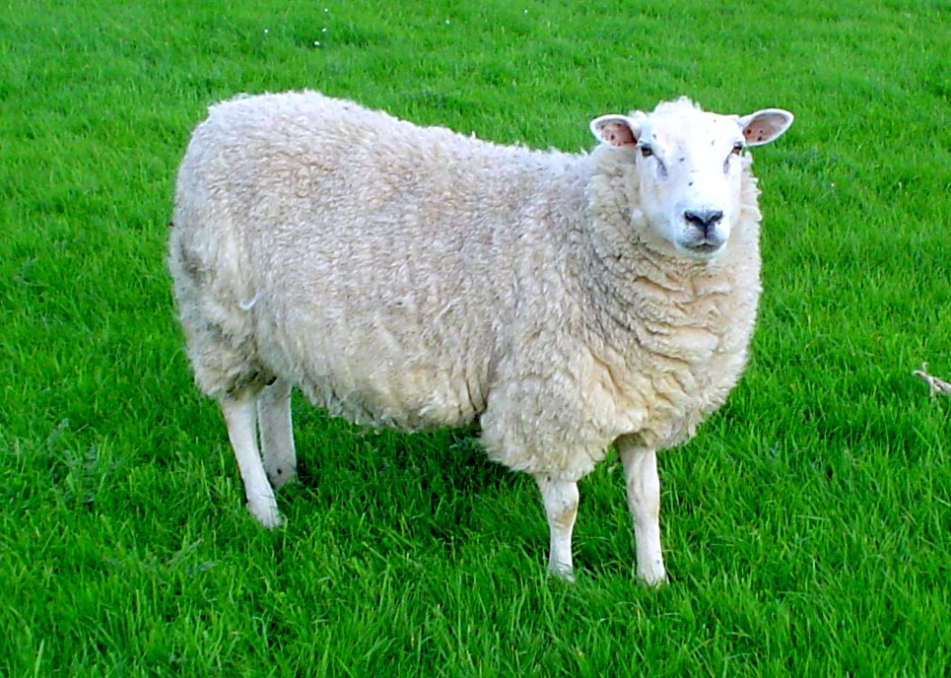
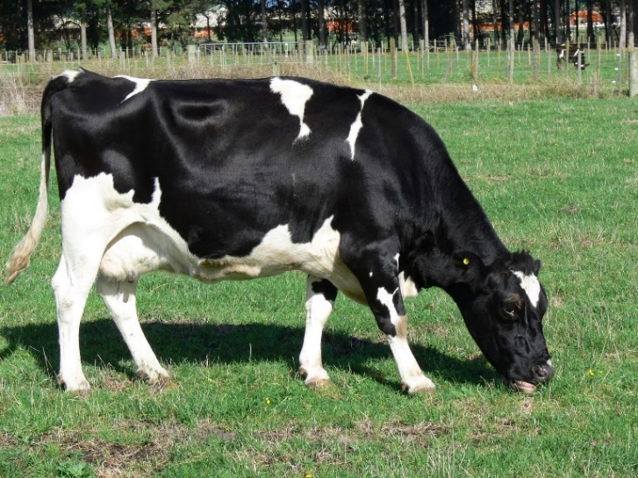
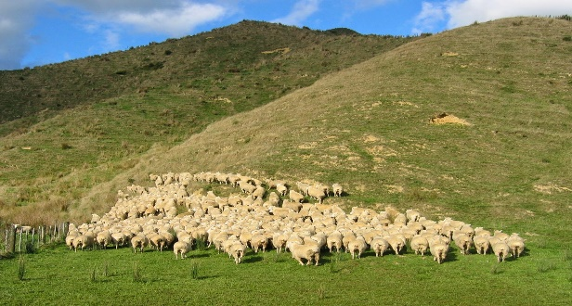
Pastoral Farming
Pastoral farming is all about animals and their products, but most of all dairy cows, because they produce a big amount of milk, cheese, ice cream and clotted cream. Goats and sheep are a big part of this type of farming, they produce wool, milk and cheese. All milk and wool are produced at the farm then shipped of to factories that make butter, cheese and creams of all sorts. Pastoral farming is aimed at producing live stock and not growing crops.

Slide 2
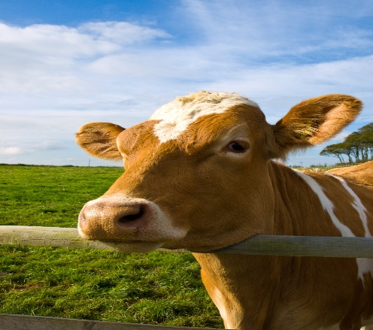
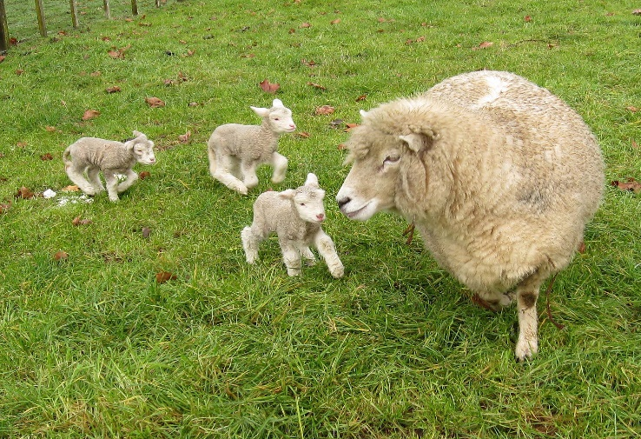
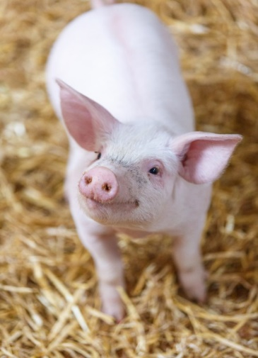
Livestock Farming
Livestock Farming can include
Sheep – female sheep are called ewes. Male sheep are called rams. They are farmed for their wool and their meat. They shear the sheep to get the wool and to help the sheep in warm weather to stop them getting fly-strike. Wool is used for making clothes and carpets. Sheepskin is used for boots
Cattle – they are kept for meat. They spend most of their time in the field eating grass. The meat is called beef. You can have roast beef, steak or beef burgers
Pigs – a female pig is called a sow they normally have 6 to 12 piglets. They use their noses to search for food and they eat plants, worms and small rodents. pigs are kept for their meat which is called pork. Bacon, sausages and ham are made from pork.

Slide 3

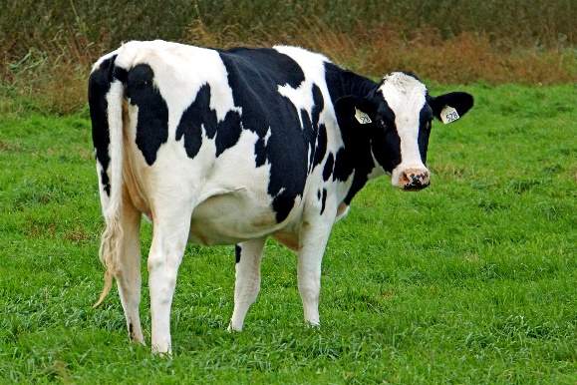
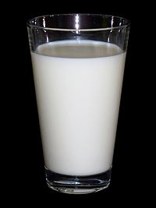
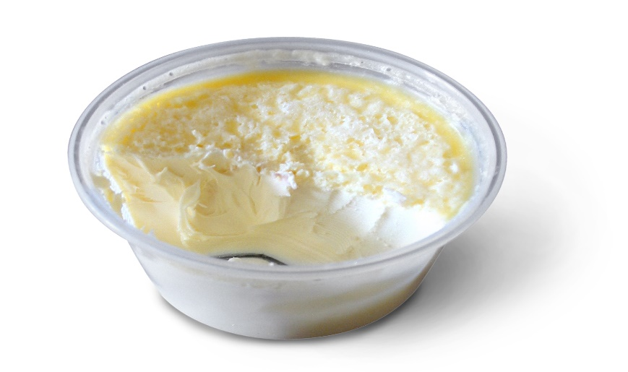
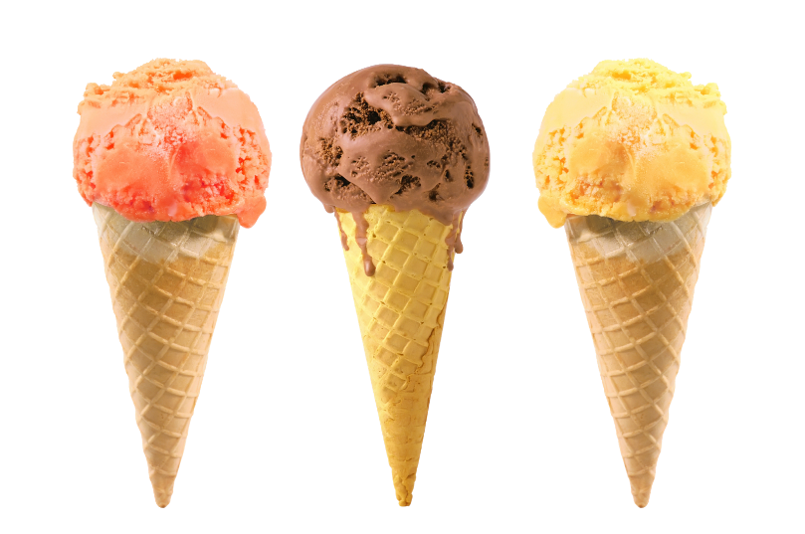
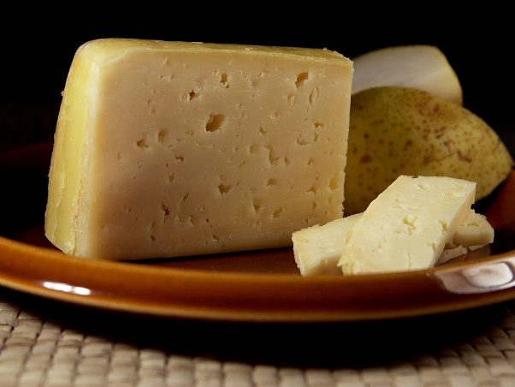
Dairy Farming
There are two different ways to milk a cow, one is to use a special machine that imitates the way their calves suck the udders and the second way is to use yet another machine but this time it lets the mom chose when she gets milked. Both of these methods use machines that have four ‘suction cups’ that connect to a long tube which ends up in a tank ready to go through a couple tests and filtrations to make sure that there are no germs in the milk.

