Slide 1

The sock sorting AND CHOOSING machine
kNOWN AS THE ‘SSCM”
”NO LONGER WILL YOUR SOCKS BE ODD!”

Slide 2
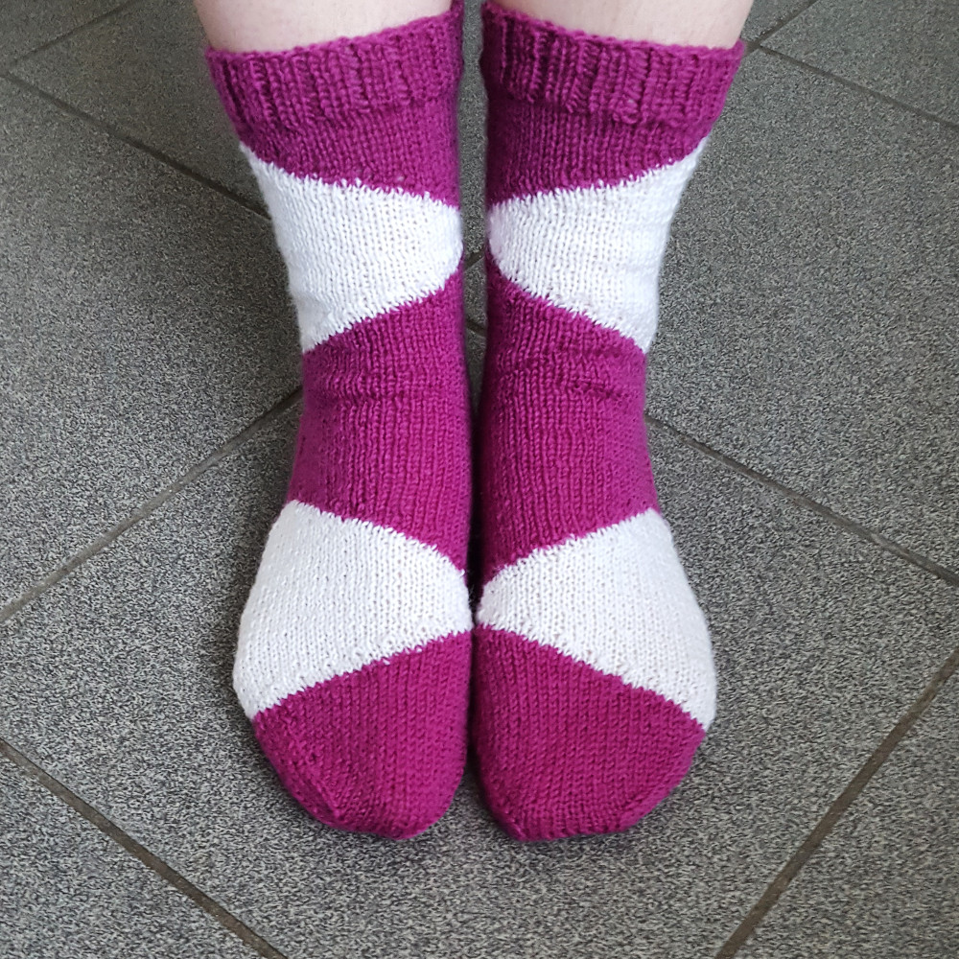
AIM OF THE SSCM
Will sort the families socks after washing into pairs and who they belong to.
Spot a hole function.
Gives you the option to choose suitable socks for the day within minutes.
Any member of the family can use it.
Moth proof.

Slide 3
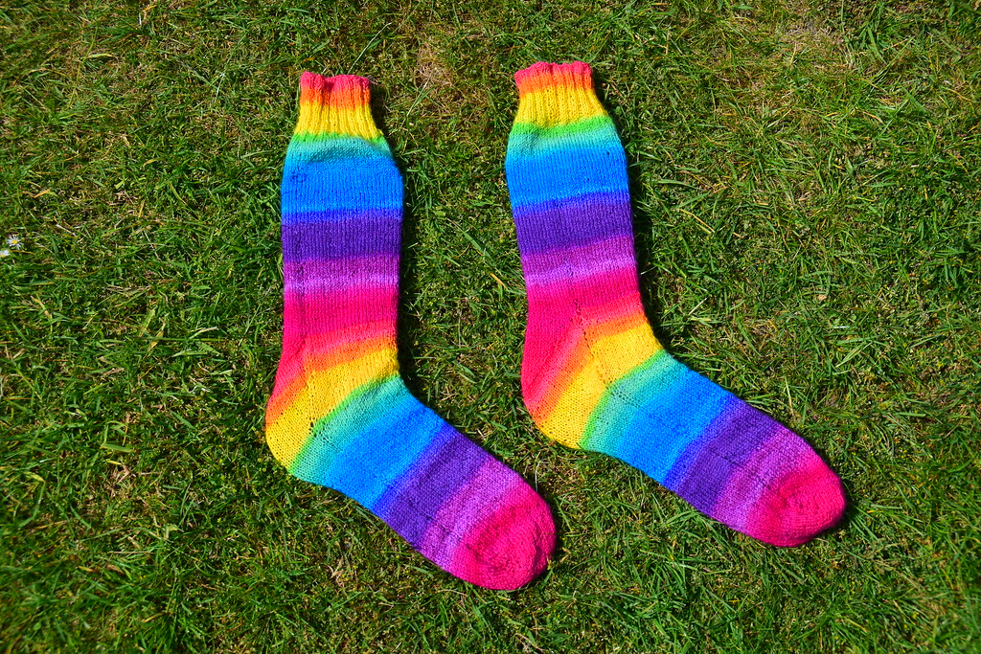


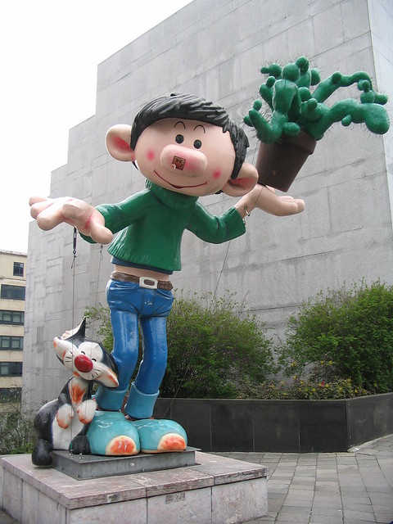
Screen one
To start, choose who you would like socks for.

Slide 4
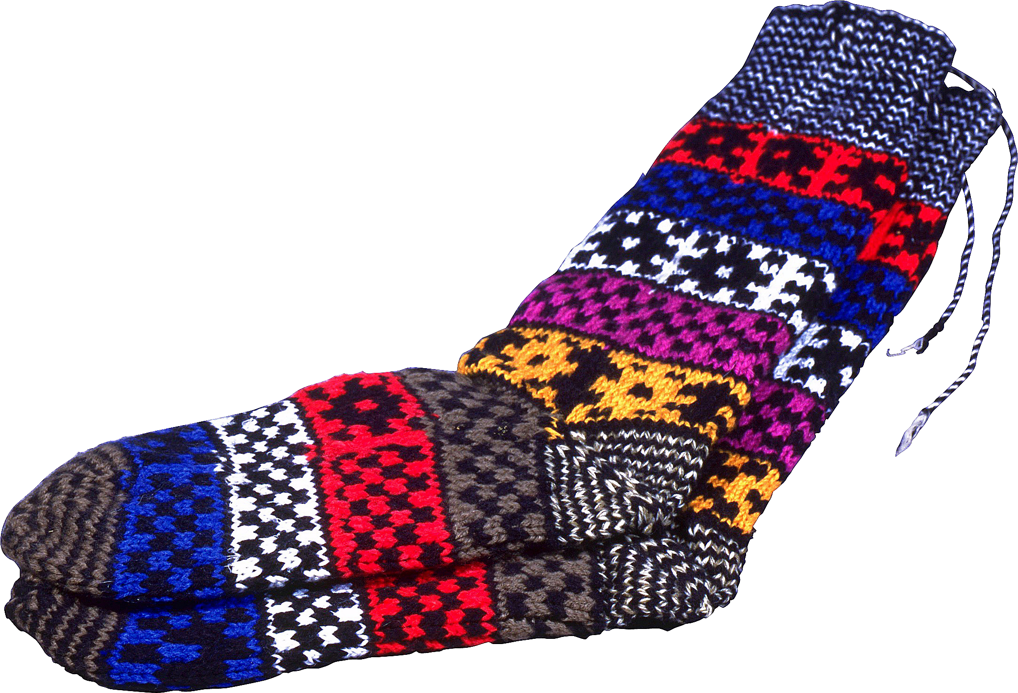
Screen two
School
Sport
Casual
Hiking
Bed
On this screen you can choose which type of sock you require.

Slide 5
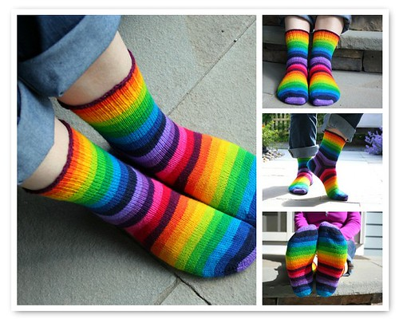
Screen three
Multi
Blue
Black
White
On this screen you choose what colour sock you would like.

Slide 6
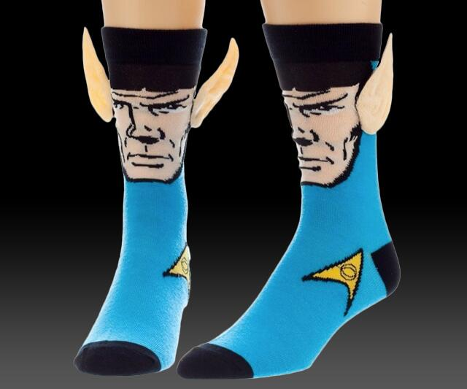
Screen four
Plain
Zigzag
Stripe
Funny
In this screen you choose what pattern you would like.

Slide 7
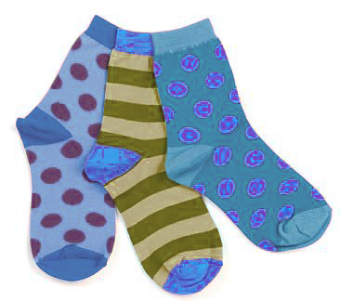

Final screen
This screen, you pick up your socks and thank the machine.
Thank you for choosing these socks, they are dispensed on your right. Have a good day!

