Slide 1

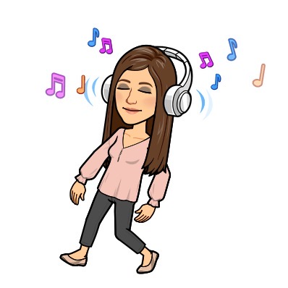
Coordination Funk
We are going to learn the song Coordination Funk in our music lesson this week. Have a go at singing along to this catchy tune! Click on the link below to listen to the song!
https://www.youtube.com/watch?v=FBiWZ9oUaDg&feature=emb_logo

Slide 2


Coordination Funk
Now that you have listened to Coordination Funk, have
a go at completing the activities.
We would love to see some videos of your ideas!

