Slide 1
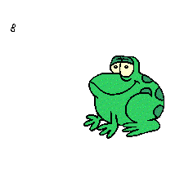

5 little speckled frogs

Slide 2
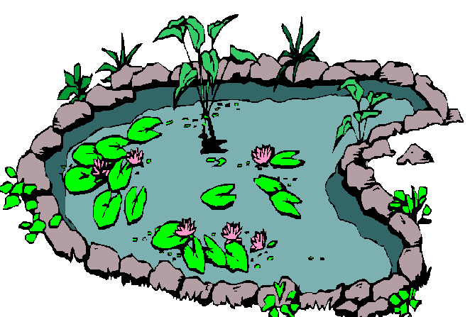
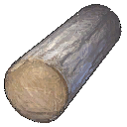
5 little speckled frogs, sat on a speckled log,
Eating the most delicious grubs.
Yum yum!
1 jumped into the pool, Where it was nice and cool,
Then there were only 4 green frogs.
Glug glug!
5+0
Notes:
Let’s count – 1, 2, 3, 4, 5!

Slide 3
4 little speckled frogs, sat on a speckled log,
Eating the most delicious grubs.
Yum yum!
1 jumped into the pool, Where it was nice and cool,
Then there were only 3 green frogs.
Glug glug!
4+1
Notes:
Let’s count – 1, 2, 3, 4, 5!

Slide 4
3 little speckled frogs, sat on a speckled log,
Eating the most delicious grubs.
Yum yum!
1 jumped into the pool, Where it was nice and cool,
Then there were only 2 green frogs.
Glug glug!
3+2
Notes:
Let’s count – 1, 2, 3, 4, 5!

Slide 5
2 little speckled frogs, sat on a speckled log,
Eating the most delicious grubs.
Yum yum!
1 jumped into the pool, Where it was nice and cool,
Then there was only 1 green frog.
Glug glug!
2+3
Notes:
Let’s count – 1, 2, 3, 4, 5!

Slide 6
1 little speckled frog, sat on a speckled log,
Eating the most delicious grubs.
Yum yum!
He jumped into the pool, Where it was nice and cool,
Then there were no green frogs.
Glug glug!
1+4
Notes:
Let’s count – 1, 2, 3, 4, 5!

