Slide 1

Phonics- Segmenting and recording.
Day 4
You will need:
A piece of paper
A pen
Optional- magnetic letters or letters on pieces of paper. ‘sh’ ‘i’ ‘p’ ‘o’ ‘f’ ‘e’ ‘d’

Slide 2


Slide 3
            ship

Slide 4


Slide 5
            shop

Slide 6
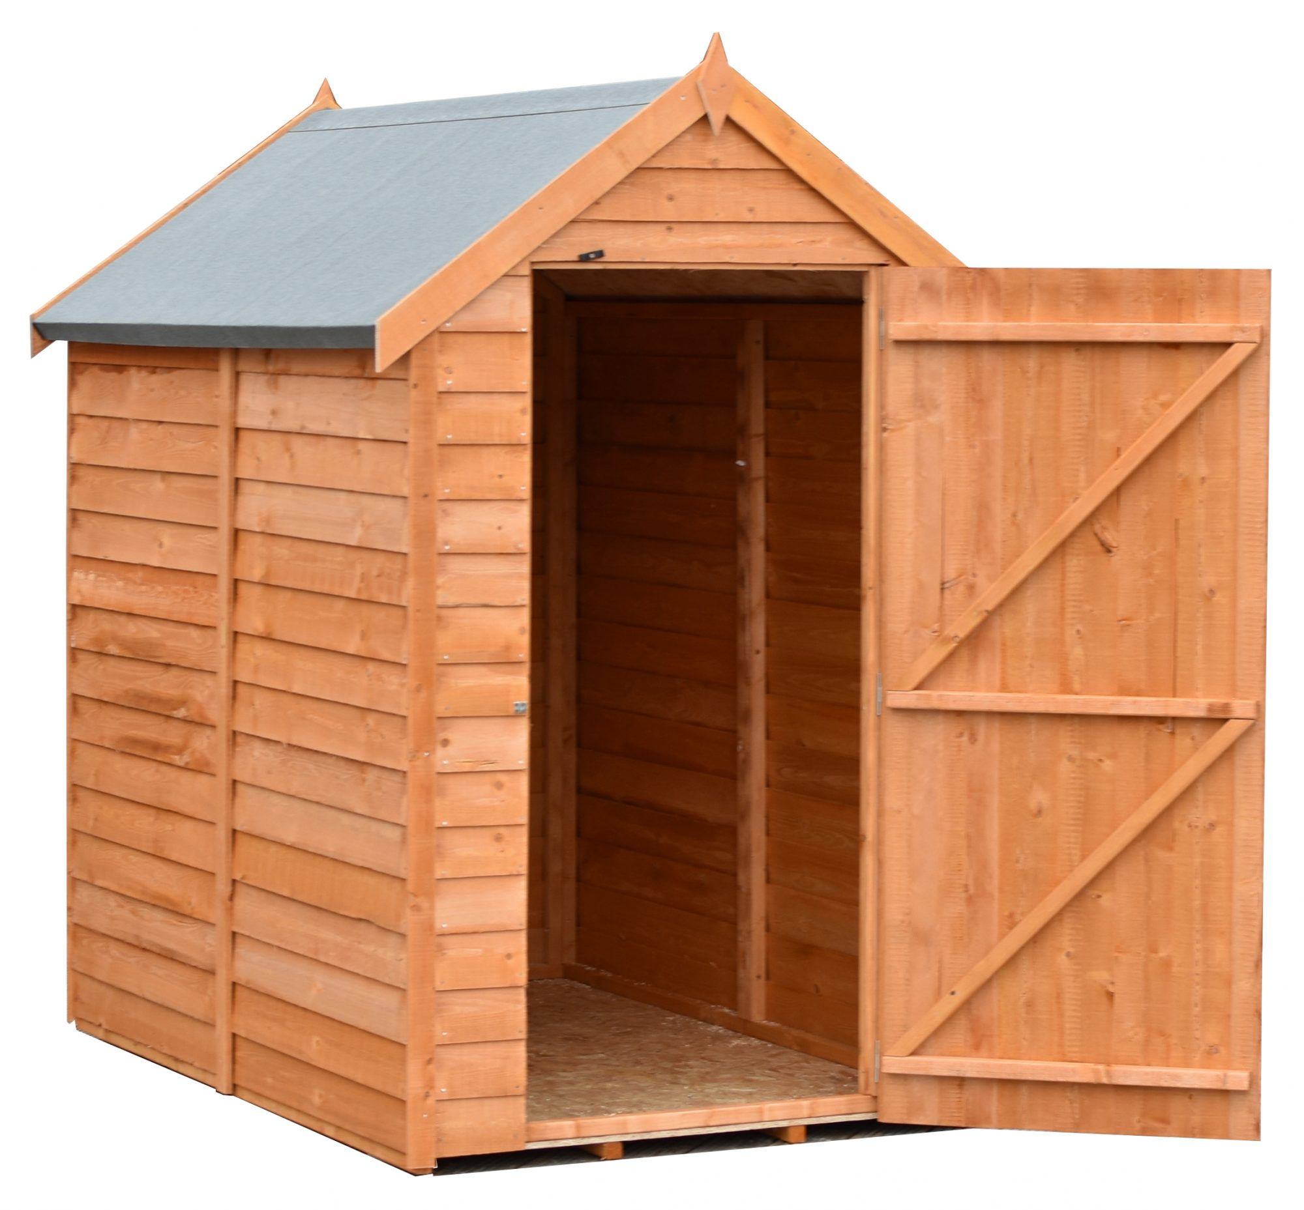

Slide 7
            shed

Slide 8
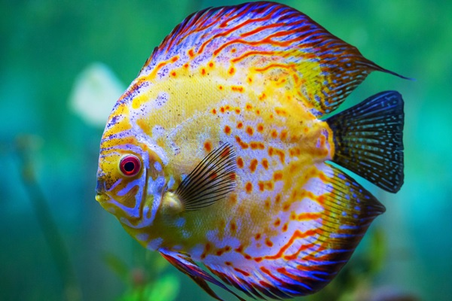

Slide 9
            fish

Slide 10
Well done!

