Slide 1




Once upon a time there was a little ladybird called Fred.
They called him Fred Five because he had 5 spots . Let’s count them together.

Slide 2

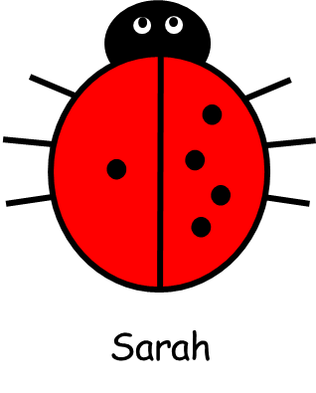
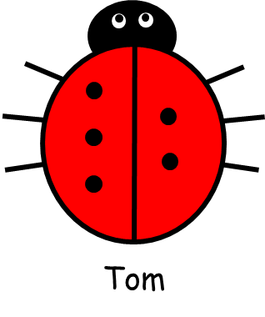
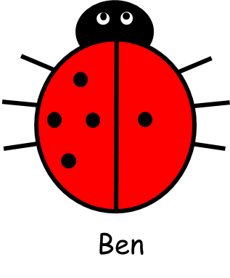
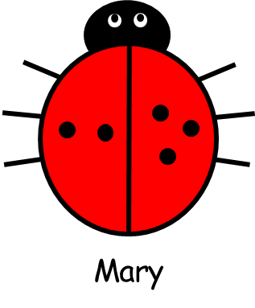
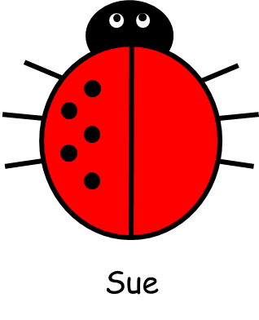
Fred has lots of brothers and sisters.
Fred

Slide 3
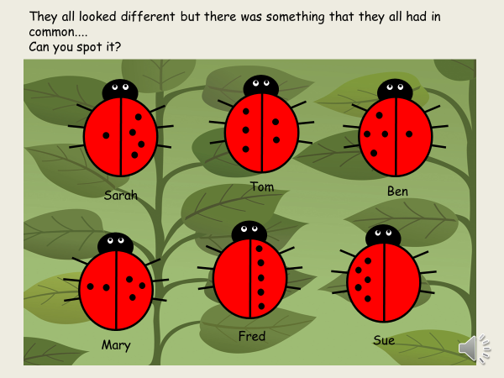

Slide 4
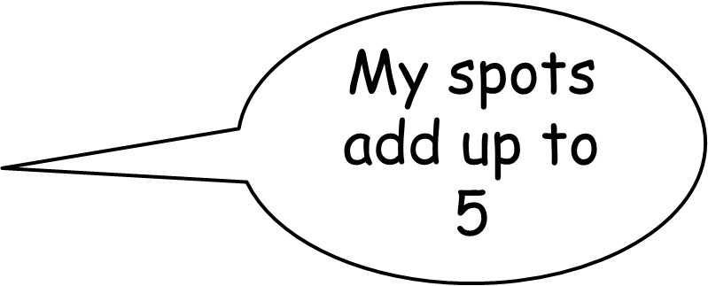
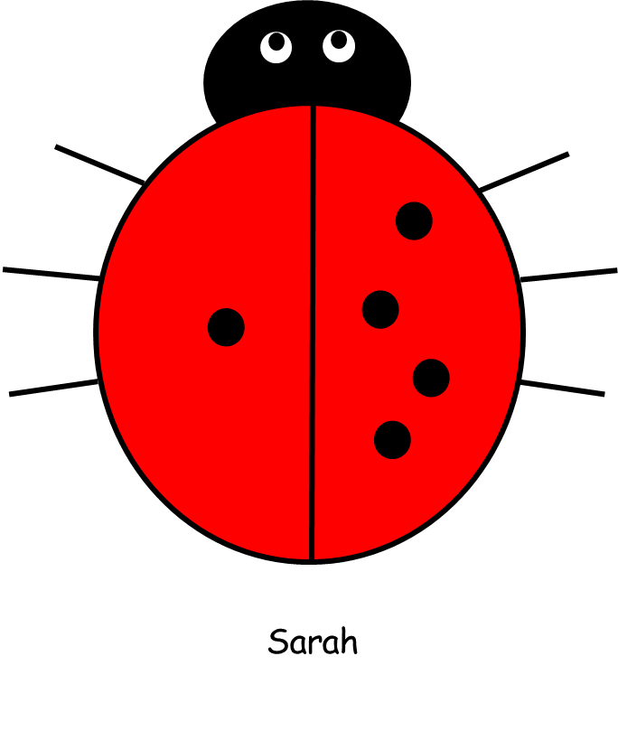
Let’s look a little more closely at Sarah’s spots....
1 + 4 = 5

Slide 5
Let’s look a little more closely at Tom’s spots....
My spots add up to 5
3 + 2 = 5
Tom

Slide 6
How many spots does Ben have?
My spots add up to 5
4 + 1 = 5
Ben

Slide 7
What about Mary?
2 + 3 = 5
Mary

Slide 8
5 + 0 = 5
Sue

Slide 9
Oh, and don’t forget Fred.
My spots add up to 5
0 + 5 = 5
Fred

Slide 10
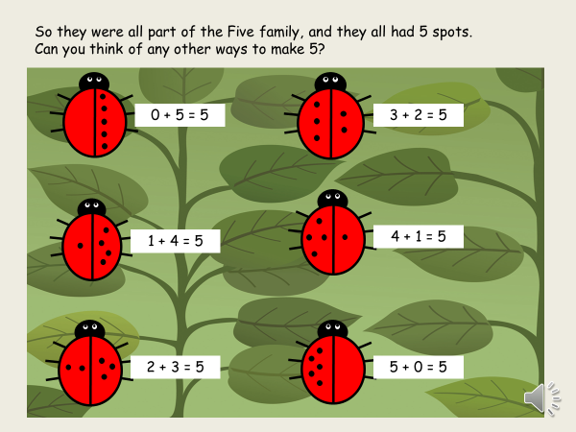

Slide 11





